Slide 1


PBIS School-Wide Team Training
Year 3: November 2022
PBIS Track
Insert Trainers Names
with support from NEPBIS Network, May Institute & Broad Reach Consulting
Notes:
Add trainer names for your event

Slide 2
Agenda & Team Tasks
Team time
Team Tasks
Presentation Content
TFI Review & Action Plan Update
Classroom PBIS Systems to Support
Identify a goal for this year’s PBIS implementation and add to your action plan
Sharing: Logic Model
Evaluation Plan
Goal Setting
Review TFI results from last year and update your action plan for this year.
Plan how your team will support Classroom PBIS practices across your building.
Share your evaluation plan for PBIS implementation.
Share w/Trainer: Updated Action Plan with Goal Statement.
We’ve planned 90 mins of team time during this training event

Slide 3

HELPFUL READINGS & RESOURCES
RESOURCES:
Start With Why: How to Put Purpose Back in Your Work
Tiered Fidelity Inventory
Data Decision Rules Activity
Evaluation Plan Template
Supporting & Responding to Student's Social, Emotional, and Behavioral Needs (Classrooms)
Supportive Environments Create Classroom Community
Classroom Support Systems Brief
The Classroom Management Observation Tool (CMOT)
Notes:
Start With Why: How to Put Purpose Back in Your Work -https://sebacademy.edc.org/start-why-how-put-purpose-back-your-work
Tiered Fidelity Inventory - https://sebacademy.edc.org/tiered-fidelity-inventory-tfi-manual
Data Decision Rules Activity - https://sebacademy.edc.org/developing-data-routines-activity
Evaluation Plan Template - https://sebacademy.edc.org/evaluation-schedule
Supporting & Responding to Student's Social, Emotional, and Behavioral Needs (Classrooms) - https://sebacademy.edc.org/supporting-and-responding-students-social-emotional-and-behavioral-needs-classrooms
Supportive Environments Create Classroom Community - https://sebacademy.edc.org/supporting-and-responding-students-social-emotional-and-behavioral-needs-classrooms
Classroom Support Systems Brief - https://sebacademy.edc.org/classroom-support-systems-brief
The Classroom Management Observation Tool (CMOT) - https://sebacademy.edc.org/classroom-management-observation-tool-cmot

Slide 4

EXPECTATIONS
Self
Others
Environment
Self-monitor
Listen while others are speaking​
Have your computer charged and ready to go​
If you have questions or comments:
Work as a team:
Keep necessary materials at hand
Are you participating?
Engaged as a learner?
Stretch, break, stand as needed​
Raise hand
Room for every voice
Reinforce participation
action plan
relevant docs
water/snacks
Minimize distractions if possible​

Slide 5
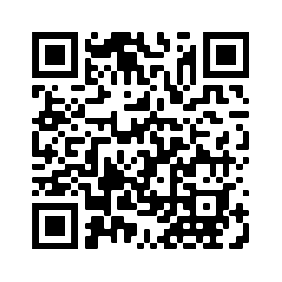
ACTIVITY: ATTENDANCE
Scan QR code on the left or follow the URL posted in the chat to access the online attendance survey
Follow prompts to enter attendance information
Notify trainers if you require assistance (e.g., identifying your cohort or cohort group)
Certificates of Attendance will be sent in January and June. Attendance records will be use as verification
You are in Cohort 7
1 minute
Notes:
Link to attendance form is here: https://edc.co1.qualtrics.com/jfe/form/SV_5BiXqi4bxzOCMS2
Add your cohort number
Post a link to the attendance survey (below) in the chat for those who do not use the QR code on the slide:
ATTENDANCE: https://edc.co1.qualtrics.com/jfe/form/SV_5BiXqi4bxzOCMS2

Slide 6
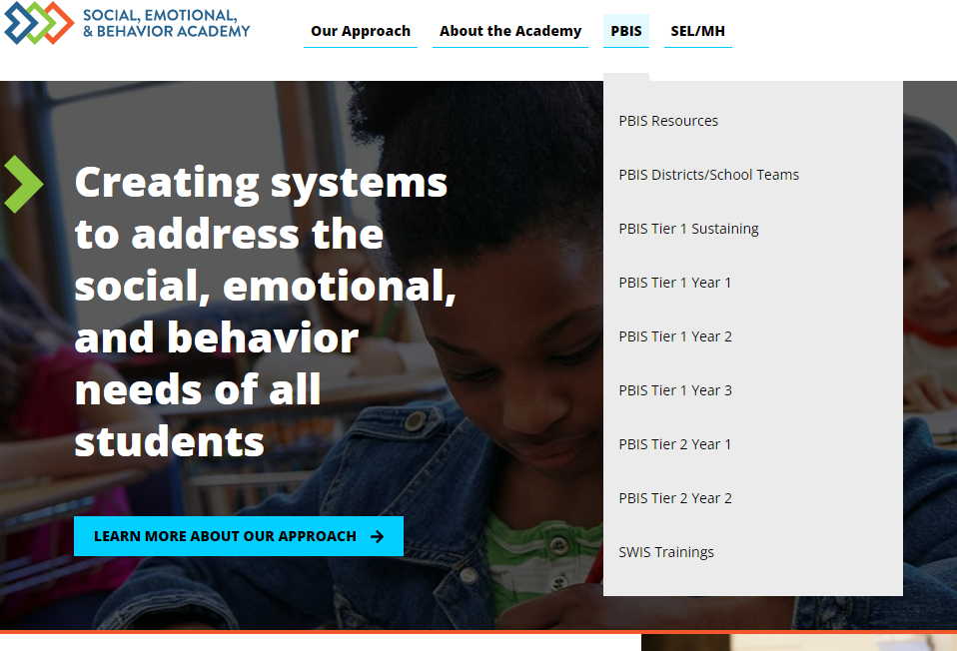
SEB Academy – PBIS Track Website
https://sebacademy.edc.org/

Slide 7
REVIEW:
Goal Setting
Notes:
TRAINER NOTE: This is review content please be brief

Slide 8
Critical Features of PBIS
Systems
Practices
Data
Equity
Make student growth and benefit central to all decisions. Student outcomes that reflect equitable learning opportunities must be the ultimate criteria for all decisions.
Outcomes

Slide 9

Outcomes tell us if we achieve our purpose and guide framework implementation
As a result of implementing PBIS during the 20XX-20XY school year, student reports of school climate will improve by 20%
Based on data
Locally important and meaningful
Applicable to all (culturally equitable)
  Students’ social competence and academic achievement
  Staff implementation of critical skills
Observable and measurable
Written as a goal

Slide 10

Outcomes are our GOALS for implementation
As a result of
implementing PBIS,
school climate will improve and the school will feel better.
As a result of implementing PBIS during the
20XX-20XY school year, student reports of school climate will improve by 20%
As a result of implementing PBIS during the
20XX-20XY school year, behavior incident data will decrease by __% relative to that same period the prior year.
Based on data
Locally important and meaningful
Applicable to all (culturally equitable)
  Students’ social competence and academic achievement
  Staff implementation of critical skills
Observable and measurable
Written as a goal

Slide 11
What would it look like if all students developed the SEB skills needed to be effective learners?
As a result of implementing PBIS during the 20XX-20XY school year:
behavior incidents will decrease by __% relative to the same period as the prior year.
incidents of exclusionary discipline (suspension/expulsion) will decrease by __ % relative to the same period as the prior year
Behavior referrals and exclusionary discipline would decrease
disproportionate discipline would decrease
students would be in class consistently
all students would meet academic standards
use of disproportionate discipline will decrease by __%
% of students who are chronically absent will decrease by __%
% of students meeting grade level academic standards will increase by __%

Slide 12
Identifying Outcomes/Goals
What outcomes are you hoping to achieve this year?
(Consider BOTH implementation fidelity and student outcomes)
Step 1: Develop evaluation questions.
Step 2: Identify indicators or measures.
Step 3: Develop methods for collecting & analyzing indicators.
What do you want to know?
What information can be collected?
How/when should information be gathered?
Step 4: Make decisions and action plan from analysis of indicators.
How will the question be answered & what should be done next?

Slide 13
ACTIVITY: DEFINING PURPOSE AND OUTCOMES
As a team, review your team’s identified goal statement for PBIS implementation in your school.
Consider how you can support your team to use your team’s goal to determine an observable, measurable outcome statement(s) as goals for this year.
Identify how your goal and outcomes can be shared with stakeholders and used to support rollout.
Be ready to share 1 next step with the whole group.
15 minutes
Notes:
TRAINER NOTE: Remember last year folks prepared purpose and goal statements. Review / Revising this goal statement to be more data driven this year.

Slide 14
SELF CHECK:
TFI Review & PBIS Action Planning
Notes:
TRAINER NOTE: This is review content please be brief

Slide 15
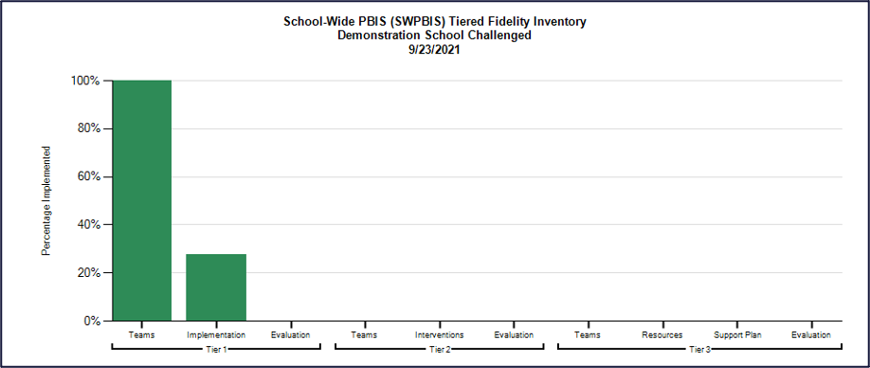
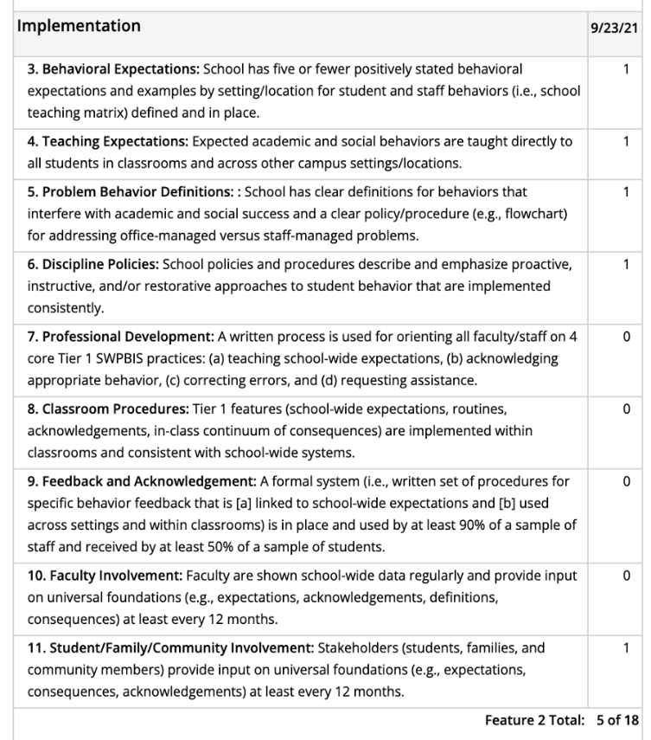
Use TFI data to guide your action planning!
Select action steps based upon TFI data
AND
your identified goals (outcomes)!

Slide 16
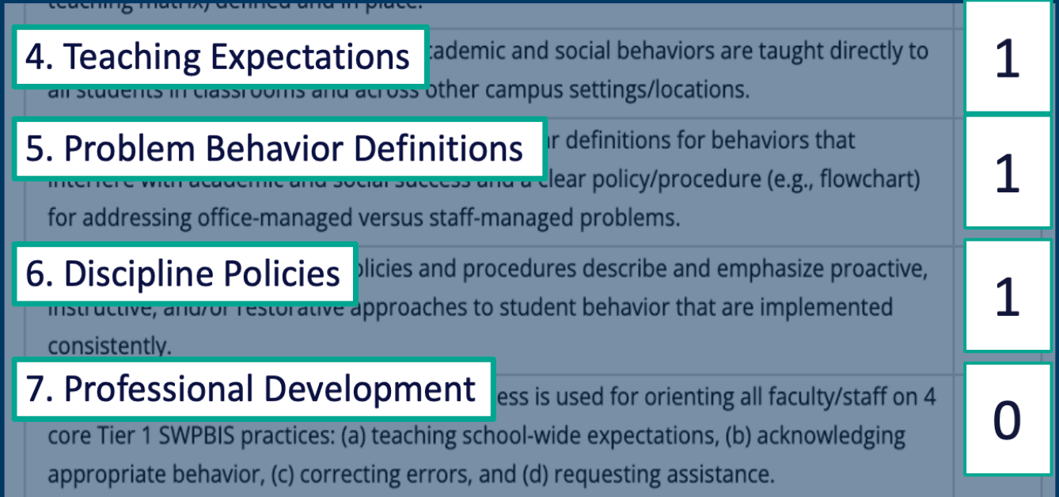
EXAMPLE
Identified goal (outcome):
behavior incidents will decrease by __% relative to the same period as the prior year.
Team determines that implementing these features can help achieve identified outcomes.
So, the team engages in targeted action planning:
What do we need to do?
How?
Who?
By when?
Team assessment of TFI features:

Slide 17
Let's review critical features assessed with the TFI.

Slide 18

QUICK CHECK: Teaming and Purpose (TFI 1.1, 1.2, & 1.15)
Establish an effective and representative leadership team
Develop brief statement of behavioral purpose
Membership representative of school community including administration?
Meeting at least monthly with agenda, minutes, action plan?
PBIS identified as a top priority with allocated time for team to share with staff?
Does the statement match the primary outcome(s) of PBIS implementation in your school?
Is it positively stated, short, and comprehensive?
Do staff know it exists and why it was created?
Learn More:
Tier 1 Coordination and Problem Solving Team Meeting Foundations and
Action Planning
Establish Leadership Team
Notes:
TRAINERS: At the end of each refresher slide, prompt participants to jot down their responses to the questions.
https://youtu.be/zs2z6dVtX1I
https://nepbis.org/wp-content/uploads/2021/08/Team-Profile-and-Meeting-Schedule-Document-1.docx

Slide 19
QUICK CHECK: Developing and Teaching School-wide Expectations
(TFI 1.3 & 1.4)
Identify positive SW behavioral expectations
Do you have 3-5 positively stated expectations?
Do they match your school context?
Have your stakeholders helped to create them or provided feedback and know what they are?
Develop procedures for teaching SW expectations
Have you developed a teaching matrix with participation from all stakeholders?
Is there a teaching calendar with lesson plans created?
Have booster sessions been planned for reteaching?
Learn More:
Creating school wide expectations
Teaching expectations
Notes:
https://www.youtube.com/watch?v=QQCaKy6U50s&feature=youtu.be
https://youtu.be/K1DCgiJiIGk

Slide 20
QUICK CHECK: Responding to Behavior (TFI 1.5, 1.6, 1.7, & 1.9)
Develop continuum for strengthening appropriate behavior
Develop continuum for discouraging violations of expectations
Have you developed an efficient acknowledgement system that provides predictable, relevant feedback to students?
Have you gathered input from staff, students and families?
Are you acknowledging staff for their efforts?
Have you defined and determined which behaviors are staff vs. office managed?
Have you created a flowchart of ways to respond to undesired behavior and taught staff how to use it?
How are you documenting behavior violations for decision-making and interventions?
Learn More:
Developing acknowledgement systems
Responding to challenging behavior: Major v minor
Responding to challenging behavior: Discipline flow chart
Responding to challenging behavior: Referral form and data collection
Notes:
https://youtu.be/7M1OfJYMPcg
https://youtu.be/6-w19VJu1RU
https://youtu.be/ZJCU28XSLqQ
https://youtu.be/hq8kfsJLADQ

Slide 21
QUICK CHECK: Systems Check (TFI 1.10, 1.11, 1.12, 1.13, 1.14, & 1.15)
What is your efficient process for collecting student outcome data?
Develop data-based procedures for monitoring
Build routines to ensure on-going implementation
Develop systems to support staff
What structures and routines are in place to ensure regular review and sharing of data?
How are you monitoring the fidelity and effectiveness of PBIS implementation?
How are you gathering your staff voice as your implementation continues?
When do staff get to view outcome and fidelity data?
How are staff being trained in and supported with PBIS?
How will you continue to increase staff capacity?
How can PBIS be integrated into your school routines and systems?
What plans need to be made for next year?
Are systems formally documented (in writing)?
Learn More:
Data decisions & monitoring
Developing systems to support staff
Notes:
https://youtu.be/IvpbUWvl44g
https://www.youtube.com/watch?v=VE94EWTJo4Y&feature=youtu.be

Slide 22
TEAM TIME
Meet with your team and discuss action steps related to your TFI review and quick check content reviewed:
1. Do you have your action plan document so your team can identify what is still needed to complete and what has been completed?
2. Has your team reviewed the Tiered Fidelity Inventory (TFI) completed in the Spring? If so, please use to assess the implementation of critical features and update your action plan.
Based on your discussions... Update your team's action plan!
Prepare to share 1 new action item or goal from your discussion.
Teams
25 minutes

Slide 23
SHARE OUT
What was one action item or goal your team identified?
10 minutes
Whole Group

Slide 24
SHARING TIME:
LOGIC MODEL

Slide 25

Small Group Discussions
Purpose: Share and compare across Systems, Data, Practices.
Share with other school team members the great data, system features, and practices you developed.
Discussions in small groups.
*Have your school's visual ready (outcomes, systems, data, practices)
*Be prepared to share and take notes​
*Take new ideas back to your team for action planning!​

Slide 26
School: ___________________________
Identify an outcome to focus on for this activity
(see examples below)
Implement Tier 1 PBIS with fidelity (≥ 70 on TFI)
Developing a continuum of responses to increase appropriate behavior
Reduce disruptive behavior across the school day
OUTCOME
How do we
sustain this?
SYSTEMS
DATA
How do we support staff to
implement this with fidelity?
What is one highlight
associated with this outcome?
__________________________________
__________________________________
What is one lesson learned?
__________________________________
__________________________________
How do we know we are doing what we say we are doing? How do we know it is working?
What are we doing?
What do we want to be doing?
PRACTICES

Slide 27
Lincoln School Logic Model
OUTCOME
How do we sustain this?
Explicit expectations taught & retaught, monitors trained and overlap with staff for first month, zones created & assigned to staff
Reduce injuries and referrals during recess
Recess monitors taught expectations with students at the start of the year. Four playground zones were created and staff were assigned to each zone and active monitoring was modeled by school staff for the first 3 weeks of school.
DATA
Office referrals, visits to the nurse, recess monitor weekly survey
How do we support staff to
implement this with fidelity?
SYSTEMS
What is one highlight
associated with this outcome?
Office referrals and injuries at recess have decreased. Monitors are more engaged with students and spend less time talking to one another.
What is one lesson learned?
Arranging schedules to overlap with monitors to train and model was challenging but critical.
Active monitoring at recess, expectations for behavior and use of equipment explicitly taught, each monitor acknowledges 5 students per recess for appropriate behavior
How do we know we are doing what we say we are doing? How do we know it is working?
What are we doing?
What do we want to be doing?
PRACTICES

Slide 28
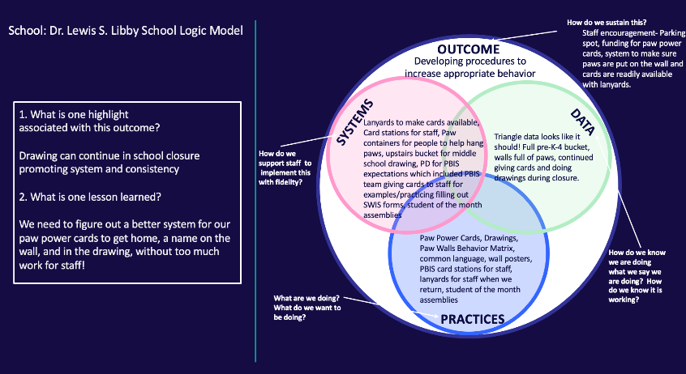
ACTIVITY: SMALL GROUP DISCUSSIONS
1. Randomize participants into 4 or 5 groups.
2. In each group take turns sharing how your logic model including outcomes, systems, data, and practices (4 or 5 mins).
3. Ask questions and take good notes.
4. Bring new examples back to your team for action planning!
20 minutes
Randomized Small Groups

Slide 29

10 minute break

Slide 30
DATA ROUTINES & EVALUATION PLAN

Slide 31

Systems
Data
Data
Use data to inform decisions about which students, families, and educators need which supports, as well as whether supports should be continued, adjusted, or faded. Data should be used to ensure that all recipients experience benefit and that supports are implemented with fidelity.
Equity
Outcomes

Slide 32
Data used in PBIS implementation
Data
Fidelity Data
Did we implement the systems and practices we agreed upon?
Outcome Data
Is the plan resulting in progress towards our goals (student benefit)

Slide 33
Why develop data routines?
To continuously improve
your Tier 1 framework!
Are we achieving our desired outcomes?
Which groups are benefiting from our plan? Which are not?
Are we implementing as planned?
What needs to be strengthened? Revised?
Are students receiving adequate support to achieve positive outcomes?

Slide 34
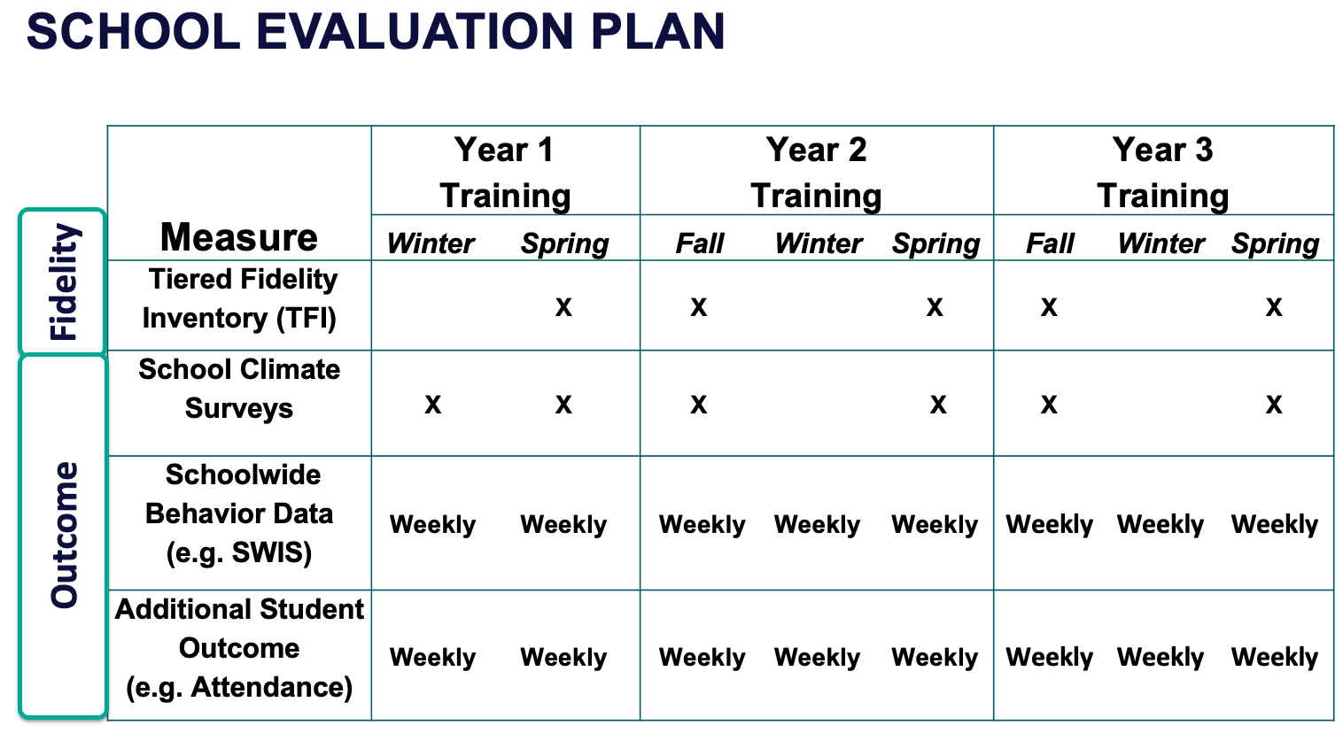
Strengthen Routines to Gather Fidelity and Outcome Data

Slide 35
Establish and Strengthen Data Routines
1. Identify the RIGHT data
Outcome data tied to goals
Fidelity data tied to evaluation plan
3. Identify the RIGHT people
Who needs to see these data to inform decisions? (e.g., PBIS team, grade level teams, family groups, other committees?)
4. Identify the RIGHT time & format
When/how often should these data be reviewed to inform decisions?
What format will facilitate decision making?
2. Assess data integrity
Consider staff training & buy-in, systems, response rates

Slide 36

EXAMPLE: School-wide Behavior Data
1. Identify the RIGHT data
Office discipline referrals
3. Identify the RIGHT people
PBIS Leadership Team
4. Identify the RIGHT time & format
Team’s data analyst provides monthly report at meeting
Core SWIS reports reviewed each month and compared to previous years
2. Assess data integrity
Staff trained and coached on completing ODR forms and following discipline procedures
Data shown to whole staff to determine if it matches their perceptions

Slide 37

NON-EXAMPLE: School-wide Behavior Data
September
Student Behavior Data System Established
June
ODR data for the year shared at a PBIS Leadership meeting for the first time all year

Slide 38
EXAMPLE: Student Attendance
1. Identify the RIGHT data
Student attendance records
3. Identify the RIGHT people
PBIS Leadership Team
4. Identify the RIGHT time & format
Team’s data analyst provides monthly report at meeting
Table of students who have missed more than 5%, 10%, 20% of cumulative school days
2. Assess data integrity
Completed by homeroom staff and checked by administrative assistant daily

Slide 39
Establish Routines to Share Data with Vested Partners Regularly
The frequency that data are presented to all school staff is the factor most related to high levels of sustainability!
(Pinkelman et al., 2015)
School Board Families
Student Community
Share with other vested partners to increase commitment, accountability, and support

Slide 40
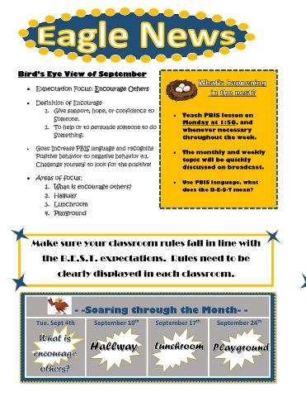
Ideas for Sharing Data
1. Share Annual Outcome Goals:
  When everyone understands the goals and sees progress from their efforts, vested partners are more likely to engage with interventions to meet those goals.
2. Email a Monthly/Quarterly Report:
      Give context, provide connections, suggest next steps
  Examples:
  Referrals from the hallway, month by month pre/post intervention
  Number of days since last playground referral

Slide 41
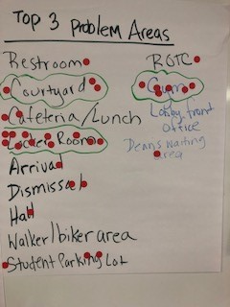
Ideas for Sharing Data
3. Create a data wall focusing on data related to school-wide goals:
Display data related to school-wide goals so everyone walking through can see the progress
4. Share data at monthly staff/PTO/student council meetings
  Invite members to actively participate in generating solutions

Slide 42
Developing Data Routines
Data Source | Date(s) for administration | Who brings data to team meeting | Meeting date to review data | Plan to share data
TFI
Behavior (ODR)
School Climate
Other Outcome
Establishing consistent, efficient data routines will enhance your team’s ability to effectively use data for decision-making!

Slide 43
Do you have an EVALUATION PLAN?
At a minimum, it is strongly recommended that teams include the following in an evaluation plan:
School-wide student outcomes (weekly)
Student and staff perceptions (annually)
Fidelity (annually with the TFI)
DISTRICTS/SCHOOLS IN TRAINING |  |  | SCHEDULE
Purpose | Measure | Function | Year 1 Training |  | Year 2 Training
 |  |  | Winter | Spring | Fall | Winter | Spring
Capacity Building—District Level | District Systems Fidelity Inventory (DSFI) | Completed by district leadership team (with the support of a trained facilitator) to assess district capacity and to guide Action Planning. |  | X |  |  | X
Fidelity of Implementation—Building Level | PBIS Tiered Fidelity Inventory (TFI) | Leadership team self-evaluation (with support of external coach) to assess the critical features of PBIS across Tiers I, II, and III. |  | X | X |  | X
Progress Monitoring—Building Level | Self-Assessment Survey (SAS) | Used by school staff for initial and annual assessment of effective behavior support systems in their school and to guide Action Planning. |  | X |  |  | X
Progress Monitoring—Team Level | Team Implementation Checklist (TIC) | A self-assessment tool that serves as a multi-level guide for creating School-Wide PBIS Action Plans and evaluating the status of implementation activities. | X | X | X | X | X
School Climate | PBIS School Climate Survey (Extended & Brief) | An annual survey that assesses student (grades 3-12), teacher, and parent perceptions of school climate. The middle and high school surveys also include items about adolescent drug/alcohol/tobacco use, self-harm ideation and behaviors, school dropout, and parental involvement. The survey provides information to determine training support needs related to school climate, safety, and violence prevention. |  | X | X
Student Outcomes | School-wide Information System (SWIS) | Office discipline referrals (ODR) provide data for monthly team reviews and decision-making by teachers, administrators, and other staff to guide prevention efforts and Action Planning. | Weekly | Weekly | Weekly | Weekly | Weekly
A written plan will support the sustainability of PBIS.
Notes:
Evaluation Schedule template: https://nepbis.org/tier-1-workbook-and-supplemental-materials/

Slide 44

Guidelines for Efficient Data Collection Routines
What Data?
  Limit to information that answers important student, classroom, and school questions
How should information be gathered?
  Integrate data collection procedures into typical routines (e.g., ODRs, attendance, behavior incident reports)
  Schedule data collection and staffing to ensure that data are current
When?
  No more than 1% of time each day for managing data
By whom?
  Ensure access to all necessary information (e.g., student records)
  Data collection reports regularly checked for accuracy

Slide 45
Guidelines for Efficient Data Review Routines
Protect team time to review data monthly
Identify 2-3 staff members to:
  manage data systems
  provide efficient, timely, and graphic displays of data
Establish structures and routines for staff members to receive weekly/monthly data reports about status of SW discipline

Slide 46
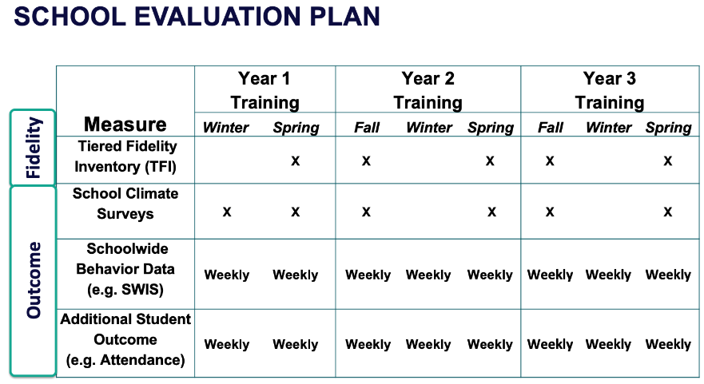
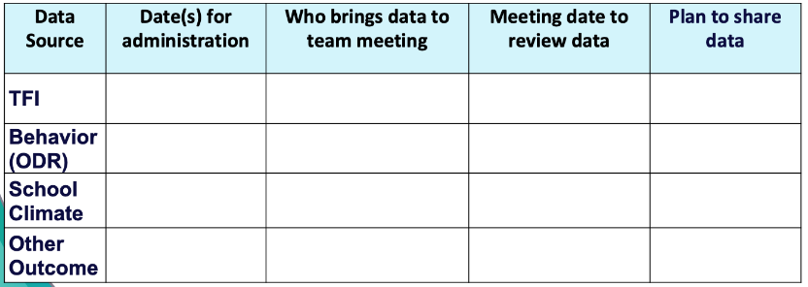

ACTIVITY: Data Routines
As a team,
Review your evaluation plan and identify what still needs to be completed this year.
Plan your data routines for the year ahead.
Add items to your Action Plan as necessary.
Be ready to present 2-3 “big ideas” from your discussion.
20 minutes

Slide 47
WHOLE GROUP DEBRIEF:
Routines for Gathering and Reviewing Data
How will you:
Develop and maintain your evaluation plan
Identify and progress monitor your outcome goals
Share data with vested partners?
What further support will you need to implement these routines?
5 minutes

Slide 48

LUNCH

Slide 49
CLASSROOM BEHAVIOR SUPPORT PRACTICES & SUPPORT SYSTEMS

Slide 50

Supporting and Responding to Students’ SEB Needs
Practices
Center on PBIS. (2022). Supporting and responding to student’s social, emotional, and behavioral needs: Evidence-based practices for educators (Version 2.0). Center on PBIS, University of Oregon. www.pbis.org.
Notes:
https://www.pbis.org/resource/supporting-and-responding-to-behavior-evidence-based-classroom-strategies-for-teachers

Slide 51

Supporting and Responding to Students’ SEB Needs
1. Create Positive Teaching and Learning Environments
Design a Safe Environment
2. Actively Promote SEB Growth
Engage Students in Relevant Learning
3. Monitor Fidelity and Use Data to Guide Implementation
Monitor Educator Implementation
4. Monitor Student Outcomes and Use Data to Guide Response
Establish Positive Connections
Develop Predictable Routines
Define and Teach Positive Expectations
Plan Relevant Instruction
Foster Positive Relationships
Prompt and Supervise SEB and Academic Skills
Provide Specific Feedback (> 5 : 1 Ratio)
Consider Other Response Strategies
Provide Training, Coaching, and Feedback
If data indicate implementation challenges...
Monitor Student Outcomes
Enhance Tier 1
If many students make ongoing SEB errors...
Enhance Tier 1 and Consider Tiers 2 and 3
If few students make ongoing SEB errors...

Slide 52
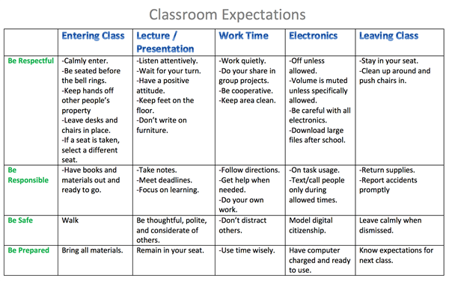
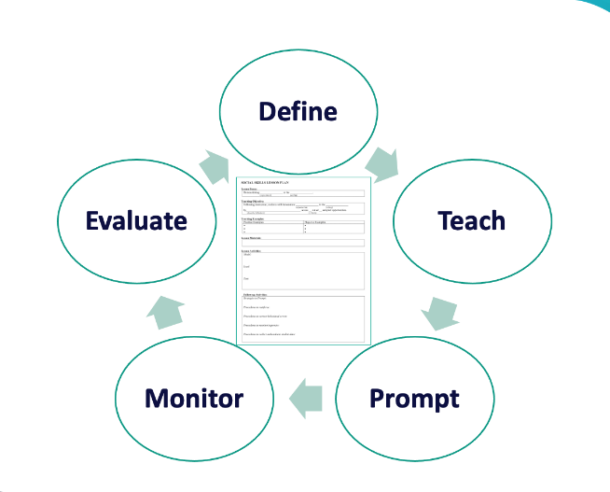
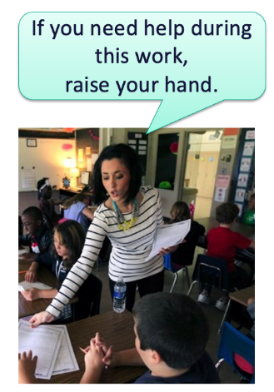
1. Create Positive Teaching and Learning Environments
Design a Safe Environment
2. Actively Promote SEB Growth
Engage Students in Relevant Learning
Establish Positive Connections
Develop Predictable Routines
Define and Teach Positive Expectations
Plan Relevant Instruction
Foster Positive Relationships
Prompt and Supervise SEB and Academic Skills
Provide Specific Feedback (> 5 : 1 Ratio)
Consider Other Response Strategies

Slide 53
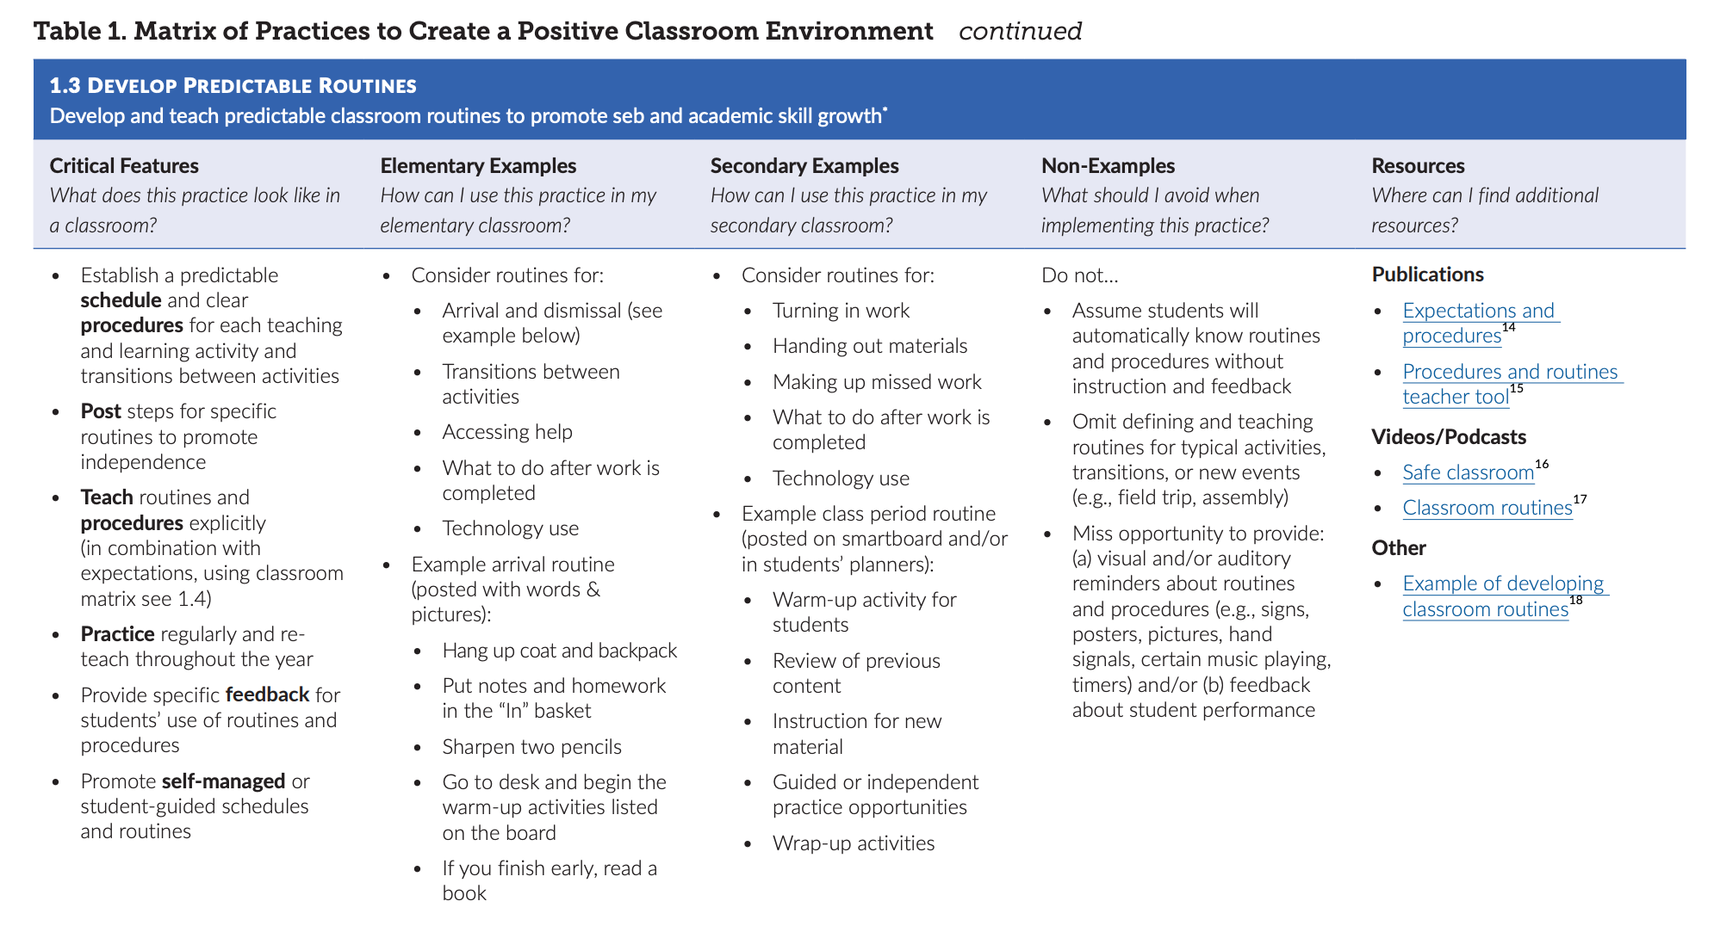

Slide 54
3 Key Positive and Proactive Practices
1. Create Positive Teaching and Learning Environments
Design a Safe Environment
2. Actively Promote SEB Growth
Engage Students in Relevant Learning
Establish Positive Connections
Develop Predictable Routines
Define and Teach Positive Expectations
Plan Relevant Instruction
Foster Positive Relationships
Prompt and Supervise SEB and Academic Skills
Provide Specific Feedback (> 5 : 1 Ratio)
Consider Other Response Strategies
Prompts
Opportunities to Respond
Specific Praise

Slide 55
Support Staff with Implementing Classroom PBIS
How can we support staff to use these practices?
Professional Development
What? Select 1 or 2 practices at a time, based on data
Coaching
Who? Identify staff with dedicated time to support classroom PBIS practices
How? Support classroom PBIS along with academic coaching support
Acknowledgement
Implementation and outcome data are shared & reviewed with staff and progress is recognized and celebrated
When? Set time aside at staff, grade level, or PLC meetings to discuss & problem solve
Notes:
This should be very brief (5 minutes)

Slide 56
HOW CAN WE ASSESS THE USE OF POSITIVE CLASSROOM PRACTICES?

Slide 57
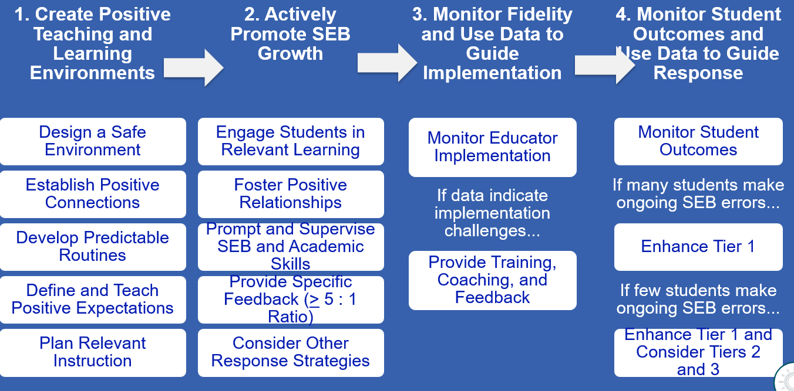
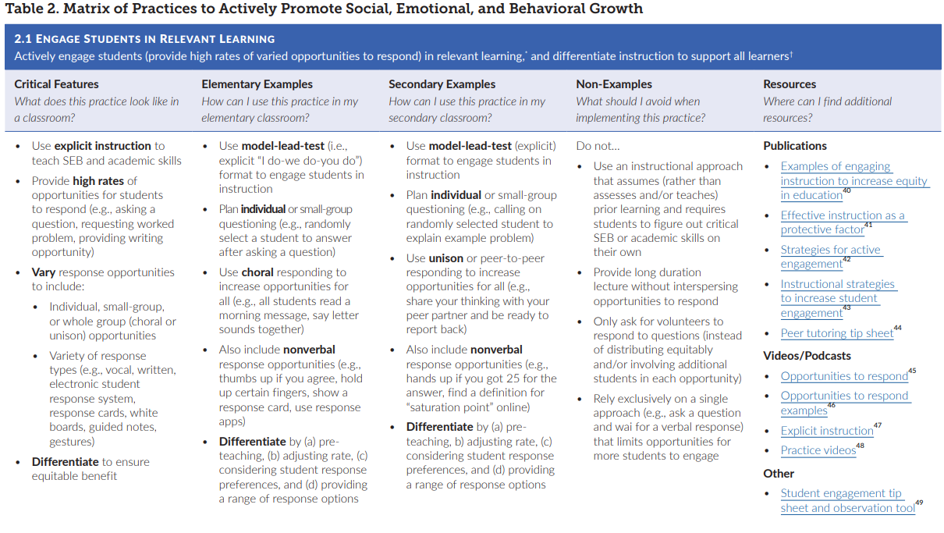
First, be familiar with important resources
Notes:
Incorporate familiar resources, such as the Supporting and Responding to behavior document, which can be found on PBIS.org and provides useful tools for organizing class-wide supports.
Please add this document to the chat: https://www.pbis.org/resource/supporting-and-responding-to-behavior-evidence-based-classroom-strategies-for-teachers

Slide 58
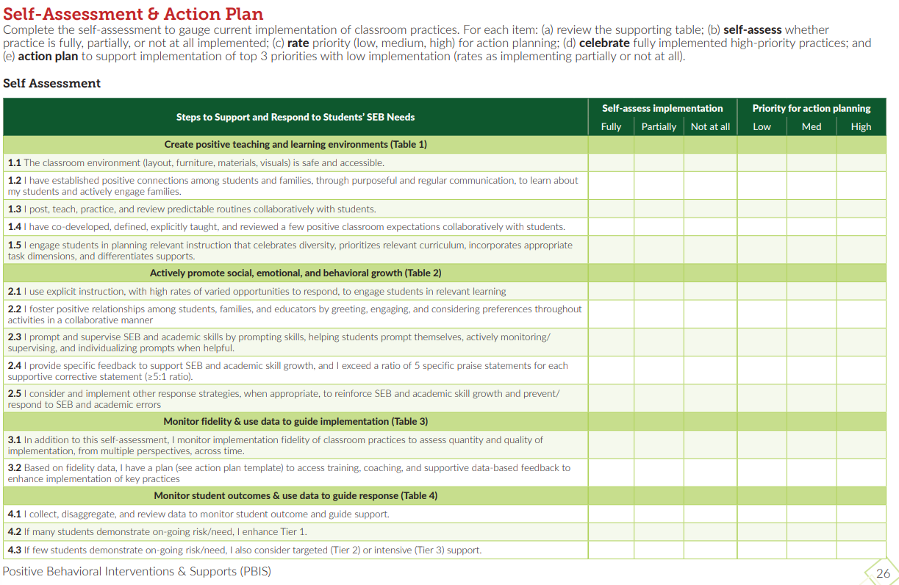
Self-Assessment?
Page 26 of the Supporting & Responding Brief
Notes:
Resource: https://www.pbis.org/resource/supporting-and-responding-to-behavior-evidence-based-classroom-strategies-for-teachers

Slide 59
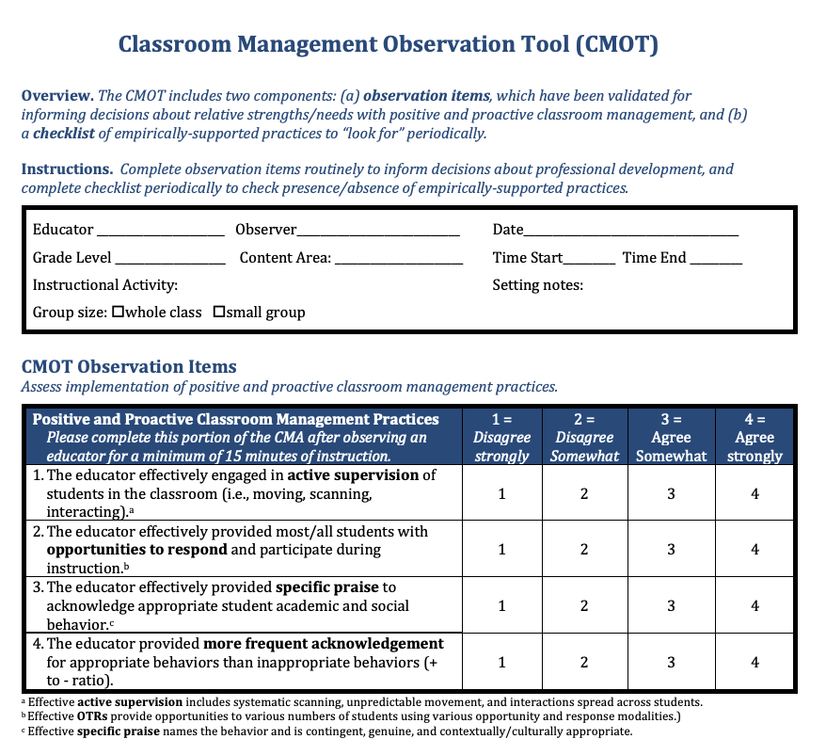
Observation tool?
CMOT
2 Components:
Validated Observation Tool (min 15 mins)
Checklist of empirically supported practices
Notes:
The Classroom Management Observation Tool (CMOT) mentioned in
https://nepbis.org/wp-content/uploads/2020/06/CMOT-5.1.20.pdf

Slide 60
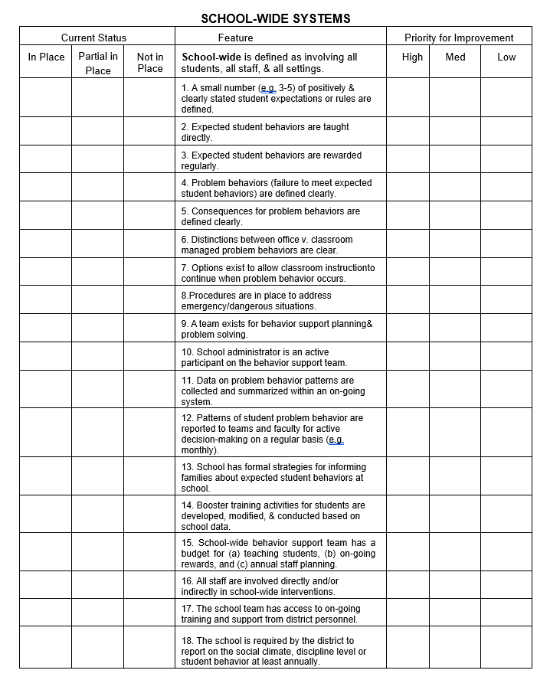
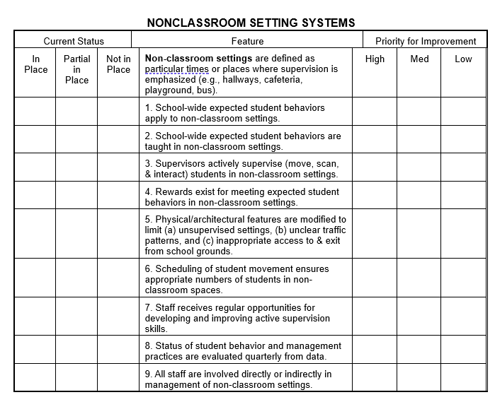
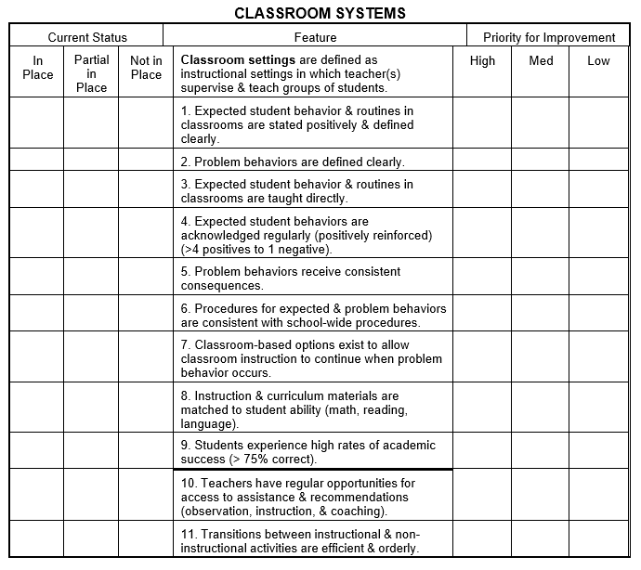
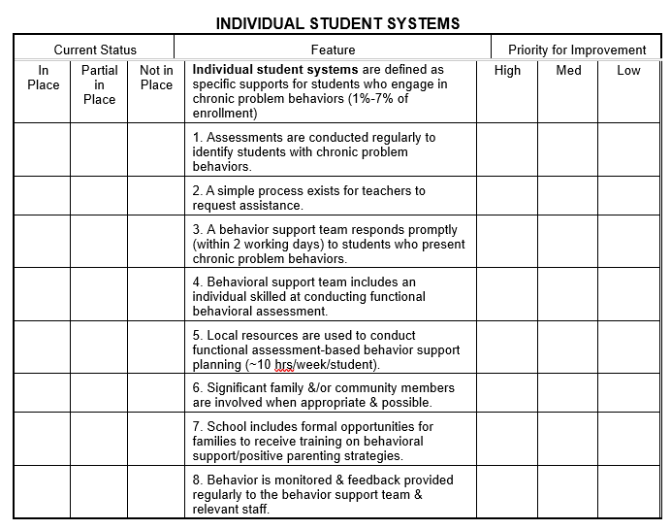
Self Assessment Survey (SAS)
School Wide – 18
Non-Classroom – 9
Classroom– 11
Individual Student – 8

Slide 61
SELF ASSESSMENT SURVEY
CLASSROOM SYSTEMS
Notes:
Review of question and how to complete survey.

Slide 62
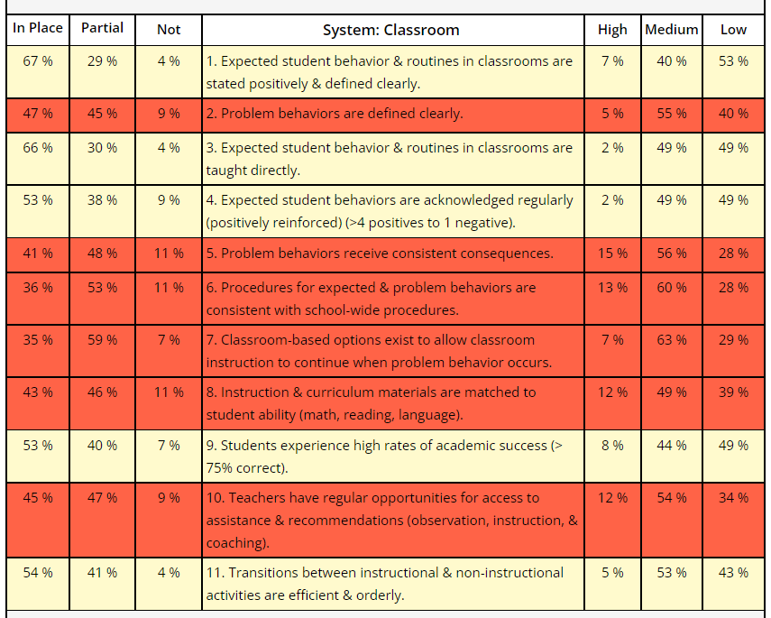
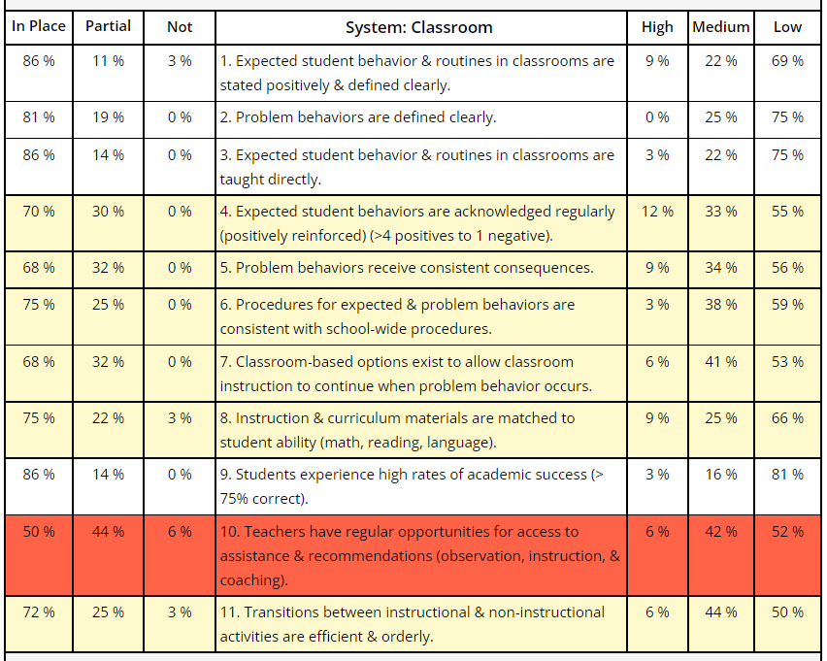
Classroom Items Report
From this → ------------------------ → To this
Notes:
Review of item graph as a quick action plan and tool for staff buy-in.
Red – less than 50% in place
Yellow – 50-79% in place
White – 80% in place or higher
If you want to take the SAS ask your training
Date Ranges for survey period
Recommend giving staff time to complete it during a staff meeting or PD.

Slide 63
ACTIVITY: SUPPORTING CLASSROOM PRACTICES
Review the shared resources.
In your teams discuss:
  What Classroom Practices need supporting?
  How might your team use one of these tools to assess implementation of Classroom PBIS?
  Can these tools be used to provide professional development to staff? How?
Be ready to provide a 1-minute share-out of your discussion
Team Time
20 minutes

Slide 64
Team
Action Planning Time

Slide 65
TEAM TIME
Meet with your team and discuss action steps related to the following items reviewed today:
1. Review notes from our sharing activity today. What great ideas did you take away?
2. What are your next steps with PBIS critical features?
3. Work together as a team to draft or revise your data routines and evaluation plan?
4. Discuss your school's current use of classroom PBIS. How could assess staff’s use of these strategies?
Please update your action plans and share with your trainers.
Prepare to share 1 new action item or goal from your discussion.
Teams
90 minutes

Slide 66
SHARE OUT
What was one action item or goal your team identified?
5 minutes
Whole Group

Slide 67
Agenda & Team Tasks
What questions do you have on today’s content?
Team time
Team Tasks
Presentation Content
TFI Review & Action Plan Update
Classroom PBIS Systems to Support
Identify a goal for this year’s PBIS implementation and add to your action plan
Sharing: Logic Model
Evaluation Plan
Goal Setting
Review TFI results from last year and update your action plan for this year.
Plan how your team will support Classroom PBIS practices across your building.
Share your evaluation plan for PBIS implementation.
Share w/Trainer: Updated Action Plan with Goal Statement.
What questions do you have on the follow-up tasks?

Slide 68
HELPFUL READINGS & RESOURCES
RESOURCES:
Start With Why: How to Put Purpose Back in Your Work
Tiered Fidelity Inventory
Data Decision Rules Activity
Evaluation Plan Template
Supporting & Responding to Student's Social, Emotional, and Behavioral Needs (Classrooms)
Supportive Environments Create Classroom Community
Classroom Support Systems Brief
The Classroom Management Observation Tool (CMOT)
Notes:
Start With Why: How to Put Purpose Back in Your Work -https://sebacademy.edc.org/start-why-how-put-purpose-back-your-work
Tiered Fidelity Inventory - https://sebacademy.edc.org/tiered-fidelity-inventory-tfi-manual
Data Decision Rules Activity - https://sebacademy.edc.org/developing-data-routines-activity
Evaluation Plan Template - https://sebacademy.edc.org/evaluation-schedule
Supporting & Responding to Student's Social, Emotional, and Behavioral Needs (Classrooms) - https://sebacademy.edc.org/supporting-and-responding-students-social-emotional-and-behavioral-needs-classrooms
Supportive Environments Create Classroom Community - https://sebacademy.edc.org/supporting-and-responding-students-social-emotional-and-behavioral-needs-classrooms
Classroom Support Systems Brief - https://sebacademy.edc.org/classroom-support-systems-brief
The Classroom Management Observation Tool (CMOT) - https://sebacademy.edc.org/classroom-management-observation-tool-cmot

Slide 69
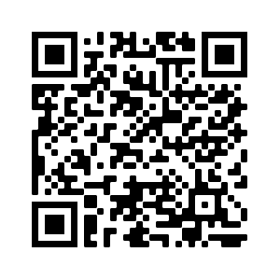
EVALUATION
Notes:
https://edc.co1.qualtrics.com/jfe/form/SV_cBF9GI7gVEBsfSC

