Slide 1
Welcome tO THE Tier 2 COACHES’ MEETing!
GETTING STARTED:
Update your display name in Zoom to read: [Your School], [Your Name] (e.g., Eastside HS, Joe Clark)
Complete the ATTENDANCE
Bookmark link to find training resources at : SEB PBIS Tier 2 Academy
In the chat, please share your name, school, and role in the school
~15%
Notes:
LINKS for today:
Attendance
https://edc.co1.qualtrics.com/jfe/form/SV_5BiXqi4bxzOCMS2
New team member communications survey - https://edc.co1.qualtrics.com/jfe/form/SV_db8zhNj6NJ3eXga
EDC Website for SEB Academy
https://sebacademy.edc.org/
Event Evaluation (at the end)
https://edc.co1.qualtrics.com/jfe/form/SV_cBF9GI7gVEBsfSC

Slide 2
PBIS Coaching Meeting TIER 2, Year 2 October 2022
Marcie Handler
with support from NEPBIS Network, May Institute & Broad Reach Consulting
Notes:
Add trainer names for your event

Slide 3
ACKNOWLEDGEMENTS
02
03
04
Northeast PBIS Network (nepbis.org)
01
Michigan Integrated Behavior & Learning Support Initiative
Dr. Heather George & FLPBIS
Missouri PBIS
Drs. Leanne Hawken, Deanne Crone, & Rob Horner
05
06
Midwest PBIS Network

Slide 4
EXPECTATIONS
Self
Others
Environment
Self-monitor
Mute when listening, unmute to talk​
Have electronics ready to use
Obtain help from peers and trainers
Work as a team:
Keep necessary materials at hand
Are you participating?
Engaged as a learner?
Stretch, break, stand as needed​
Room for every voice
Reinforce participation
action plan
relevant docs
water/snacks
Minimize distractions if possible​
Complete tasks efficiently
Notes:
Taking CARE of…

Slide 5
Agenda & Coaches' Tasks
Coaches’ Tasks:
Share documents or folder with access to:
Presentation Content:
Resources: Tier 2 Academy Year 2 Structure; Building on Tier 1
BIG IDEAS: From Installing to Full Implementation
Nomination Form, Decision Rules, Universal Screening overview
Targeted Intervention Organizer
Glows and Grows: Foundation Steps
Team Profile and Meeting Schedule, 2022-2023 Action Plan

Slide 6
LEGEND
Timing
Example
Activity
Non-example
Guidelines
Preview
Big Idea
Review
Organization

Slide 7
ACTIVITY: ATTENDANCE
Use this link for ATTENDANCE
Follow prompts to enter attendance information
Notify trainers if you require assistance
Complete the evaluation at the end of the meeting to receive your Certificate of Attendance!
You are in Tier 2
Year 2
1 minute
Notes:
Attendance
https://edc.co1.qualtrics.com/jfe/form/SV_5BiXqi4bxzOCMS2

Slide 8
(Re-) Introductions
Please share in chat:
Name
School
Role in the school

Slide 9
Resources: PBIS Tier 2 Academy Support Structure and Building on Tier 1

Slide 10
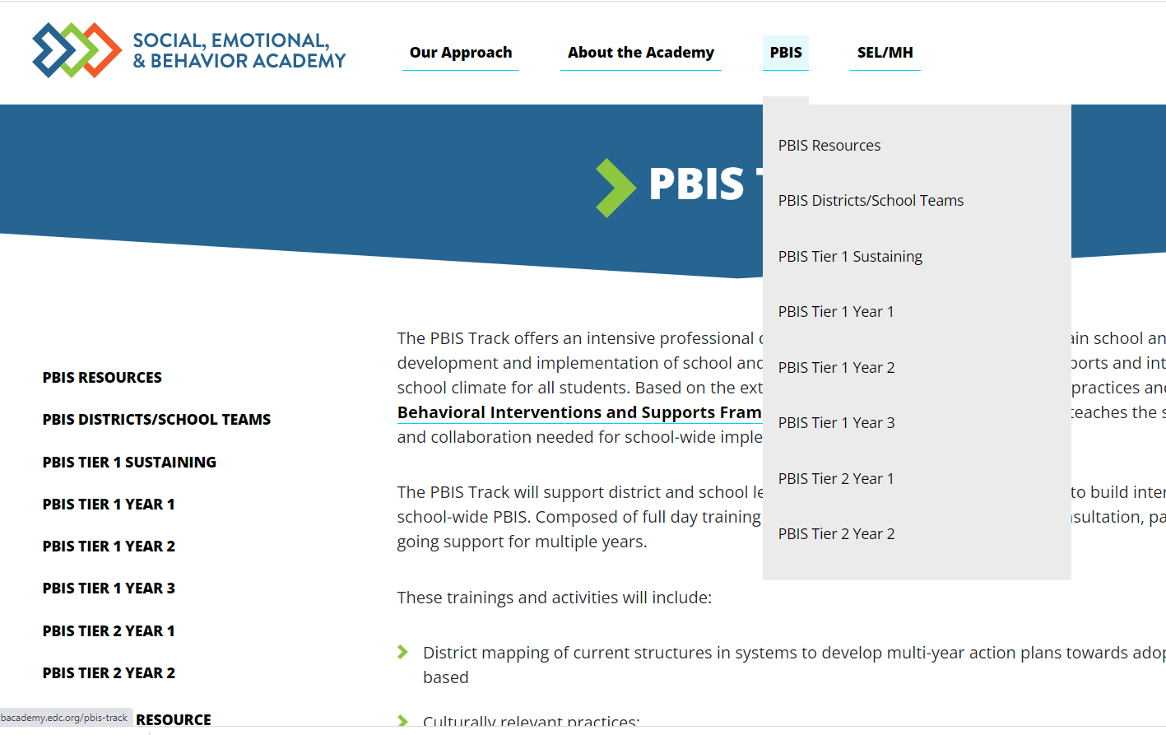
PBIS Academy Support Structure
What is it?
Your team's guide for training content, readings, and resources for both each monthly event.
Purpose:
Monthly organized resource repository for your team to access all PBIS Academy content
Website https://sebacademy.edc.org
Notes:
TRAINER NOTE: Please share the website address https://sebacademy.edc.org/pbis-track
NOTE: SWIS page with training dates will be up shortly

Slide 11
SEB PBIS TIER 2 TRAINING MODEL
Year 1
Exploration and Installation of 10 Getting Started Steps
Year 2
Initial Implementation of 10 Getting Started Steps
½ days of team training (Oct/Jan/May) + 7 coaches’ trainings
Networking and content through coaches meetings
4-5 hours to meet with coaches or teams (Fall, Winter, Spring)
TFI (April/May)
Free year of SWIS + CICO
TA support

Slide 12
ONGOING RESOURCES - websites
RESOURCES:
Pbis.org
https://www.pbis.org/pbis/tier-2
https://www.pbis.org/topics/coaching
Pbisapps.org
Become a Better Team by Solving 3 Common Mistakes
7 Ways to MacGyver Your Action Plans
https://sebacademy.edc.org/list-of-pbis-resources
Notes:
Center on PBIS’ Coaching Page: https://www.pbis.org/topics/coaching
Other:
Become a Better Team by Solving 3 Common Mistakes: https://www.pbisapps.org/articles/become-a-better-team-by-solving-3-common-mistakes
7 Ways to MacGyver Your Action Plans: https://www.pbisapps.org/articles/7-ways-to-macgyver-your-action-plans

Slide 13
RESOURCES Enhance Tier 1 Sustainability
RESOURCES
Advanced TIER 1 Action Plan:
Organize your annual activities with team membership and schedules for meetings, teaching opportunities, recognition, staff feedback, progress monitoring and evaluation
READINGS
9 thing you might have forgotten how to do in pbisapps
Refresher on beginning-of-year tasks such as updating student enrollment, entering school days, revising staff lists, and entering paperless referrals can be found in this resource from pbisapps.org .
Notes:
Schools will get more information on this in the Year 3 and sustaining academies
TIER 1 ANNUAL PLANNING TEMPLATE (adapted from pbis academy template)
https://sebacademy.edc.org/annual-action-plan-template-advanced
Start of year pbisapps Check-up (pbisapps.org)
PBISApps | News—9 Things You Might Have Forgotten How to Do in PBISApps
Refresher on beginning-of-year tasks such as updating student enrollment, entering school days, revising staff lists, and entering paperless referrals can be found in this resource from pbisapps.org

Slide 14
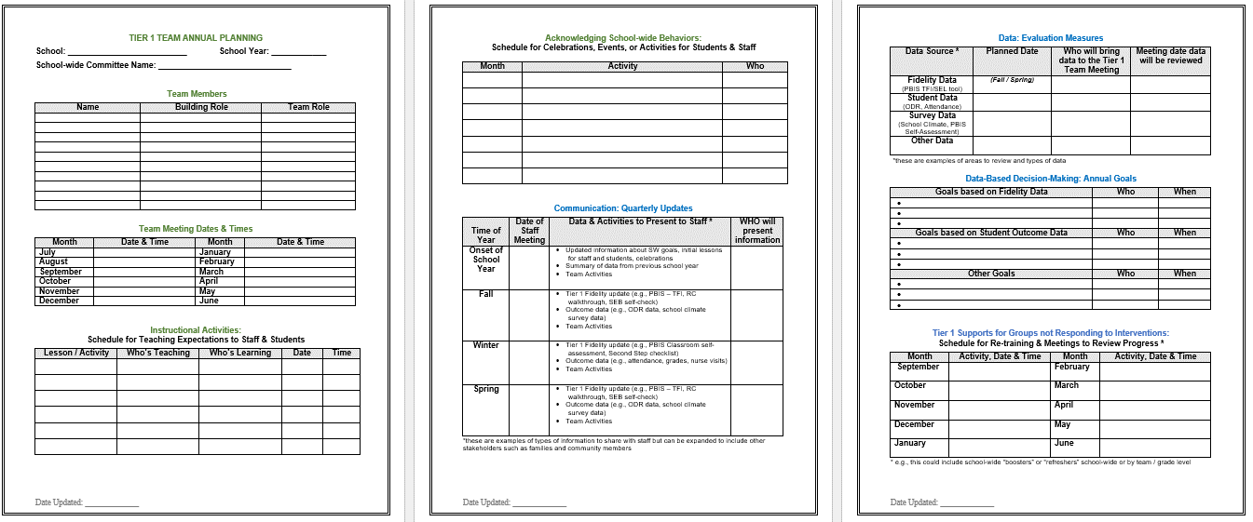
Action Plan – Annual Planning Tier 1
Acknowledgment Plans
Evaluation Measures
Team
Info
Annual Goals
Teaching Expectations Plan
Tier 1 Student Follow Up
Communication
Notes:
This Action plan is more advanced and is intended for schools in years 2 and beyond. Review with the team.
https://sebacademy.edc.org/annual-action-plan-template-advanced

Slide 15
Q: Why “BUILD on” and intentionally link to Tier 1 Team?
A: If schools do not have a solid Tier 1 foundation…
Lack of solid Tier 1 foundation
Too many students identified
Strain on resources
Staff frustration
Limited support options for students in need
Reluctance to identify students in need
Unmet student needs
Notes:
Rationale:
Without a Tier 1 behavioral system on campus, too many students will be misidentified as needing more advanced supports (i.e., Tiers 2 & 3). It is essential that a Tier 1 system be implemented first with fidelity to truly identify the students that are not responding well to the universal interventions on campus. A campus will not have the resources to provide advanced supports to many or all students on their campus. It is also more cost effective to use a preventative approach and provide Tier 1 supports for all.
Trainer’s Notes:
There is no animation on this slide but it is important to walk the participants through each of the boxes to understand the consequences to not establishing a solid Tier 1 system on campus.
Remember the following:
Tier 1 is a building block for identifying students in need of Tier 2 supports
Tier 1 data are your blueprint
(2) Provides better information for planning & problem solving

Slide 16
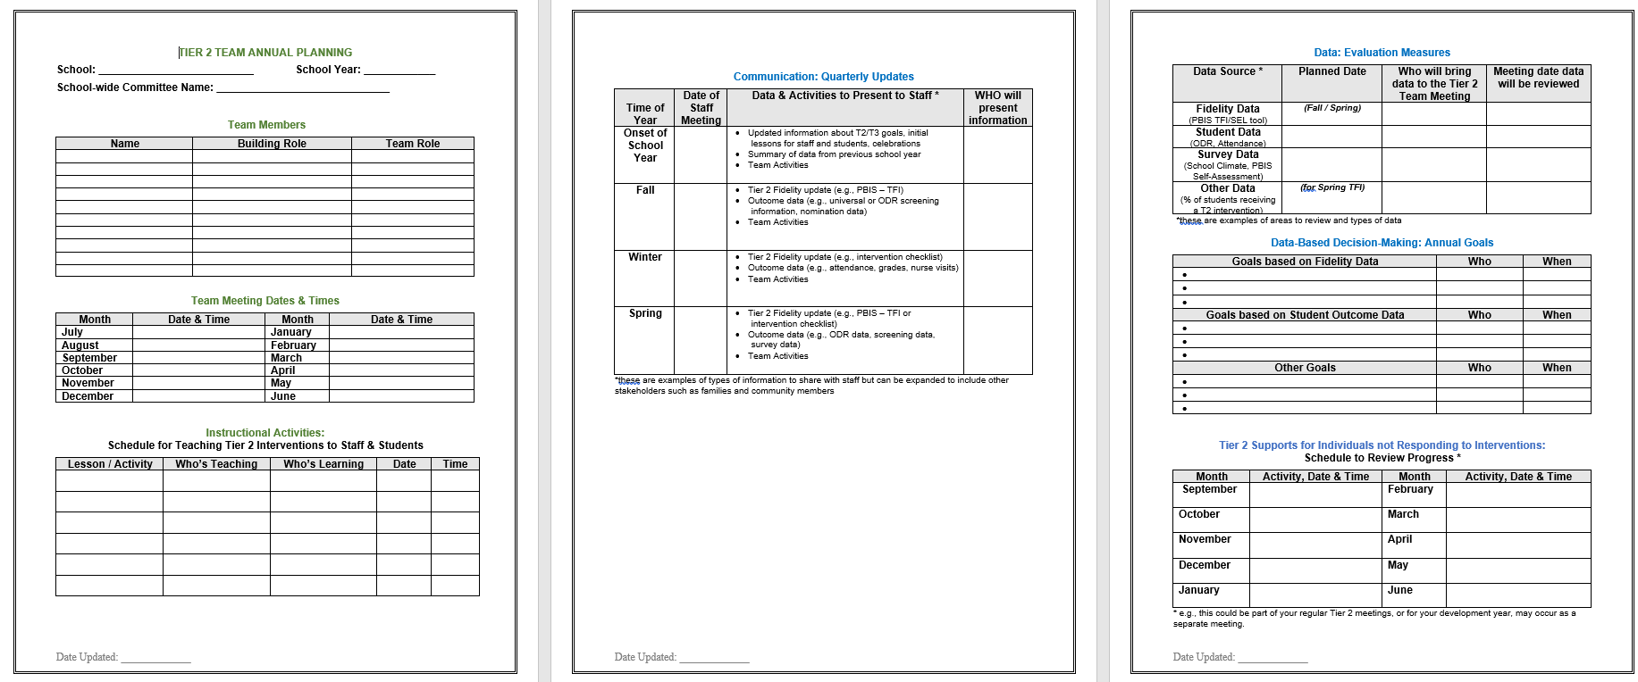
Action Plan – TIER 2 Template
Acknowledgment Plans
Evaluation Measures
Team
Info
Annual Goals
Teaching T2 Routines
Communication
Tier 2 Student Follow Up
Notes:
This Action plan is more advanced and is intended for schools in years 2 and beyond. Review with the team.
https://sebacademy.edc.org/annual-action-plan-template-advanced

Slide 17
Big Ideas Check In: Tier 2 Foundation Steps
Notes:
TRAINER NOTE:
Use this section to do a BRIEF check in on initial team composition and action planning steps. The activity was already presented in Canvas.
The question prompts are meant to serve as self-checks rather than in-depth conversations.
If challenges with getting started exist, TA time can be used to address those needs.

Slide 18
Tier 2 FOUNDATION STEPS
Develop an equitable process for matching student need to practices
1
Establish a representative T2 leadership team
6
2
Develop a collaborative process for identifying students
Develop a process for progress monitoring, data-based decision rules
7
3
Evaluate, select and adopt culturally appropriate tier 2 practices
Develop procedures for modifying/ adjusting implementation
8
4
Develop a process to install selected practices
Develop evaluation routines for fidelity and outcome data
9
5
Develop procedures to train staff and students; partner with families and community
Document and share routines, practices, and policies
10
Notes:
COACHES:
Seeing all of these steps can be uncomfortable or overwhelming – the goal is to walk away with an understanding of the elements and need to prioritize time and resources to get the steps achieved over a period of time.

Slide 19
3-Tiered System of Support
Necessary Conversations (Teams)
Universal
Team
Targeted Systems Team
Problem Solving Team
Tertiary Systems Team
Plans SW & class-wide supports
Uses process data; determines overall intervention effectiveness
Standing team; uses FBA/BIP process for one youth at a time
Uses Process data; determines overall intervention effectiveness
Universal Support
CICO
SAIG
Brief
FBA/BIP
Complex
FBA/BIP
Group w/ individual
feature
WRAP
How do your teams work together to support students and staff?
Brief FBA/BIP
Notes:
19
19
Team structure
Universal or Tier 1 PBIS team
Targeted or Tier 2 Systems team
Problem Solving team (SAT, SST, CST) – individual discussions about students (e.g., 2-3 students in a meeting) and more frequent meetings (e.g., weekly or biweekly)
*click* Tertiary or Tier 3 Systems team
How many are on that intervention and how many are responding
PROBLEM solving team - (2-3 kids in 60 minutes) more intensive
SAIG - social and academic intervention groups
CICO - Check in / Check Out
FBA - Functional Behavioral Assessment
BIP - Behavior Intervention Plan

Slide 20
3-Tiered System of Support
Necessary Conversations (Teams)
Universal
Team
Targeted Systems Team
Problem Solving Team
Tertiary Systems Team
Plans SW & class-wide supports
Uses process data; determines overall intervention effectiveness
Standing team; uses FBA/BIP process for one youth at a time
Uses Process data; determines overall intervention effectiveness
WORKING SMARTER
ACTIVITY
How do your teams work together to support students and staff?
How does the Tier 2 Team ‘fit’ with other teams?
Notes:
20
20
If you’re in a smaller school, you may want to use an existing team as your Tier 2 team.
Your Tier 2 team could be the same or a subset of your Tier 1 team.
Tier 2 teams are often smaller than Tier 1 teams (4-6 members). Dedicate one meeting per month to Tier 2 systems.
Or Tier 2 team could be your existing problem solving team.
Or you may want a separate team to oversee the development and implementation of Tier 2 interventions and systems and have a separate Tier 2 team, especially if you are in a large school with a variety of Tier 2 interventions to coordinate and monitor.

Slide 21
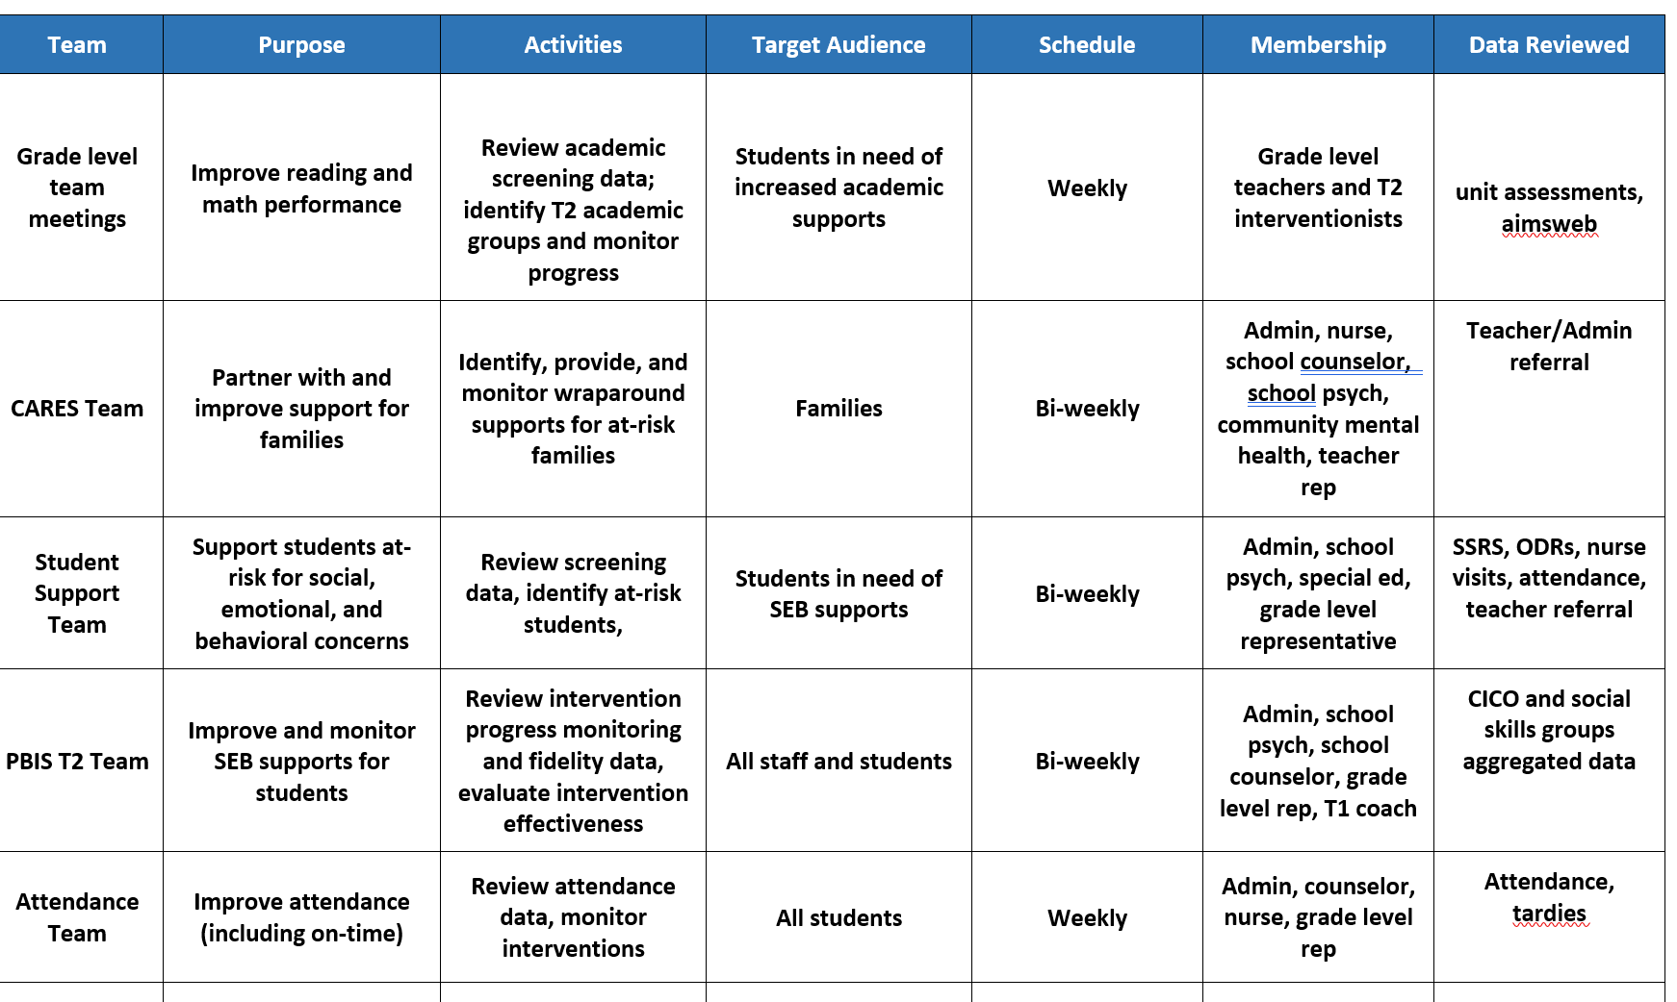
Working Smarter at Tier 2

Slide 22
GUIDELINES FOR TEAMS
Systems
ACTION PLAN GUIDES ACTIVITIES
SYSTEMS
Integrated with other behavior-related initiatives/programs
Given appropriate priority relative to school/district goals
Established rules/agreements/roles
Regular meeting times
Coaching support (at the district or regional level)

Slide 23
Team Roles
Is this a routine?
Facilitator
Note Taker
Time Keeper
Norm Keeper
“Friendly Nag”
Family/Student Voice

Slide 24
ACTION PLANNING
Foundation for all you do as a team
Action Plan
Vital for achieving goals
Specifies three features:
1
2
3
Who
What
When
Who is responsible…
…for doing what…
…by when?
Action Planning: The process of organizing resources to enable individuals to engage in activities designed to achieve specific and important outcomes.

Slide 25
REVIEW YOUR TEAM STRUCTURES
Access team TFI results from last year. What is still in place?
Review team membership; if needed, invite new team members to make it representative
Start a 2022-2023 action planning document or revisit the one from last year; Discuss GOALS for the year.
Establish a regular (monthly) team meeting schedule
https://sebacademy.edc.org/list-of-pbis-resources
Do you need to modify the team?
Have you updated your action plan for this year?
15 minutes
Notes:
Find action plan templates, team membership and meeting schedule tool under “pbis resources” on the website
https://sebacademy.edc.org/list-of-pbis-resources
https://sebacademy.edc.org/tier-2-team-profile-and-meeting-schedule

Slide 26
GETTING STARTED WITH Tier 2
Develop an equitable process for matching student need to practices
1
Establish a representative T2 leadership team
6
2
Develop a collaborative process for identifying students
Develop a process for progress monitoring, data-based decision rules
7
3
Evaluate, select and adopt culturally appropriate tier 2 practices
Develop procedures for modifying/ adjusting implementation
8
4
Develop a process to install selected practices
Develop evaluation routines for fidelity and outcome data
9
5
Develop procedures to train staff and students; partner with families and community
Document and share routines, practices, and policies
10
Notes:
COACHES:
Seeing all of these steps can be uncomfortable or overwhelming – the goal is to walk away with an understanding of the elements and need to prioritize time and resources to get the steps achieved over a period of time.

Slide 27
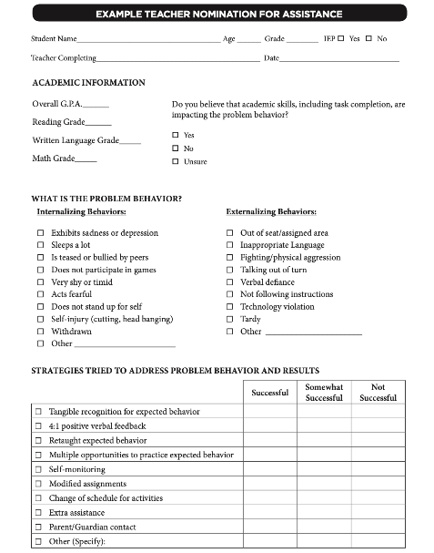
Methods for Identification
Gather information for the November TA meeting
Nomination
Data Decision Rules
Screening
Do we have something simple?
What are some of our data sources?
Is the school using a universal screener?
Notes:
Initial step:
Have you rolled out the nomination form?
Identified data sources?
Advanced steps:
Are the decision rules clear for various data sources? When do you review that data?
Can you provide a one page overview for staff and families about the universal screener?

Slide 28
Possible Data Sources for Identifying Students
ATTENDANCE | BEHAVIOR | ACADEMICS
Absences Tardies (to school and/or to individual classes) Visits to nurse, guidance, office, restroom | Office discipline referrals Classroom managed behaviors Suspensions (in or out of school) Detentions | Course grades GPA Number of failures Academic screener scores Standardized test scores
Additional data to consider: teacher referrals, universal behavior screeners, parent/student requests, Early Warning Indicators

Slide 29
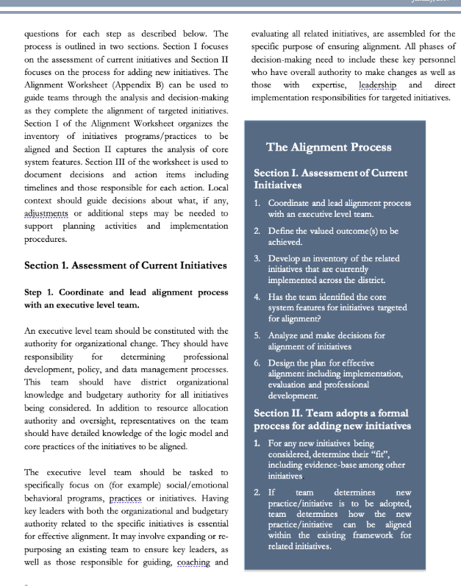
ADDITIONAL RESOURCES
RESOURCES:
Guidance for Systematic Screening: Lessons Learned from Practitioners
Selecting a Universal Behavior Screening Tool: Questions to Consider
Notes:
RESOURCES
- Team meeting profile & meeting schedule: https://nepbis.org/wp-content/uploads/2021/08/Team-Profile-and-Meeting-Schedule-Document-1.docx
- Team meeting foundations checklist: https://nepbis.org/wp-content/uploads/2020/09/Conducting-Leadership-Meetings-Worksheet.docx
- Alignment Checklist: https://nepbis.org/wp-content/uploads/2021/09/MA-Academy-Integration-and-Alignment-Activity.docx
READINGS:
- Technical Guide for Aligning Programs: https://www.pbis.org/resource/technical-guide-for-alignment-of-initiatives-programs-and-practices-in-school-districts
- Integration & Aligning Family Engagement in PBIS: https://www.pbis.org/resource/aligning-and-integrating-family-engagement-in-pbis
- PBIS & SEL as Essential Life Skills: https://www.pbis.org/video/social-emotional-learning-cultivating-essential-life-skills

Slide 30
GETTING STARTED WITH Tier 2
Develop an equitable process for matching student need to practices
1
Establish a representative T2 leadership team
6
2
Develop a collaborative process for identifying students
Develop a process for progress monitoring, data-based decision rules
7
3
Evaluate, select and adopt culturally appropriate tier 2 practices
Develop procedures for modifying/ adjusting implementation
8
4
Develop a process to install selected practices
Develop evaluation routines for fidelity and outcome data
9
5
Develop procedures to train staff and students; partner with families and community
Document and share routines, practices, and policies
10
Notes:
COACHES:
Seeing all of these steps can be uncomfortable or overwhelming – the goal is to walk away with an understanding of the elements and need to prioritize time and resources to get the steps achieved over a period of time.

Slide 31
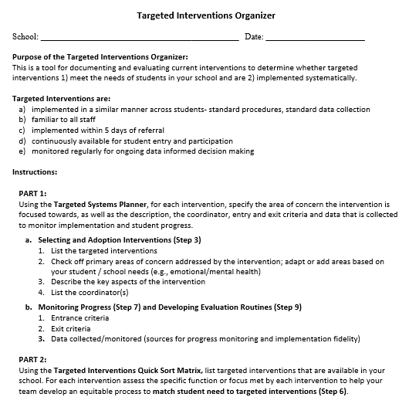
TARGETED INTERVENTIONS ORGANIZER
Systems
Purpose :
Document and evaluate current interventions
Determine whether targeted interventions
1) meet the needs of students, and
2) are implemented systematically
+ ENHANCED Communication
Notes:
The Targeted Interventions ORGANIZER gives teams some guidance to document and evaluate their current interventions.
During this process, we try to consider “fit” and “resources” in order to enhance, eliminate, or add interventions.
By establishing SYSTEMS, teams will be able to evaluate how meaningful and effective the interventions, if aspects need to be refined for them to work better, and what other interventions might be needed to address student needs.

Slide 32
GUIDING QUESTIONS when Evaluating Targeted Interventions
Systems
Targeted Interventions are implemented:
in a similar manner across students - standard procedures, standard data collection
by relevant staff AND familiar to all staff
within 5 days of referral
continuously available for student entry and participation
monitored regularly for ongoing data informed decision making
Notes:
We will begin by doing an “INVENTORY” or list of our targeted interventions.
But before or as you list each intervention, the team should consider “does it meet the criteria as a targeted intervention,” meaning:
It can be implemented in a similar manner across multiple students – standard procedures and standard ways of collecting data on student progress builds efficiency in the delivery of interventions and improves access for students.
It also means that all staff are at least familiar with the ‘menu’ of interventions available, and what their role might be in implementing or assisting in the intervention.
Tier 2 interventions are implemented within 5 days of a ‘referral’ meaning either a request/nomination by staff or review of data patterns such as behavioral referrals to the office, attendance, nurses visits, guidance visits, mid-term progress reports, etc. The key here quick access - being pro-active reduce risk rather than a ‘wait and see’ approach
Continuously available for student entry and participation – this means that students can begin an intervention at any point in the year, rather than wait for the intervention to become available (e.g., a spot in a social skills group facilitated by the school counselor).
Intervention can be monitored regularly using standard data collection procedures and that data are used for decision making (more to come about that)
If it meets this criteria, keep it on the list.
If it doesn’t, what might be needed to ‘round’ out the intervention (e.g., a uniform checklist that all teachers use, a way of collecting data when students attend a skills group)?

Slide 33
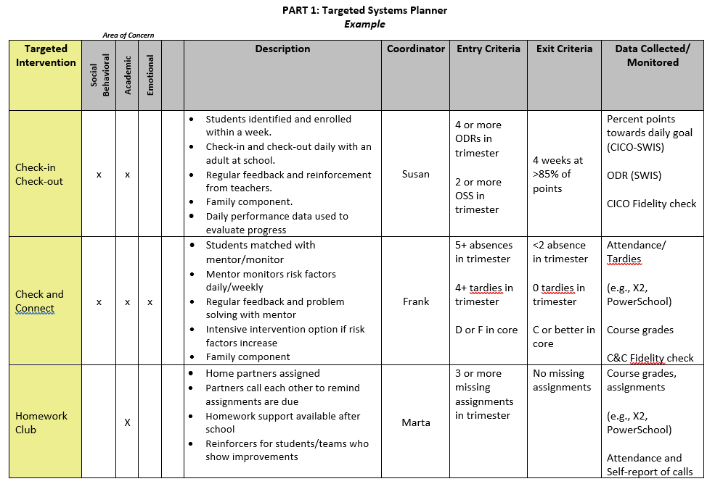
MEETING STUDENT NEEDS: PART 1
Notes:
Now we are ready for the TOOL
Part 1 is called the Targeted Systems Planner. This part provides teams with the chance to reflect on each intervention and how it may (or may not be) implemented systematically to provide meaningful outcomes.
On the left is the name of the intervention. Across the top some teams do a quick check off of whether they consider the intervention goals in area of concern (academic, social/behavioral, emotional or mental health focused).
This aligns well with Step 3 – select and adopt – first we need to see what we have and what global areas of concerns they address.
Then they describe the “essence” of the intervention – a few details and perhaps the purpose.
Teams might want to list the current year’s coordinator for each intervention to assist in planning and support for staff.
ADVANCED STEP: Sometimes teams expand the columns to show the frequency of the intervention (e.g., delivered daily, 1x per week, options of Monday or Wed). The name of the intervention, coordinator, and frequency of the intervention can also be something you put in a table at the end of the document if that seems easier.
The last three columns are areas you may not be quite ready for yet, but are critical for installing systems for data-based decisions.
Teams discuss what data will be considered to access or “enter” the intervention (e.g., ODRs, absences, missed assignments) and what data goal would indicate it’s time to “exit” or graduate from the intervention.
The last column reminds us of the data being collected to monitor implementation of the intervention (Fidelity) and student progress – what type of data, where can the team find the data that will be used to assess response to the intervention?
Reminders:
Don’t feel overwhelmed if your team doesn’t have each box filled in yet - that’s expected. Use this to identify those gaps and action plan as a team around a reasonable timeline to get aspects developed for ONE intervention.
Do that well and it will be easier to replicate for the next ones.

Slide 34
GUIDING QUESTION: GROUPING COMMON NEEDS
Systems
Do identified students have similar instructional needs?
Skills to develop vs. Skills to practice/improve using (skill deficits) (performance deficits)
Do identified students have both academic and emotional/behavioral needs?
Are identified students’ academic needs similar?
Are the functions of behavior (assessed informally) similar across students?
Notes:
When we think about how students might be grouped for targeted interventions, remember that we are considering the similar manner in which the intervention is delivered across students because of their need – so staff gain efficiency in intervention design, standard procedures, and standard data collection and multiple students receiving a standard intervention. It does not necessarily mean the intervention is always received in a group format. That can sometimes be confusing to school teams.
So we ask as a guiding question when we consider the TYPES of targeted interventions if there are common needs.
Common needs = standard, quicker access interventions and more groups of students getting support
Do identified students have similar instructional needs?
Do identified students have both academic and emotional/behavioral needs?
Are identified students’ academic needs similar?
Are the functions of behavior (assessed informally) similar across students? (meaning can we make some informed assumptions about what the function is and deliver an intervention that meets the function?)

Slide 35
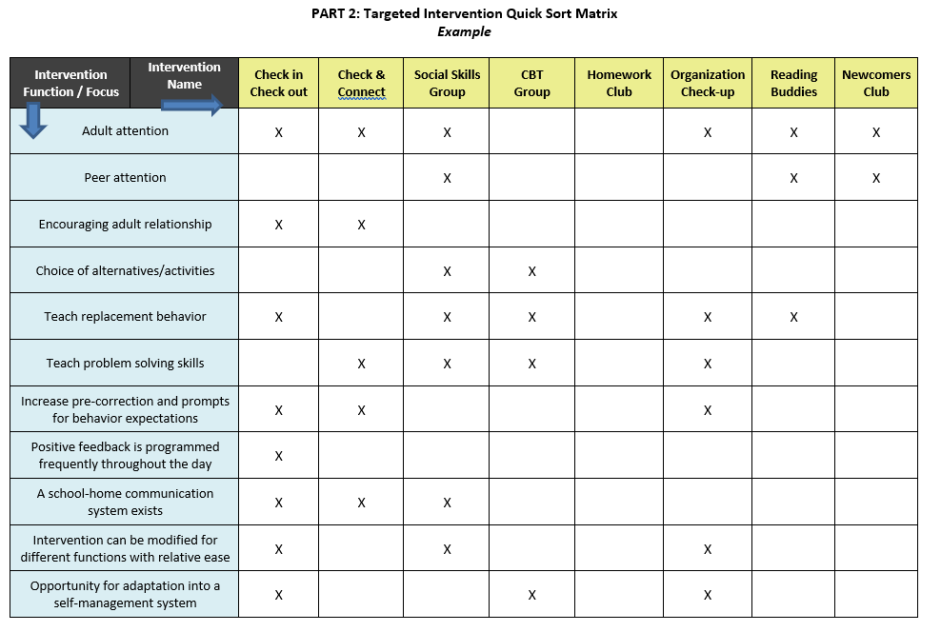
MEETING STUDENT NEEDS: PART 2
(Update before Jan)
Notes:
Part 2 is called the “Quick Sort Matrix”
So across the top we see the list of targeted interventions.
On the left side, we see the intervention focus and in some cases function. Essentially this is a quick way of seeing, in part 1, what interventions match to what need.
For example, Check in Check Out meets several student needs – it is well suited for students whose behavior is motivated by adult attention, and thus also serves to encourage adult relationships. CICO teaches students replacement behaviors such as how to gain attention appropriately. It’s structured to provide students with prompts and frequent feedback of behavioral expectations throughout the day by adults.
In this example, with an Organization Check-up, students will receive adult attention, but the primary purpose is to teach (weekly) problem solving strategies to help prepare academically and what we call replacement behaviors or other, more appropriate behaviors like scheduling meetings with teachers to access support instead of trying to avoid challenging tasks through missed assignments or disruptive behavior in class.
Some reminders as you complete this tool:
Typically, interventions will meet more than one of these needs or focus areas, but don’t expect it to meet all.
One size does NOT fits all – we need multiple interventions to meet multiple needs.
Schools do NOT begin with this many targeted social-emotional/behavioral interventions. It’s ok to only list a few to start the process.

Slide 36
ACTIVITY: Targeted Intervention Organizer
Review the Targeted Intervention Organizer from last year and determine:
Is it complete for at least 1 intervention?
What methods did you add to monitor fidelity and progress?
What other interventions do you want to target for this year?
Have you complete Part 2, quick sort matrix?
15 minutes

Slide 37
Glows & Grows: Tier 2 Foundations Tier 2 Implementation
Notes:
TRAINER NOTE:
Use this time to check in with coaches and gauge their existing knowledge base of PBIS and determine whether or not they already watched the PBIS Overview.
The following 2 slides provide an opportunity for a BRIEF review and chance to develop a basic common understanding. It is not intended to be a full explanation.

Slide 38
DISCUSSION: GLOWS & GROWS
What is something to celebrate & something you’re working on related to:
Tier 2 systems, practices, and data
Tier 2 roll out to staff, students, and families
Add to our shared doc
5 minutes
15 minutes
Independent Jot
Whole Group
Notes:
https://docs.google.com/presentation/d/1vTArKNhe9ncl5wqXppNoj1__3PvErxEOx68Jx2HSO4E/edit?usp=sharing

Slide 39
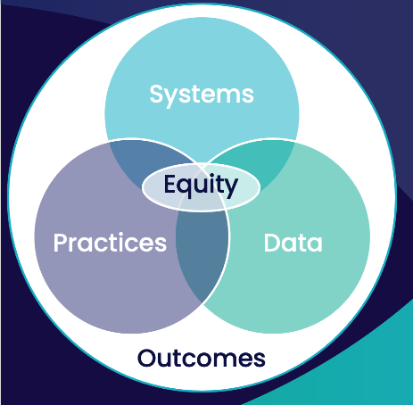
School-wide PBIS is a...
~5%
~15%
Framework for enhancing adoption & implementation of
Continuum of evidence-based interventions to achieve
Academically & behaviorally important outcomes for
All students
~80% of students respond

Slide 40
TIER 2 CRITICAL FEATURES
Consistent, standardized implementation across students
Easily accessible (e.g., within a few days of referral)
Continuous availability
Implemented by all school staff
Consistent with and extra doses of school-wide expectations and interventions

Slide 41
GETTING STARTED WITH Tier 2
1
Establish a representative T2 leadership team
6
Develop an equitable process for matching student need to practices
2
Develop a collaborative process for identifying students
Develop a process for progress monitoring, data-based decision rules
7
3
Evaluate, select and adopt culturally appropriate tier 2 practices
Develop procedures for modifying/ adjusting implementation
8
4
Develop a process to install selected practices
Develop evaluation routines for fidelity and outcome data
9
5
Develop procedures to train staff and students; partner with families and community
Document and share routines, practices, and policies
10
Notes:
COACHES:
Seeing all of these steps can be uncomfortable or overwhelming – the goal is to walk away with an understanding of the elements and need to prioritize time and resources to get the steps achieved over a period of time.

Slide 42
EVALUATING TIER 2 INTERVENTION FIDELITY
Are we doing what we said we’d do?
How will we know?
How will we directly measure this?
How will we ensure that we assess fidelity on a (minimum) monthly basis?
Notes:
A simpler measure that could be used monthly (prior example—annual measure)
Rationale:
Not all curricula have intervention fidelity checklists available.
Trainer’s Notes:
This is a generic Tier 2 Intervention Fidelity Checklist that can be used with any Tier 2 intervention. It is available in the MISC section of this training binder.

Slide 43
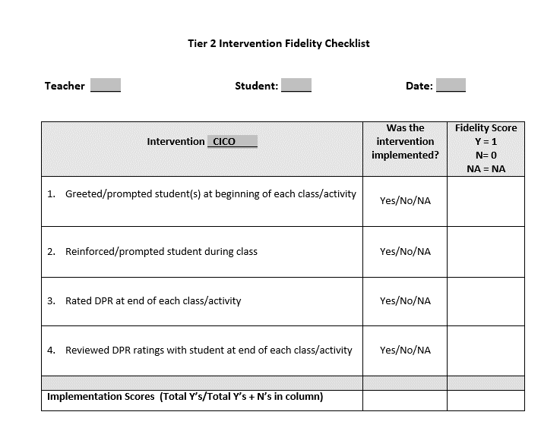
EXAMPLE: FIDELITY CHECKLIST
Notes:
A simpler measure that could be used monthly (prior example—annual measure)
Rationale:
Not all curricula have intervention fidelity checklists available.
Trainer’s Notes:
This is a generic Tier 2 Intervention Fidelity Checklist that can be used with any Tier 2 intervention. It is available in the MISC section of this training binder.

Slide 44
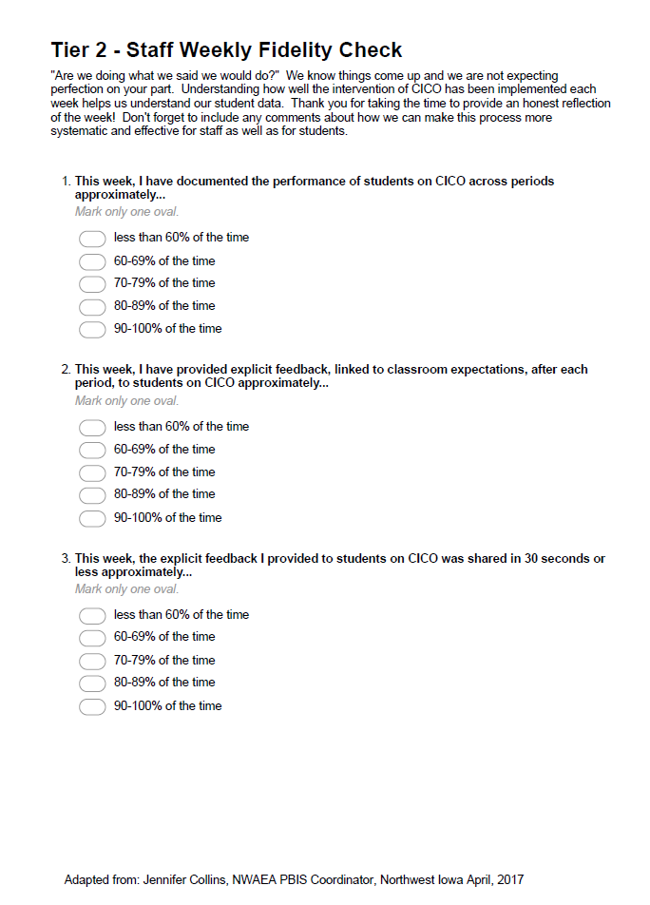
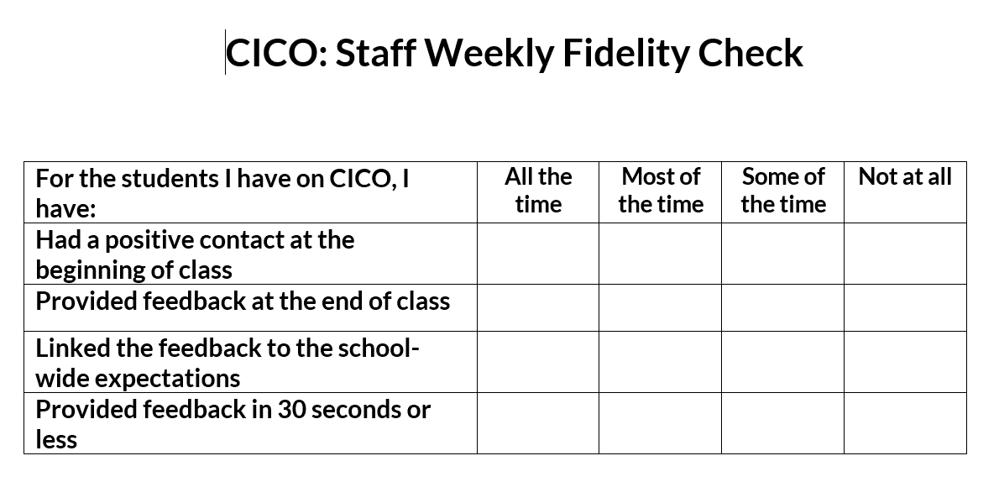
CICO Weekly Fidelity Check
Item 2.12
Observations
Morning & Afternoon Checks
Teacher Checks
Team Meetings
Review permanent products (e.g., point cards)
Quick surveys or interviews
Adapted from Jennifer Collins, NWAEA (Iowa)
Notes:
Adapted from Jennifer Collins, Iowa

Slide 45
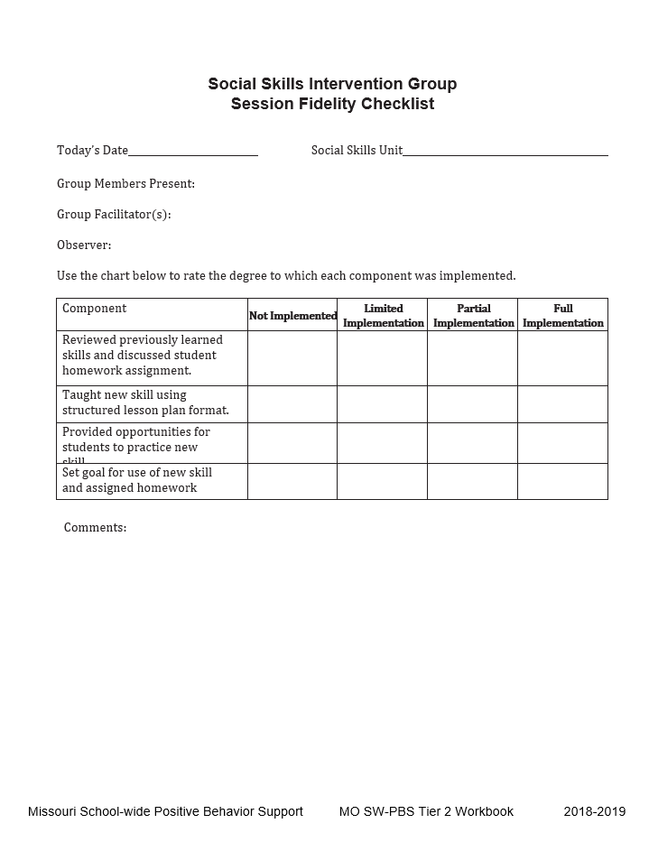
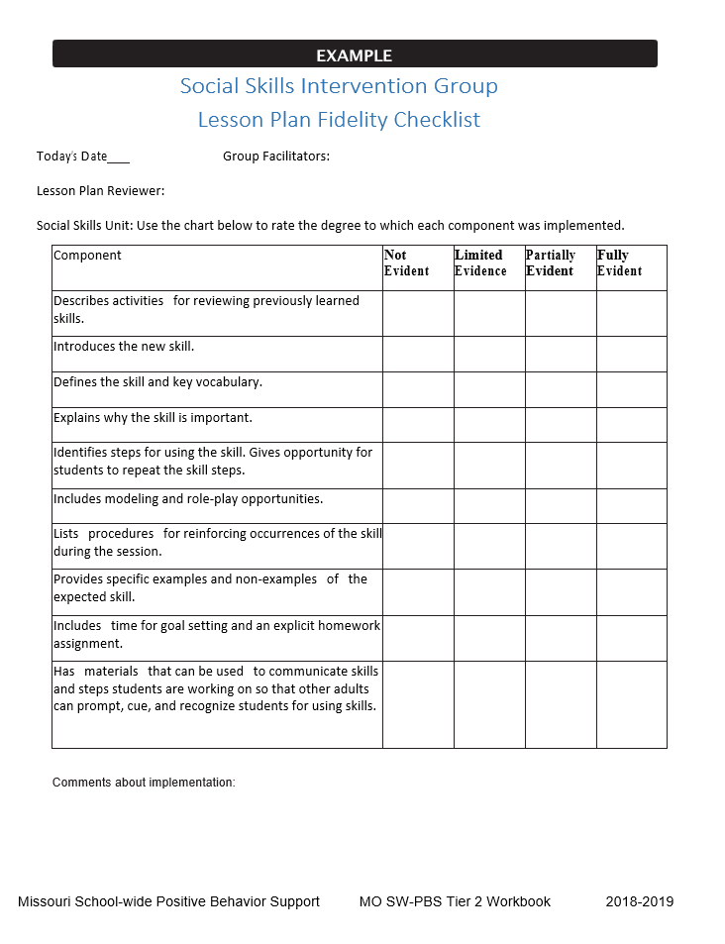
Social Skills Fidelity Checklists
Missouri SWPBIS
Notes:
Missouri PBIS site has many Tier 2 materials available. The two shown here are from their Tier 2 handbook. Michigan also has a strong Tier 2 section.

Slide 46
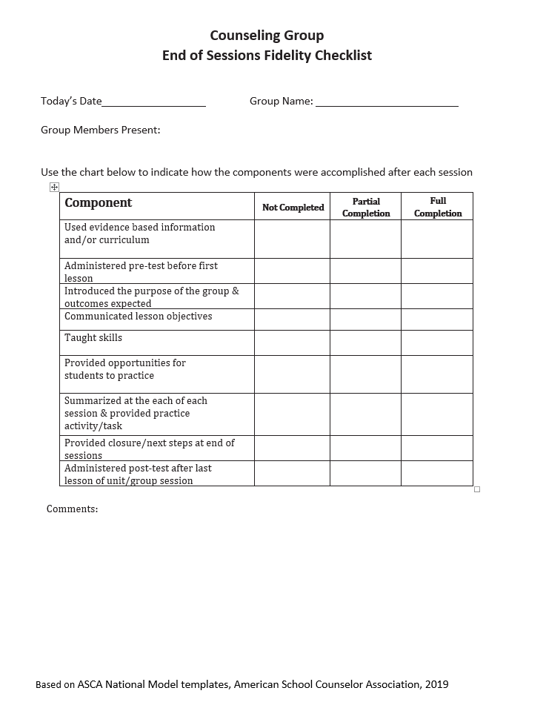
Counseling Group Fidelity Checklist
Item 2.12
American School Counselor Association
Notes:
This is a checklist that I developed using information from the ASCA lesson plan.

Slide 47
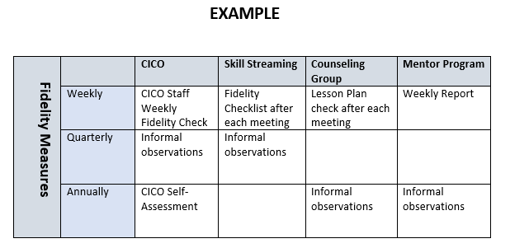
Fidelity Assessment Organizer
“If you fail to plan, you plan to fail”
- Harry Wong

Slide 48
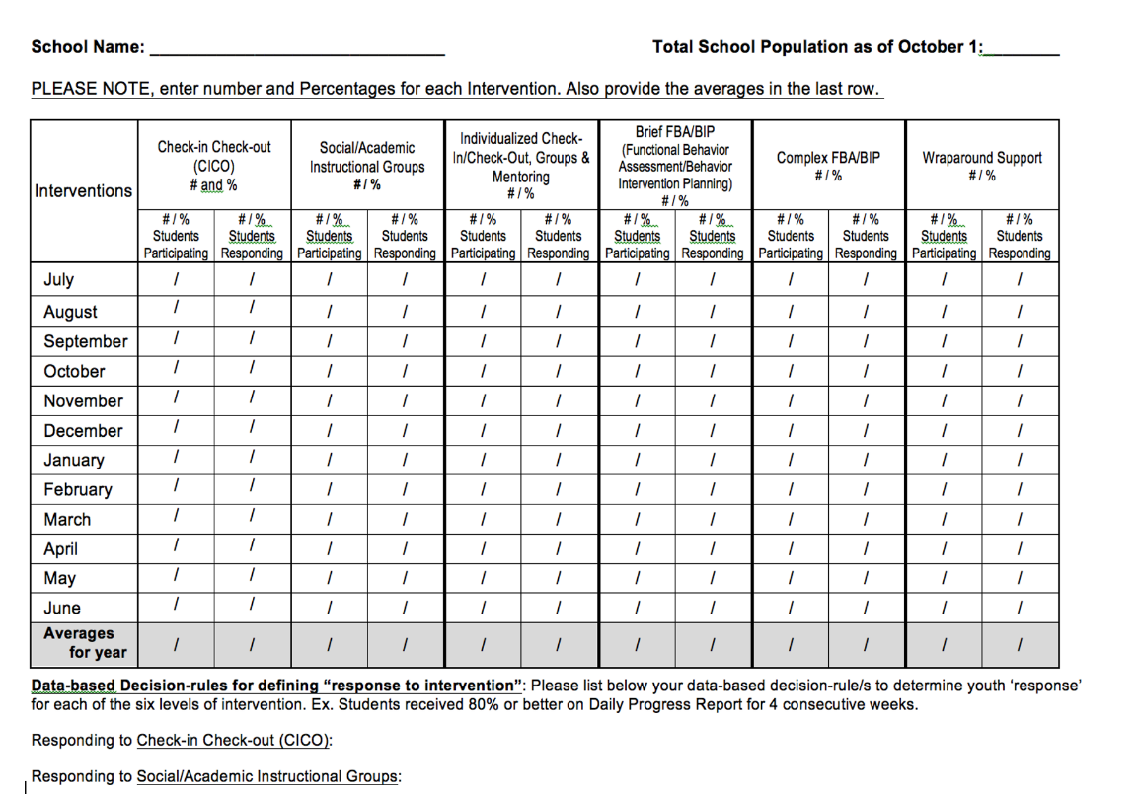
EVALUATING OUTCOMES: T2/T3 Level of Use
Notes:
https://docs.google.com/document/d/1Ne0HMulzq-nkxQH5vFyTg7-49MFkiIT1/edit?usp=sharing&ouid=113176138085448434640&rtpof=true&sd=true

Slide 49
ACTIVITY: Evaluation Steps
Review the Evaluation Steps and consider what goals you want to set for this year:
Do you need to add fidelity checklists for some interventions?
Is there a way of tracking students who participate in each intervention? Students responding positively to the intervention?
What percentage of your student population is participating in a Tier 2 SEB intervention?
5 minutes

Slide 50
FALL Technical Assistance (TA) SCHEDULE NOV or DEC DATES
1:1 Coaching Support
or
Team Support
Establish
Routines
Work
smarter!
Review
Practices
Data-based Decisions
Evaluate
outcomes
Problem solve barriers

Slide 51
ACTIVITY: SELF-ASSESS TIER 2 TFI (December/January)
Login to www.pbisapps.org
Click on PBIS assessments, then “open survey window.”
Click on SWPBIS TFI 2.1; “take survey”
Choose today’s date, team members w/o coach, and no walkthrough
Complete only Tier 2 items as a team
(2.1-2.13)
Add priority items to your action plan
PBIS TFI document
Plan for 30 minutes
Notes:
TRAINERS – Prompts for activity below; allow 30 minutes. Emphasize baseline for action planning
Login to www.pbisapps.org
Click on PBIS assessments, then “open survey window.”
Click on SWPBIS TFI 2.1; “take survey”
Choose today’s date, team members w/o external coach, and no walkthrough
Complete only Tier 2 items as a team (2.1-2.13)
Add items to your action plan; remember this is just a baseline!

Slide 52
WINTER Coaches Meeting
Communicate Interest in Topic Areas
Tuesday Jan 10th, 9-11am
BIG IDEAS
EXPAND on: Evaluating and Selecting Tier 2 Practices using the Targeted Intervention Organizer
Possible Topics:
Data based decisions (drill down using the T2/T3 student monitoring tool)
Additional interventions (e.g., CBT, Social Skills Groups, Check and Connect)
What do you want to make sure we cover this year either individually or as a group?
Notes:
TRAINER NOTE:
Prompt coaches to begin these conversations with their teams prior to the team training

Slide 53
Agenda & Coaches' Tasks
Coaches’ Tasks:
Share documents or folder with access to:
Presentation Content:
Resources: Tier 2 Academy Year 2 Structure; Building on Tier 1
BIG IDEAS: From Installing to Full Implementation
Nomination Form, Decision Rules, Universal Screening overview
Targeted Intervention Organizer
Glows and Grows: Foundation Steps
Team Profile and Meeting Schedule, 2022-2023 Action Plan

Slide 54
EVALUATION
CONTACT INFORMATION:
Marcie Handler
mwhandler@gmail.com
Please remember to complete the evaluation to receive your Certificate of Attendance!
Notes:
Evaluation Link
https://edc.co1.qualtrics.com/jfe/form/SV_cBF9GI7gVEBsfSC

