Slide 1
WELCOME to PBIS TIER 2 TEAM TRAINING DAY!
~15%
GETTING STARTED:
Find your table
Get comfy
Find training resources at edc.org: SEB PBIS Tier 2 Academy
Complete the ATTENDANCE link found in the presentation
Warm up Activity:
What superpower do you bring to your TEAM?
Notes:
Attendance
https://edc.co1.qualtrics.com/jfe/form/SV_5BiXqi4bxzOCMS2
New team member communications survey - https://edc.co1.qualtrics.com/jfe/form/SV_db8zhNj6NJ3eXga
EDC Website for SEB Academy
https://sebacademy.edc.org/
Event Evaluation (at the end)
https://edc.co1.qualtrics.com/jfe/form/SV_cBF9GI7gVEBsfSC
If needed, we will use the link we use for coaches meetings as a backup for teams.

Slide 2
PBIS TEAM TRAINING TIER 2, Year 1 October 2022
Marcie Handler & Katie Meyer
with support from NEPBIS Network, May Institute & Broad Reach Consulting
Notes:
Add trainer names for your event

Slide 3
Welcome! WHO'S HERE?
Berkley | Berkley Community School (PreK-4)
Peabody | Welch Elem (PreK-5)
Lowell | Bailey Elem (PreK-4)
 | Sullivan Middle (Gr 5-8)
Taunton | Martin Middle (Gr 5-8)
 | Mulcahey Elem (Gr PreK-4)
 | Parker Middle (5-8)
Hopkinton | Elmwood Elem (Gr 2-3)
 | Hopkins Elem (Gr 4-5)
 | Marathon Elem (PreK-1)
N. Brookfield | North Brookfield Elem (PreK-6)
Monson | Granite Valley (Gr 1-6)
Holyoke | STEM Academy (Gr 6-8)
Lynn | Callahan (PreK-5)
LIST SCHOOLS IN COHORT HERE
Notes:
TRAINER NOTE: Give teams several minutes each to introduce themselves to each other and to another school or the whole group; share what year of implementation they are in.

Slide 4
ACTIVITY: ATTENDANCE
Use this link for ATTENDANCE
Follow prompts to enter attendance information
Notify trainers if you require assistance
Complete the evaluation at the end of the meeting to receive your Certificate of Attendance!
You are in Tier 2
Cohort 2
1 minute
Notes:
Attendance
https://edc.co1.qualtrics.com/jfe/form/SV_5BiXqi4bxzOCMS2

Slide 5
ACKNOWLEDGEMENTS
02
03
04
Northeast PBIS Network (nepbis.org)
01
Michigan Integrated Behavior & Learning Support Initiative
Dr. Heather George & FLPBIS
Missouri PBIS
Drs. Leanne Hawken, Deanne Crone, & Rob Horner
05
06
Midwest PBIS Network

Slide 6
EXPECTATIONS
Self
Others
Environment
Self-monitor
Mute when listening, unmute to talk​
Have electronics ready to use
Obtain help from peers and trainers
Work as a team:
Keep necessary materials at hand
Are you participating?
Engaged as a learner?
Stretch, break, stand as needed​
Room for every voice
Reinforce participation
action plan
relevant docs
water/snacks
Minimize distractions if possible​
Complete tasks efficiently
Notes:
Taking CARE of…

Slide 7
LEGEND
Timing
Example
Activity
Non-example
Guidelines
Preview
Big Idea
Review
Organization

Slide 8
Agenda & Tasks
TEAM Tasks:
Presentation Content:
Introductions / Logistics
Glows and Grows: Getting Started
Overview of Tier 2 & Why Tier 2?
Getting Started with Tier 2: Tier 2 Goals
Tier 2 Academy Training Overview
Confirm Leadership Team
Draft T2 goals
Targeted Interventions Organizer (Part 1)
Complete Baseline Tier 2 TFI
Coaches’ Tasks:
From September – share
Team Profile and Meeting Schedule
After today – share or email
Team Goals
Targeted Intervention Organizer (even if it is in progress)
Updated Action Plan
Create a Shared FOLDER with us called “PBIS ACADEMY TIER 2 – SCHOOL NAME”
Notes:
All Tasks from TIER 2 YEAR 1 September Coaches Meeting
Submit your Tier 2 Team Profile and Meeting Schedule (share doc or email to trainers).
Communications survey
Review the Action Planning Document Templates found on the pbis resource page. Select one or use an existing example from your school to begin your Tier 2 team action planning process at the October 18th team training.

Slide 9
PREVIEW: GLOWS & GROWS across teams
Identify something to celebrate (GLOW) & something you’re working on (GROW) related to three areas from today:
Teaming
T2 Targeted Interventions Systems Planner
TFI self-assessment
Share these items on the group slide deck ☺
15 minutes
Share by School

Slide 10
Resources: PBIS Tier 2 Academy Support Structure and how to build on Tier 1

Slide 11
SEB PBIS TIER 2 TRAINING MODEL
Training / Networking
Exploration and Installation of 10 Getting Started Steps
Year 2 (TBD)
Initial Implementation of 10 Getting Started Steps
3 days of team training (Oct/Jan/April) +
7 coaches’ trainings
Networking
Up to 1 day of technical assistance
Meeting with coach or team (Fall, Winter, Spring)
TFI (April/May)
TA support
CICO-SWIS
T2 behavioral data system – optional and free

Slide 12
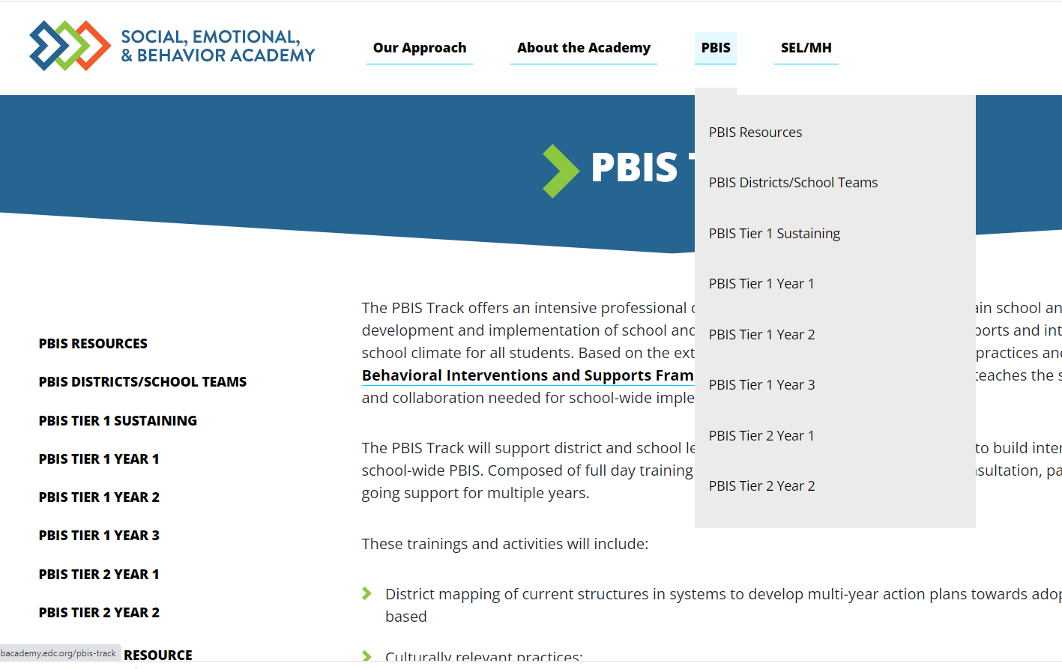
PBIS Academy Support Structure
What is it?
Your team's guide for training content, readings, and resources for both each monthly event.
Purpose:
Monthly organized resource repository for your team to access all PBIS Academy content
Website https://sebacademy.edc.org
Notes:
TRAINER NOTE: Please share the website address https://sebacademy.edc.org/pbis-track
NOTE: SWIS page with training dates will be up shortly

Slide 13
Additional resources
Pbis.org
Pbisapps.org
Nepbis.org
https://www.pbis.org/pbis/tier-2
Notes:
https://www.pbis.org/pbis/tier-2

Slide 14
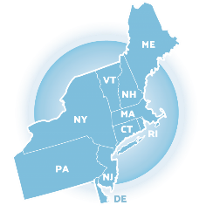
Tier 2: Overview
Notes:
Why Tier 2?
What are the Critical Features?

Slide 15
WHY Tier 2?
Context matters for prevention at Tier 2
Part of a continuum of supports
Efficient use of resources for at-risk students
Tier 2 works
Provides a framework to promote equity

Slide 16
SWPBIS Message!
Successful individual student behavior support is linked to host environments or school climates that are effective, efficient, relevant, & durable.
(Zins & Ponti, 1990)

Slide 17
PREVENTION LOGIC FOR ALL
Prevention Objectives
Decrease development of new problem behavior
Prevent worsening & reduce intensity of existing behavior
Prevention Actions
Eliminate triggers & maintainers of problem behavior
Add triggers & maintainers of prosocial behavior
Teach, monitor, & acknowledge prosocial behavior
Redesign of teaching environments… not students
Incidence
Prevalence
Biglan (1995); Mayer (1995); Walker et al. (1996)

Slide 18
Continuum of School-Wide Instructional & Positive Behavior Support
Tertiary Prevention:
Specialized
Individualized
Systems for Students with High-Risk Behavior
Primary Prevention:
School-/Classroom-
Wide Systems for
All Students,
Staff, & Settings
~5%
~15%
Secondary Prevention:
Specialized Group
Systems for Students with At-Risk Behavior
~80% of Students
Notes:
Key Points
-Many of you have probably seen this triangle before. It’s the same construct we use when talking about Response to Intervention (RTI), Multi-tiered Systems of Support (MTSS), AND Positive Behavioral Interventions and Supports (PBIS).
-If we provide evidence based intervention (whether academic or behavioral), to ALL students, that at least 80% of students should respond and need no further intervention. We call this Tier I, School wide, or universal intervention.
-But, we know that there will be a portion of the population, around 15%, who will need more specialized intervention. NOTE….they’ll still be getting that Tier I intervention, but we may provide an additional exposure to that Tier I intervention or maybe provide a short-term group to address the need. Once the students show they don’t need the additional layer of intervention anymore, that intervention is peeled away and they continue to get the Tier I.
-Yet, there will always be a smaller part of the population who may need more intensive, more individualized intervention. We assume that this will be about 5% of the population. This population with “tier III needs” will receive: the Tier I interventions, the Tier II interventions, AND their own individualized intervention. Once they show that they don’t NEED the Tier III intervention anymore, that layer is peeled away, and so on.
(click)
NOTICE GREEN GOES IS FOR “ALL”
Tier 1 must be firmly in place before you build Tier2 and Tier 3.
Otherwise, you will wind up with an inverted triangle or volcano!
By providing Tier I to fidelity, you reduce the need for Tier II and Tier III services, reduce the burden on those providers, and use your resources more efficiently.

Slide 19
TIER 2 IS DESIGNED TO…
Use data to identify students who are at-risk for or currently experiencing emotional and/or behavioral difficulties
Prevent the development or decrease the frequency and/or intensity of students’ problem behaviors
Provide standardized interventions that effectively and efficiently support students yet do not require the time and resources needed to develop individualized plans

Slide 20
WHO BENEFITS FROM SECONDARY SUPPORTS?
Students who continue to demonstrate challenging behavior despite school & classroom
supports being in place at
≥ ____% implementation.
Approximately ______%
of the student
population.
10-15%
80%
Likely to be students
with ______________
& _________________
difficulties.
Without effective school-
wide prevention, we cannot
reliably identify students who
benefit from secondary supports.
academic
behavioral

Slide 21
Creating an Efficient System of Supports
Create a system that includes:
A set of readily available interventions
A process to identify “at-risk” students
A procedure to match interventions to student need
A method to monitor progress that uses objective data
Notes:
Once your building’s administrator and staff determine that universal level features are in place and that adequate resources are available to devote to Tier 2 planning – it is important to understand the initial focus will be directed toward developing a system.
Many school’s enter the Tier 2 process expecting to begin working with at-risk students shortly after the first training session. This is a common misunderstanding.
It is important for everyone in a building to realize that intervention development is a critical aspect of the Tier 2 Team, but developing a systematic process for identifying at-risk students, designing procedures for matching students with appropriate interventions according to the function of their behavior and delineating a process to monitor each intervention will be the initial focus of the team. Students will not begin to access interventions until each of these “system” features are developed and communicated to the full staff.

Slide 22
PBIS centers equity in all decisions...
Throughout your Tier 2 training and implementation,
Access
Representation
Meaningful Participation
Positive Outcomes
will be highlighted as well as the systems needed to promote and sustain equity for each and every individual.
Notes:
https://www.pbis.org/topics/equity
Examples at Tier 2: Strengthening T2 to support equity through access
Identifying Students in Need of Additional Supports
Supporting fidelity of implementation
Supporting cultural adaptations

Slide 23
Goals of Targeted Systems Support
Have available a menu of interventions for responding to the diverse range of student needs
Internalizing needs
Externalizing needs
Provide interventions to support approximately 15% of the student population who are at risk, but not currently engaging in severe problem behavior
Walker & Horner, 1996; Crone, Hawken & Horner, 2010, p. 7
Notes:
Equity means all students have access to interventions/range of supports that meet student need
A primary goal of the PBIS team at the Tier 2 level is to develop adequate resources that meet the needs of at-risk students in your building. For some schools this may mean development of more than one intervention.
Ideally – in the same way many schools provide a standard set of treatments when students display academic deficits a goal of the PBIS Tier 2 Team is to also offer a standard set of social-behavioral interventions that are continuously available as extra support for students.
Targeted behavior supports are intended to support approximately 15% of the student population.

Slide 24
RESEARCH SAYS…
Increases in academic engagement
Increases in prosocial behavior
Decreases in office discipline referrals
Implementing Tier 2 SWPBS interventions with fidelity is associated with the following positive outcomes:
(e.g., Campbell & Anderson, 2011; Crone, Hawken, & Horner, 2010; Fairbanks et al., 2007, McIntosh et al., 2009; Wolfe et al., 2016)

Slide 25
TEAM DISCUSSION: Why Tier 2 at your school?
Context matters for prevention at Tier 2
Part of a continuum of supports
Efficient use of resources for at-risk students
Tier 2 works
Provides a framework to promote equity
Which of these messages will your team identify as being most important to your school? Why?
Which messages do you need more support to articulate?
5 minutes

Slide 26
Systems
Data
Practices
Equity
Critical Features of PBIS….
At EVERY TIER!
Outcomes

Slide 27
Guiding Principles
Systems
Data
Practices
Prioritize equity. MTSS is for all students, families, and educators. Use the MTSS framework to differentiate supports for students and monitor to ensure equitable outcomes are observed.
Equity
Outcomes
Notes:
Trainer note: Go through this quickly as they've been exposed to this multiple times before. Highlight unique T2 features.

Slide 28
Equity
Make student growth and benefit central to all decisions. Student outcomes that reflect equitable learning opportunities must be the ultimate criteria for all decisions.
Outcomes
Notes:
Equity is new for folks.

Slide 29
Systems
Data
Practices
Prioritize the most efficient and effective practices. Do a few important and relevant practices well. Emphasize practices that are supported by evidence, match the local culture and current context, and promote high-quality implementation across time. Integrate, align, and connect practices.
Equity
Outcomes

Slide 30
Systems
Data
Practices
Equity
Use data to inform decisions about which students, families, and educators need which supports, as well as whether supports should be continued, adjusted, or faded. Data should be used to ensure that all recipients benefit and that supports are implemented with fidelity.
Outcomes

Slide 31
Systems
Data
Practices
Continue to invest in systems to support high-fidelity implementation over time. Leverage existing leadership teams to guide planning and implementation, and consider effective means to support educators’ professional learning and wellness given current resources, experience, and expertise.
Equity
Outcomes

Slide 32
PBIS TIER 2 CRITICAL FEATURES
What is currently in place that meets these features?
Consistent, standardized implementation across students
Easily accessible (e.g., within a few days of referral)
Continuous availability
Can be implemented by all school staff
Consistent with and extra doses of school-wide expectations and interventions
Continuously monitored to assess student progress
Adaptable based on functional assessment data
Notes:
Can be implemented by all staff – means that staff have received training and support to implement an intervention (in part, in all, or components that up in the classroom). It does not mean that every staff person is responsible for that particular tier 2 interventions.

Slide 33
COMMON ELEMENTS OF PBIS TIER 2 PRACTICES
01
02
03
Targeted & explicit skill instruction
Acknowledgements of appropriate behavior
Increased structure, predictability, and adult support
04
05
Plans for generalization & maintenance
Frequent performance feedback for targeted behavior
(Hawken, Crone, Bundock, & Horner, 2021)

Slide 34
ACTIVITY: Tier 2 Goals
Briefly discuss goals but realize these can be adapted after T2 self-assessments are completed
What are our primary/initial goals for T2 implementation in our school?
How will we gain input from others on our goals?
Do our goals align with district/school strategic plans?
What data might we use to transform these primary goals into observable, measurable outcomes?
Add goals to the action plan you selected for your team
15 minutes

Slide 35
DISCUSSION
Share a goal you discussed and/or set for this year.
How will you get input from others on your goals?
TO DO
What of the T2 overview can you share with staff?
When might that happen?
15 minutes

Slide 37
Tier 2 “Readiness”
Link to Tier 1

Slide 38
Optimal Timing for Launching Installation of Tier 2 and 3 Systems
2021 Study examined data from 776 schools across 27 states reporting on the first three years of T2 implementation
Kittleman et al. reported:
Higher Tier 1 implementation predicted subsequent Tier 2 and Tier 3 implementation
Waiting 2 or 3 years after initial Tier 1 implementation to launch Tier 2 systems predicted higher initial Tier 2 implementation
What do you think of these findings?
Notes:
Kittelman, A., Mercer, S. H., McIntosh, K., & Hoselton, R. (2021). Optimal Timing for Launching Installation of Tier 2 and 3 Systems of School-Wide Positive Behavioral Interventions and Supports. Journal of Positive Behavior Interventions, 1098300721996084.

Slide 39
Tier 2 Readiness
Key Reminder:
The likelihood of successful Tier 2 implementation is maximized when Tier 1 is implemented with high fidelity
How would you rate your Tier 1 Fidelity (consider TFI <70%)?
5 = 80% or higher “we’ve got this!”
4 = 70% or higher
3 = Approaching fidelity
2 = had some/lost some
1 = below 40%
Notes:
Poll: How would you rate your Tier 1 fidelity? 5 = Very high, 1 = very low.

Slide 40
Everything Builds on
Tier 1!
Data-Based Guiding Questions
Is our Tier 1 system doing what it needs to do?
Does the school have a ‘healthy’ triangle?
Do 80% of students have ~0 -1 office referrals?
Is Tier 1 accessible to and effective for students across groups?
Is Tier 1 PBIS being implementing with fidelity?
SWPBIS Tiered Fidelity Inventory (TFI) = > 70%
Are fewer than 60% of referrals coming from classrooms?
Are only a ‘few’ students receiving referrals?
Are only a ‘few’ staff writing referrals?
Are effective instruction and behavior management occurring in the classroom?
Notes:
Rationale:
Tier 1 is a building block for identifying students in need of Tier 2 supports. Essentially, Tier 1 data are your blueprint in identifying who, what and when supports need to be provided. By implementing Tier 1 with fidelity and using data for decision-making provides better information for effective and efficient planning and problem-solving.
Trainer’s Notes:
There are 6 guiding questions to assist participants in understanding if they are ready for Tier 2 supports on their campus. Remember, if your data show more than 15% of your students need Tier 2 supports, this indicates a Tier 1 issue! Each question will appear with an advanced click due to the animation.

Slide 41
Q: Why “BUILD on” and intentionally link to Tier 1 Team?
A: If schools do not have a solid Tier 1 foundation…
Lack of solid Tier 1 foundation
Too many students identified
Strain on resources
Staff frustration
Limited support options for students in need
Reluctance to identify students in need
Unmet student needs
Notes:
Rationale:
Without a Tier 1 behavioral system on campus, too many students will be misidentified as needing more advanced supports (i.e., Tiers 2 & 3). It is essential that a Tier 1 system be implemented first with fidelity to truly identify the students that are not responding well to the universal interventions on campus. A campus will not have the resources to provide advanced supports to many or all students on their campus. It is also more cost effective to use a preventative approach and provide Tier 1 supports for all.
Trainer’s Notes:
There is no animation on this slide but it is important to walk the participants through each of the boxes to understand the consequences to not establishing a solid Tier 1 system on campus.
Remember the following:
Tier 1 is a building block for identifying students in need of Tier 2 supports
Tier 1 data are your blueprint
(2) Provides better information for planning & problem solving

Slide 42
If a student is referred for Tier 2 supports, but spends a lot of time in an environment where:
A high rate of problem behavior occurs
Appropriate behaviors are not taught or acknowledged
System
or
Student?
The environment may be contributing to the student’s problem behavior
In either case, we can’t say the student had a “poor” response to Tier 1 (core curriculum)
Notes:
Rationale:
It is important that participants spend a few minutes understanding these questions. We want to be careful NOT to identify the problem behavior as a student issue if the environment has not been conducive to learning.

Slide 43
Tier 2 Readiness Checklist
Is tier 1 implemented with fidelity across all settings and effective in your school?
Are tier 2 school-wide data consistently collected, reviewed, and used for decision-making?
Has the school principal committed to tier 2 implementation?
Is a plan in place to make all school faculty members aware of tier 2 implementation and alignment with existing practices?
Has a tier 2 behavior support team been identified to attend training, guide, and coordinate implementation?
Has the district committed to supporting tier 2 implementation?
Does the school-wide discipline data system support tier 2 information?
Is a plan in place to identify possible tier 2 intervention(s) for implementation?
Notes:
General overview of questions- Participants will go through the tool as a team in a few minutes and that the tool provides more guidance to answer each question.

Slide 44
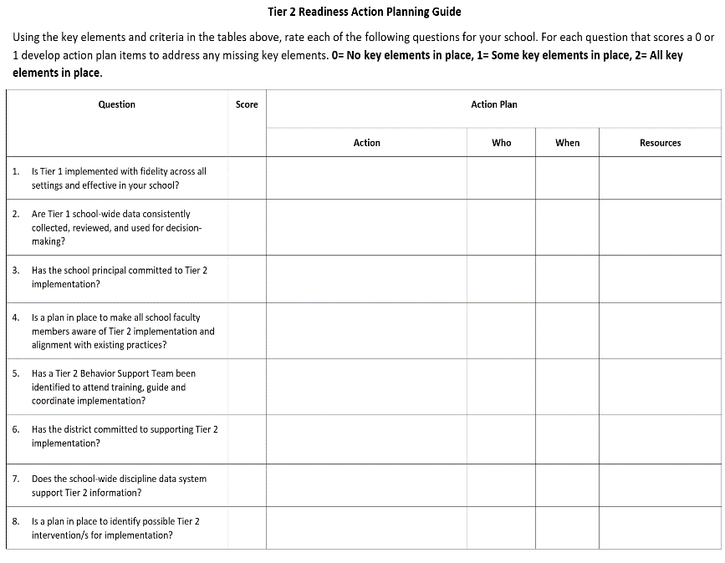
TEAM ACTIVITY: Tier 2 Readiness
1. Briefly complete the Tier 2 Readiness and Planning Tool
2. Upload the completed document to your shared folder
3. Add items for your action plan
15 minutes

Slide 45
DISCUSSION: Tier 2 Readiness Checklist Debrief
What did you learn about Tier 2 readiness and connections to Tier 1?
What is one item or action step that you will prioritize?
How will you communicate with the Tier 1 Leadership Team?
Whole group
5 minutes
Notes:
TRAINERS – Discussion prompts are below; allow 5 minutes.
What did you learn about Tier 2 readiness and connections to Tier 1?
What is one (or two!) item/action plan step that you will prioritize?
How will you communicate with the Tier 1 Leadership team?

Slide 46
Getting Started

Slide 47
GETTING STARTED WITH Tier 2
Develop an equitable process for matching student need to practices
1
Establish a representative T2 leadership team
6
2
Develop a collaborative process for identifying students
Develop a process for progress monitoring, data-based decision rules
7
3
Evaluate, select and adopt culturally appropriate tier 2 practices
Develop procedures for modifying/ adjusting implementation
8
4
Develop a process to install selected practices
Develop evaluation routines for fidelity and outcome data
9
5
Develop procedures to train staff and students; partner with families and community
Document and share routines, practices, and policies
10
Notes:
COACHES:
Seeing all of these steps can be uncomfortable or overwhelming – the goal is to walk away with an understanding of the elements and need to prioritize time and resources to get the steps achieved over a period of time.

Slide 48
Step 1: Establish a Leadership Team
Notes:
Your Tier 2 Team – Profile, roles, meeting schedule and structure (agenda/action plan doc)
How your Team fits in with other school teams – working smarter activity

Slide 49
3-Tiered System of Support
Necessary Conversations (Teams)
Universal
Team
Targeted Systems Team
Problem Solving Team
Tertiary Systems Team
Plans SW & class-wide supports
Uses process data; determines overall intervention effectiveness
Standing team; uses FBA/BIP process for one youth at a time
Uses Process data; determines overall intervention effectiveness
Universal Support
CICO
SAIG
Brief
FBA/BIP
Complex
FBA/BIP
Group w/ individual
feature
WRAP
How do your teams work together to support students and staff?
Brief FBA/BIP
Notes:
49
49
Team structure
Universal or Tier 1 PBIS team
Targeted or Tier 2 Systems team
Problem Solving team (SAT, SST, CST) – individual discussions about students (e.g., 2-3 students in a meeting) and more frequent meetings (e.g., weekly or biweekly)
*click* Tertiary or Tier 3 Systems team
How many are on that intervention and how many are responding
PROBLEM solving team - (2-3 kids in 60 minutes) more intensive
SAIG - social and academic intervention groups
CICO - Check in / Check Out
FBA - Functional Behavioral Assessment
BIP - Behavior Intervention Plan

Slide 50
3-Tiered System of Support
Necessary Conversations (Teams)
Universal
Team
Targeted Systems Team
Problem Solving Team
Tertiary Systems Team
Plans SW & class-wide supports
Uses process data; determines overall intervention effectiveness
Standing team; uses FBA/BIP process for one youth at a time
Uses Process data; determines overall intervention effectiveness
Notes:
50
50
If you’re in a smaller school, you may want to use an existing team as your Tier 2 team.
Your Tier 2 team could be the same or a subset of your Tier 1 team.
Tier 2 teams are often smaller than Tier 1 teams (4-6 members). Dedicate one meeting per month to Tier 2 systems.
Or Tier 2 team could be your existing problem solving team.
Or you may want a separate team to oversee the development and implementation of Tier 2 interventions and systems and have a separate Tier 2 team, especially if you are in a large school with a variety of Tier 2 interventions to coordinate and monitor.

Slide 51
GUIDELINES FOR TEAMS
Membership
Systems
Scheduling
Systems
Representative from Tier 1 SWPBIS Team
1-2 members with behavioral expertise
1-2 Tier 2 Intervention Coordinators
Active participation from administrator
Integrated with other behavior-related initiatives/programs
Given appropriate priority relative to school/district goals
Established rules/agreements
Coaching support (at the district or regional level)
Monthly meetings
Presentations/PD to staff
Self-assessments
Notes:
Some tips:
In addition to an administrator and rep from Tier 1 team, you’ll want to include coordinators of any existing Tier 2 interventions (e.g., homework club, student/teacher mentor program, etc.).
Including Tier 2 intervention coordinators & reps from Tier 1 will help the team support integration of Tier 2 supports with other SEB interventions from the beginning. Other systems that support the efficiency of Tier 2 teams are establishing norms and roles for meetings and identifying 1-2 internal coaches and an external coach.
Finally, ensure that there is a time when the team can meet! – At least once per month, often more frequently in the first year.

Slide 52
TEAM COMPOSITION
Tier 1 SWPBIS Leadership
Administrator
Tier 2 Intervention Coordinator(s)
Teacher Representative
Behavior Specialists
Family & Student Feedback
Team Representative
Special Educator, Counselor, School Psychologist, Social Worker, etc.

Slide 53
TEAM COMPOSITION
Representatives from Marginalized Racial/Ethnic Groups
Administrator
Tier 2 Intervention Coordinator(s)
Representative Educators general education, special education, non-certified staff
Social Emotional Behavior Specialists
Link to Tier 1
And consider other Community partners
Special Educator, Counselor, School Psychologist, Social Worker, etc.
Notes:
Who is the link to Tier 1?

Slide 54
Team Roles
Start this routine at your 1st meeting!
Facilitator
Note Taker
Time Keeper
Norm Keeper
“Friendly Nag”
Family/Student Voice

Slide 55
ACTION PLANNING
Foundation for all you do as a team
Action Plan
Vital for achieving goals
Specifies three features:
1
2
3
Who
What
When
Who is responsible…
…for doing what…
…by when?
Action Planning: The process of organizing resources to enable individuals to engage in activities designed to achieve specific and important outcomes.

Slide 56
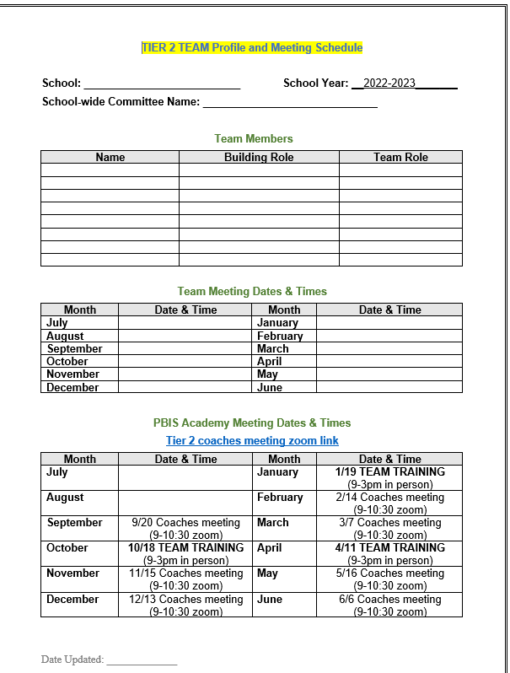
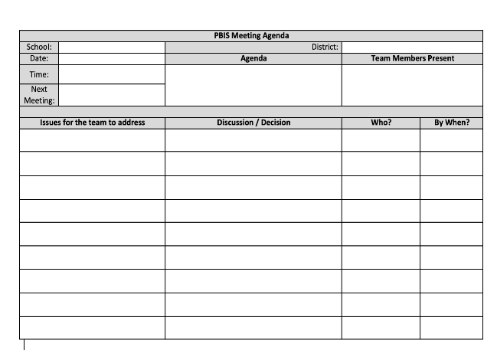
Team Profile and Action Plan
Team
Info
Select and begin using a team Action Plan
Notes:
In addition, there is an advanced annual action plan and is intended for schools in years 2 and beyond. Review with the team.
Tier 1
https://sebacademy.edc.org/annual-action-plan-template-advanced
Insert Tier 2 annual action plan

Slide 57
TEAM DISCUSSION: Team Features
1. Consider your current team membership and identify whether you need to invite any new members to make your team representative
2. Select and share your action planning document with team members
3. Confirm your regular (monthly) team meeting schedule
https://sebacademy.edc.org/list-of-pbis-resources
Now or later… Add to your school’s Glows and Grows
group slide deck ☺
Small group
5 minutes

Slide 58
Teams AND Teachers are Critical for Success!
A common misperception is that these strategies will “fix” the student and the classroom teacher does not need to be an active participant since “specialists” or outside staff are often involved in the intervention – it is important to stress that these interventions will require high level of involvement among ALL staff within the school building (Lewis, 2009).

Slide 59
WORK SMARTER/Integration and Alignment
Systems
How does Tier 2 fit with what is already in place in our school?

Slide 60
Do less,
better
Work
smarter!
Invest in a
sure thing
Do it once
Invest in clear
outcomes
Be strategic about problem solving

Slide 61
3-Tiered System of Support
Necessary Conversations (Teams)
Universal
Team
Targeted Systems Team
Problem Solving Team
Tertiary Systems Team
Plans SW & class-wide supports
Uses process data; determines overall intervention effectiveness
Standing team; uses FBA/BIP process for one youth at a time
Uses Process data; determines overall intervention effectiveness
Universal Support
CICO
SAIG
Brief
FBA/BIP
Complex
FBA/BIP
Group w/ individual
feature
WRAP
Brief FBA/BIP
Notes:
61
61
Team structure
Universal or Tier 1 PBIS team
Targeted or Tier 2 Systems team
Problem Solving team (SAT, SST, CST) – individual discussions about students (e.g., 2-3 students in a meeting) and more frequent meetings (e.g., weekly or biweekly)
*click* Tertiary or Tier 3 Systems team
How many are on that intervention and how many are responding
PROBLEM solving team - (2-3 kids in 60 minutes) more intensive
SAIG - social and academic intervention groups
CICO - Check in / Check Out
FBA - Functional Behavioral Assessment
BIP - Behavior Intervention Plan

Slide 62
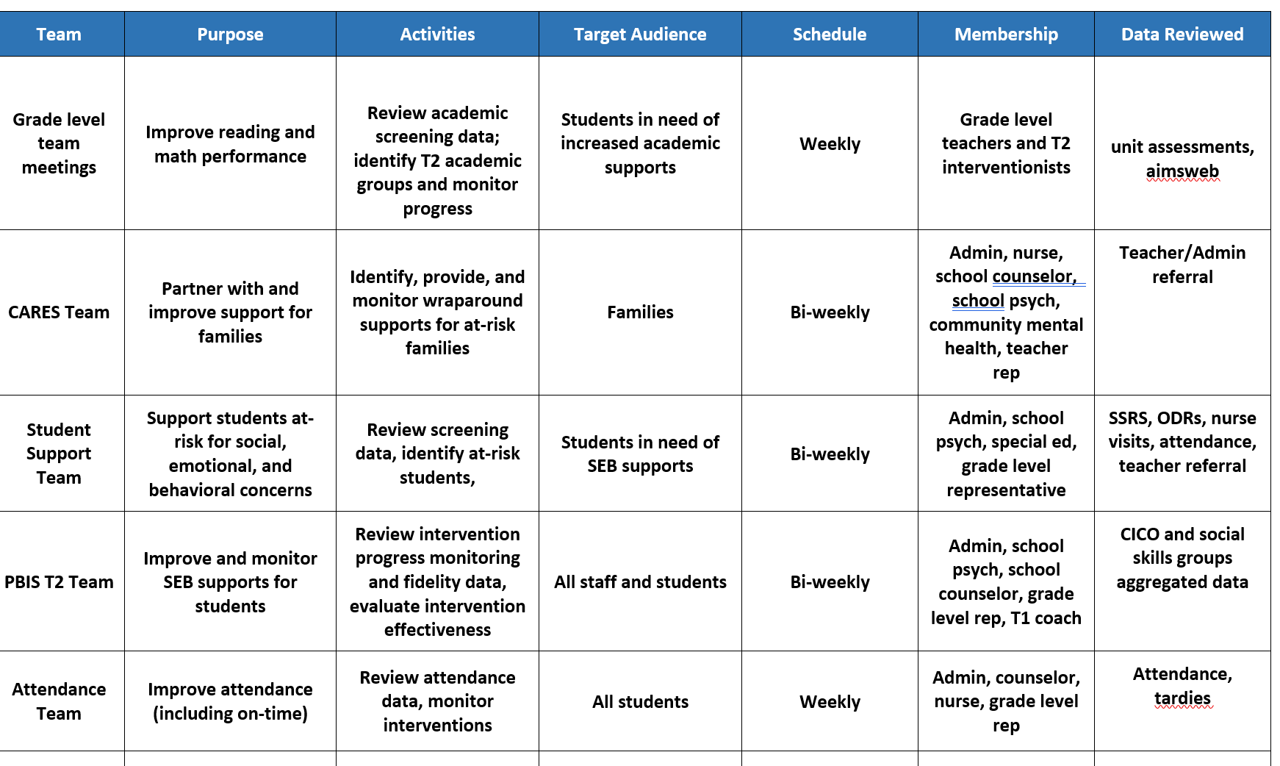
Working Smarter at Tier 2

Slide 63
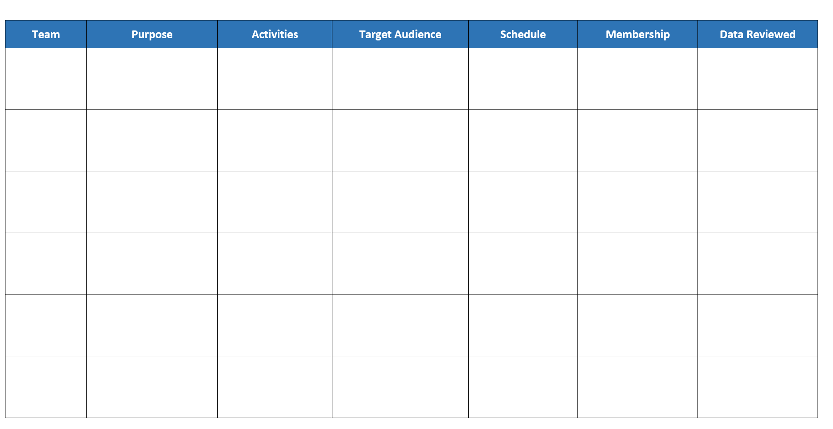
ACTIVITY: T2 Team Integration and Alignment
Go to the working smarter activity
Start inventory of your teams; discuss communication and integration
Consider items for your action plan
5 minutes
Notes:
TRAINERS – Activity prompt below; allow 10 minutes.
Split into breakout rooms
Navigate to nepbis.org
Select the “Tier 1 School-Wide” dropdown menu and click on the “Tier 1 Workbook and Supplemental Resources” page
Download Tier 2 Readiness Checklist
Review and discuss with your team, decide which activities/items are priorities
Add to your action plan

Slide 65
Step 2: Develop a collaborative process for identifying students

Slide 66
GETTING STARTED WITH Tier 2
Develop an equitable process for matching student need to practices
1
Establish a representative T2 leadership team
6
2
Develop a collaborative process for identifying students
Develop a process for progress monitoring, data-based decision rules
7
3
Evaluate, select and adopt culturally appropriate tier 2 practices
Develop procedures for modifying/ adjusting implementation
8
4
Develop a process to install selected practices
Develop evaluation routines for fidelity and outcome data
9
5
Develop procedures to train staff and students; partner with families and community
Document and share routines, practices, and policies
10
Notes:
COACHES:
Seeing all of these steps can be uncomfortable or overwhelming – the goal is to walk away with an understanding of the elements and need to prioritize time and resources to get the steps achieved over a period of time.

Slide 67
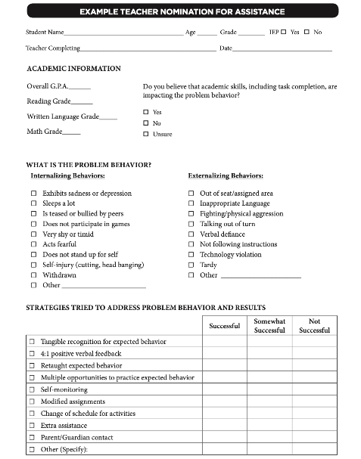
Methods for Identification
More to come in the November coaches’ meeting
Nomination
Data Decision Rules
Screening
Notes:
The process for identifying students for Tier 2 supports typically
relies on existing data sources
provides information regarding function of behavior
Methods for identifying students include
nomination
teacher/staff
parent
self
data decision rules
extant data
NOTE: screening data is wonderful, but we don’t have time to cover in this training. If you are interested, there are more resources in the syllabus, you can talk to your trainers, and also there are districts in the state who do use universal screening with whom you could connect

Slide 68
Methods for Identification
Gather information for the November coaches’ meeting
Nomination
Data Decision Rules
Screening
Do we have something simple?
What are some of our data sources?
Is the school using a universal screener?

Slide 69
Step 3: Evaluate & select Tier 2 interventions

Slide 70
GETTING STARTED WITH Tier 2
Develop an equitable process for matching student need to practices
1
Establish a representative T2 leadership team
6
2
Develop a collaborative process for identifying students
Develop a process for progress monitoring, data-based decision rules
7
3
Evaluate, select and adopt culturally appropriate tier 2 practices
Develop procedures for modifying/ adjusting implementation
8
4
Develop a process to install selected practices
Develop evaluation routines for fidelity and outcome data
9
5
Develop procedures to train staff and students; partner with families and community
Document and share routines, practices, and policies
10
Notes:
COACHES:
Seeing all of these steps can be uncomfortable or overwhelming – the goal is to walk away with an understanding of the elements and need to prioritize time and resources to get the steps achieved over a period of time.

Slide 71
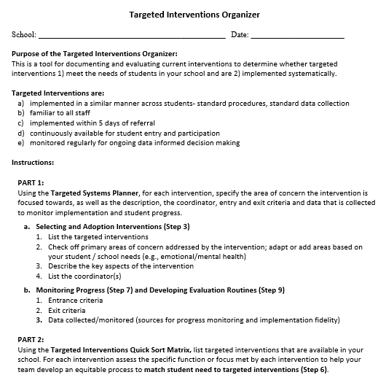
TARGETED INTERVENTIONS ORGANIZER
Systems
Purpose :
Document and evaluate current interventions
Determine whether targeted interventions
1) meet the needs of students, and
2) are implemented systematically
+ ENHANCED Communication
Notes:
The Targeted Interventions ORGANIZER gives teams some guidance to document and evaluate their current interventions.
During this process, we try to consider “fit” and “resources” in order to enhance, eliminate, or add interventions.
By establishing SYSTEMS, teams will be able to evaluate how meaningful and effective the interventions, if aspects need to be refined for them to work better, and what other interventions might be needed to address student needs.

Slide 72
GUIDING QUESTIONS when Evaluating Targeted Interventions
Systems
Targeted Interventions are implemented:
in a similar manner across students - standard procedures, standard data collection
by relevant staff AND familiar to all staff
within 5 days of referral
continuously available for student entry and participation
monitored regularly for ongoing data informed decision making
Notes:
We will begin by doing an “INVENTORY” or list of our targeted interventions.
But before or as you list each intervention, the team should consider “does it meet the criteria as a targeted intervention,” meaning:
It can be implemented in a similar manner across multiple students – standard procedures and standard ways of collecting data on student progress builds efficiency in the delivery of interventions and improves access for students.
It also means that all staff are at least familiar with the ‘menu’ of interventions available, and what their role might be in implementing or assisting in the intervention.
Tier 2 interventions are implemented within 5 days of a ‘referral’ meaning either a request/nomination by staff or review of data patterns such as behavioral referrals to the office, attendance, nurses visits, guidance visits, mid-term progress reports, etc. The key here quick access - being pro-active reduce risk rather than a ‘wait and see’ approach
Continuously available for student entry and participation – this means that students can begin an intervention at any point in the year, rather than wait for the intervention to become available (e.g., a spot in a social skills group facilitated by the school counselor).
Intervention can be monitored regularly using standard data collection procedures and that data are used for decision making (more to come about that)
If it meets this criteria, keep it on the list.
If it doesn’t, what might be needed to ‘round’ out the intervention (e.g., a uniform checklist that all teachers use, a way of collecting data when students attend a skills group)?

Slide 73
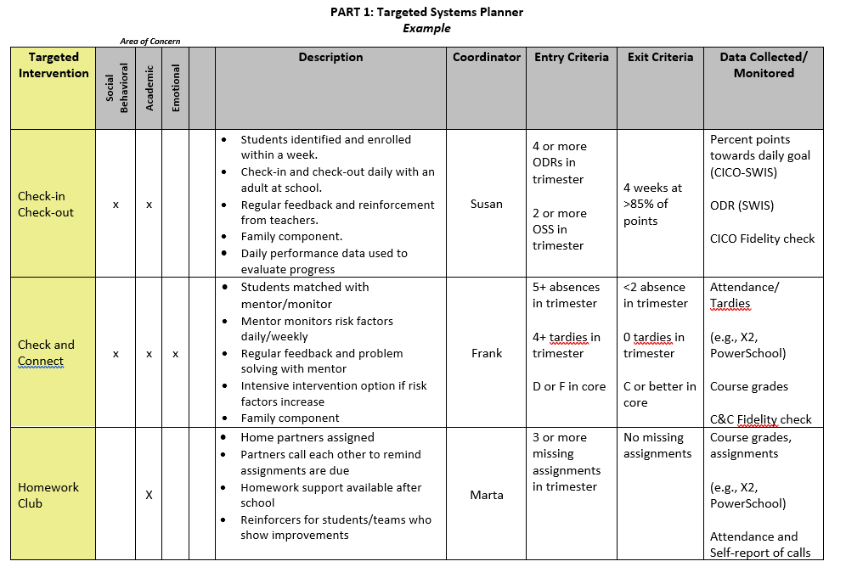
MEETING STUDENT NEEDS: PART 1
Notes:
Now we are ready for the TOOL
Part 1 is called the Targeted Systems Planner. This part provides teams with the chance to reflect on each intervention and how it may (or may not be) implemented systematically to provide meaningful outcomes.
On the left is the name of the intervention. Across the top some teams do a quick check off of whether they consider the intervention goals in area of concern (academic, social/behavioral, emotional or mental health focused).
This aligns well with Step 3 – select and adopt – first we need to see what we have and what global areas of concerns they address.
Then they describe the “essence” of the intervention – a few details and perhaps the purpose.
Teams might want to list the current year’s coordinator for each intervention to assist in planning and support for staff.
ADVANCED STEP: Sometimes teams expand the columns to show the frequency of the intervention (e.g., delivered daily, 1x per week, options of Monday or Wed). The name of the intervention, coordinator, and frequency of the intervention can also be something you put in a table at the end of the document if that seems easier.
The last three columns are areas you may not be quite ready for yet, but are critical for installing systems for data-based decisions.
Teams discuss what data will be considered to access or “enter” the intervention (e.g., ODRs, absences, missed assignments) and what data goal would indicate it’s time to “exit” or graduate from the intervention.
The last column reminds us of the data being collected to monitor implementation of the intervention (Fidelity) and student progress – what type of data, where can the team find the data that will be used to assess response to the intervention?
Reminders:
Don’t feel overwhelmed if your team doesn’t have each box filled in yet - that’s expected. Use this to identify those gaps and action plan as a team around a reasonable timeline to get aspects developed for ONE intervention.
Do that well and it will be easier to replicate for the next ones.

Slide 74
GUIDING QUESTION: GROUPING COMMON NEEDS
Systems
Do identified students have similar instructional needs?
Skills to develop vs. Skills to practice/improve using (skill deficits) (performance deficits)
Do identified students have both academic and emotional/behavioral needs?
Are identified students’ academic needs similar?
Are the functions of behavior (assessed informally) similar across students?
Notes:
When we think about how students might be grouped for targeted interventions, remember that we are considering the similar manner in which the intervention is delivered across students because of their need – so staff gain efficiency in intervention design, standard procedures, and standard data collection and multiple students receiving a standard intervention. It does not necessarily mean the intervention is always received in a group format. That can sometimes be confusing to school teams.
So we ask as a guiding question when we consider the TYPES of targeted interventions if there are common needs.
Common needs = standard, quicker access interventions and more groups of students getting support
Do identified students have similar instructional needs?
Do identified students have both academic and emotional/behavioral needs?
Are identified students’ academic needs similar?
Are the functions of behavior (assessed informally) similar across students? (meaning can we make some informed assumptions about what the function is and deliver an intervention that meets the function?)

Slide 75
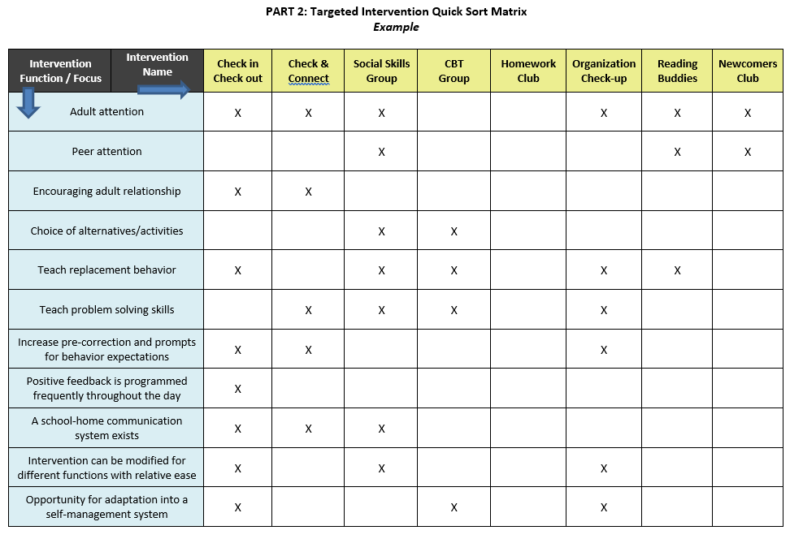
MEETING STUDENT NEEDS: PART 2
(Follow up in Jan)
Notes:
Part 2 is called the “Quick Sort Matrix”
So across the top we see the list of targeted interventions.
On the left side, we see the intervention focus and in some cases function. Essentially this is a quick way of seeing, in part 1, what interventions match to what need.
For example, Check in Check Out meets several student needs – it is well suited for students whose behavior is motivated by adult attention, and thus also serves to encourage adult relationships. CICO teaches students replacement behaviors such as how to gain attention appropriately. It’s structured to provide students with prompts and frequent feedback of behavioral expectations throughout the day by adults.
In this example, with an Organization Check-up, students will receive adult attention, but the primary purpose is to teach (weekly) problem solving strategies to help prepare academically and what we call replacement behaviors or other, more appropriate behaviors like scheduling meetings with teachers to access support instead of trying to avoid challenging tasks through missed assignments or disruptive behavior in class.
Some reminders as you complete this tool:
Typically, interventions will meet more than one of these needs or focus areas, but don’t expect it to meet all.
One size does NOT fits all – we need multiple interventions to meet multiple needs.
Schools do NOT begin with this many targeted social-emotional/behavioral interventions. It’s ok to only list a few to start the process.

Slide 76
ACTIVITY: Targeted Intervention Organizer
Using the Targeted Systems Planner (Part 1),
List the targeted interventions
Check off primary areas of concern addressed by the intervention; adapt or add areas based on your student / school needs (e.g., emotional/mental health)
Describe the key aspects of the intervention
List the coordinator(s)
* Complete other columns as you develop that feature
Now or later… Add to your school’s Glows and Grows group slide deck ☺
30 minutes
Notes:
TRAINERS – Prompts for activity below; allow 30 minutes. Emphasize baseline for action planning
Login to www.pbisapps.org
Click on PBIS assessments, then “open survey window.”
Click on SWPBIS TFI 2.1; “take survey”
Choose today’s date, team members w/o external coach, and no walkthrough
Complete only Tier 2 items as a team (2.1-2.13)
Add items to your action plan; remember this is just a baseline!

Slide 77
ACTIVITY: BASELINE TIER 2 TFI
Login to www.pbisapps.org
Click on PBIS assessments, then “open survey window.”
Click on SWPBIS TFI 2.1; “take survey”
Choose today’s date, team members w/o coach, and no walkthrough
Complete only Tier 2 items as a team
(2.1-2.13)
Add priority items to your action plan
* remember this is just a baseline!
PBIS TFI document
30-40 minutes
Notes:
TRAINERS – Prompts for activity below; allow 30 minutes. Emphasize baseline for action planning
Login to www.pbisapps.org
Click on PBIS assessments, then “open survey window.”
Click on SWPBIS TFI 2.1; “take survey”
Choose today’s date, team members w/o external coach, and no walkthrough
Complete only Tier 2 items as a team (2.1-2.13)
Add items to your action plan; remember this is just a baseline!

Slide 78
DISCUSSION: TFI DEBRIEF
What did you learn about Tier 2 systems (i.e., teams), practices (i.e., implementation), and data (i.e., evaluation)?
What is one item/action plan step that you will prioritize?
Add to your school’s Glows and Grows
5 minutes
Notes:
TRAINERS – Discussion prompts are below; allow 3 minutes.
What did you learn about Tier 2 systems, data, and practices?
What is one item/action plan step that you will prioritize?

Slide 79
Share and Wrap up

Slide 80
ACTIVITY: GLOWS & GROWS across teams
Identify something to celebrate (GLOW) & something you’re working on (GROW) related to three areas from today:
Teaming
T2 Targeted Interventions Systems Planner
TFI self-assessment
Share these items on the group slide deck ☺
15 minutes
Share by School

Slide 81
AGENDA & FOLLOW-UP
Presentation Content:
Overview
Coaches’ Tasks:
Once you have team meetings established, we can schedule to provide TA support (Nov/Dec)
Evaluating targeted interventions
Share docs
Teaming
What questions do you have on today’s content?
What questions do you have on the follow-up tasks?

Slide 82
EVALUATION
???
CONTACT INFORMATION:
Marcie Handler
mwhandler@gmail.com
Katie Meyer
Katherine.meyer@uconn.edu
Please remember to complete the evaluation to receive your Certificate of Attendance!
Notes:
Evaluation Link
https://edc.co1.qualtrics.com/jfe/form/SV_cBF9GI7gVEBsfSC

