Slide 1


PBIS School-Wide Coach Meeting
Year 3: October 2022
PBIS Track
TRAINER NAMES HERE
with support from NEPBIS Network, May Institute & Broad Reach Consulting
Notes:
Add trainer names for your event

Slide 2

EXPECTATIONS
Self
Others
Environment
Self-monitor
Mute when listening, unmute to talk​
Have your computer charged and ready to go​
If you have questions or comments:
Work as a team:
Keep necessary materials at hand
Are you participating?
Engaged as a learner?
Stretch, break, stand as needed​
unmute
use the chat box
Room for every voice
Reinforce participation
action plan
relevant docs
water/snacks
Minimize distractions if possible​

Slide 3
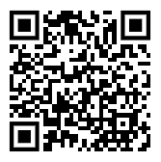
ACTIVITY: ATTENDANCE
Scan QR code on the left or follow the URL posted in the chat to access the online attendance survey
Follow prompts to enter attendance information
Notify trainers if you require assistance (e.g., identifying your cohort or cohort group)
Certificates of Attendance will be sent in January and June. Attendance records and Zoom log in will be use as verification
You are in Cohort 7
1 minute
Notes:
TRAINERS – QR Code is updated
Add your cohort number
Post a link to the attendance survey (below) in the chat for those who do not use the QR code on the slide:
ATTENDANCE: https://edc.co1.qualtrics.com/jfe/form/SV_5BiXqi4bxzOCMS2

Slide 4
Agenda & Coaches' Tasks
Coaches’ Tasks:
Presentation Content:
Glows & Grows: Goals for 22-23
Develop a logic model document with team for November Team training
Decide how and when to solicit staff, student & family input: Focus Group, Feedback & Input Survey, School Created Survey – Add to Action Plan
Feedback and Input Surveys
PBIS Assessments: Becoming a PBIS Assessment Coordinator
Prepping for November Roundtables

Slide 5
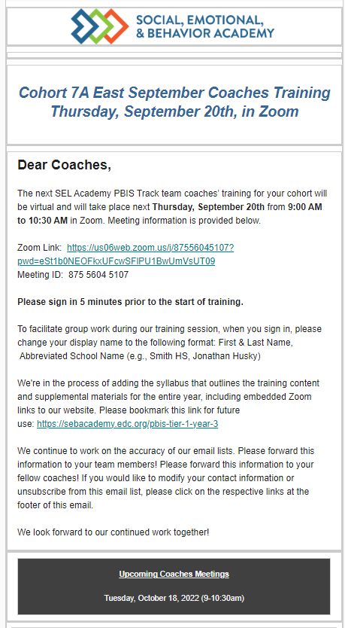
Event Reminders
Training or Coach Meeting Reminder
Are you receiving our Event Reminders?
Email Reminders will be sent to all coaches & administrators for Coach Meetings and to the full team for our Team Training Events.
The email will come from SEB Academy sebacademy@edc.org
If you are not receiving the email notifications please put your name and email in the chat
Next upcoming Training or Coach Meeting

Slide 6
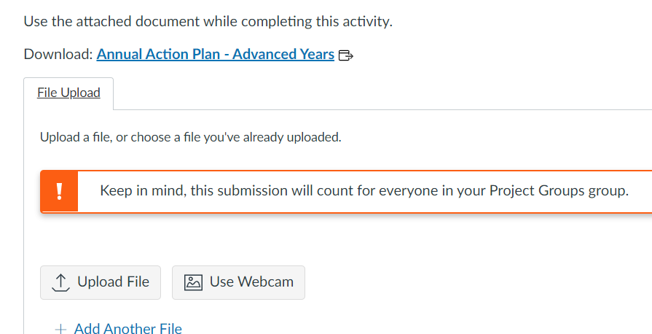
Canvas – For Coaches to Submit Documents
2.
Read Instructions for Assignment1234
Start Assignment
Download any documents still needed
Uploaded completed Document
1.
3.
If you have not received an invitation to join CANVAS please put your name and email in the chat
4.
Notes:
Review how to read directions and how to upload into canvas

Slide 7
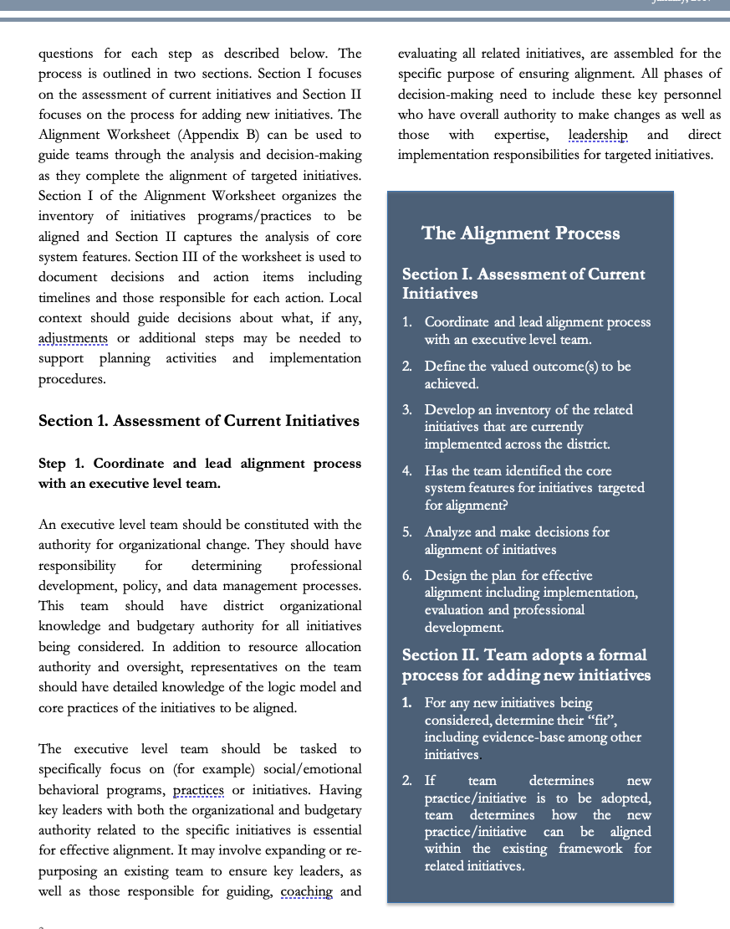
HELPFUL RESOURCES
RESOURCES:
PBIS Assessment User Manual
Feedback & Input Survey Manual
PBIS Assessment FREE PD Options
Logic Model Sample & Template
READINGS / Videos:
Overview of the Feedback and Input Survey
Consistent Process + Reliable Data = Better Results
Notes:
RESOURCES:
PBIS Assessment User Manual https://www.pbisapps.org/resource/pbis-assessment-users-manual
Feedback & Input Survey Manual https://www.pbisapps.org/resource/feedback-input-surveys-fis-manual
READINGS / Videos:
Overview of the Feedback and Input Survey https://www.pbisapps.org/articles/announcing-the-feedback-and-input-survey
PBIS Assessment FREE PD Options https://training.pbisapps.org/w/courses/cat-8-pbis-assessment/
Consistent Process + Reliable Data = Better Results https://www.pbisapps.org/articles/consistent-process-reliable-data-better-results

Slide 8
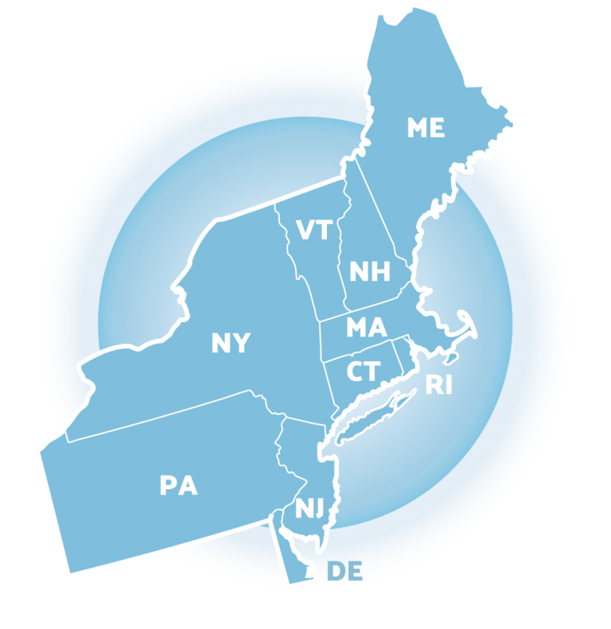
Glows & Grows:
Goals and Eval Planning
Notes:
12:30

Slide 9
DISCUSSION: GLOWS & GROWS
What is something to celebrate & something you’re working on related to:
Goals for this year (outcome goals or implementation goals)
Evaluation Planning
  Surveys
  Data Collection/Review
SHARE OUT: 1 Glow & 1 Grow
Independent Jot
Whole Group
5 minutes
10 minutes

Slide 10

PBIS
Resource Spotlight:
PBIS Assessment: Feedback and Input Surveys

Slide 11
MONITORING & EVALUATING PBIS PRACTICES
Use data to monitor the implementation & effectiveness of PBIS practices
Linked with meaningful outcome goals
Communicates purpose
Guides action planning
Used to measure and demonstrate progress
It is important to collect both Qualitative (feedback) and Quantitative (outcome) data

Slide 12
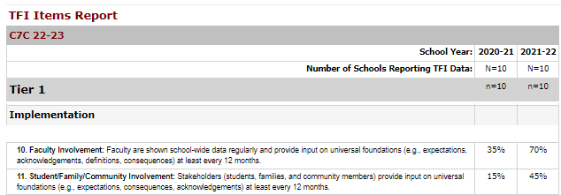
TFI 7C – Feedback and Input
TFI Questions 10 & 11: Teams typically report lower scores on these 2 questions
Staff Input (question 10)
3/10 Teams = 100%
7/10 Teams = 50% ut
Student/Family Input (question 11)
10/10 Teams = 0-50%

Slide 13
TFI 7A – Feedback and Input
TFI Questions 10 & 11: Teams typically report lower scores on these 2 questions
Staff Input (question 10)
2/6 Teams = 100%
4/8 Teams = 50%
2/8 Did not complete in 21/22
(Scores in 20/21 = 0-50%)
Student/Family Input (question 11)
1/8 Teams = 100%
5/8 Teams = 0-50%
2/8 Did not complete in 21/22
(Scores in 20/21 = 0-50%)

Slide 14
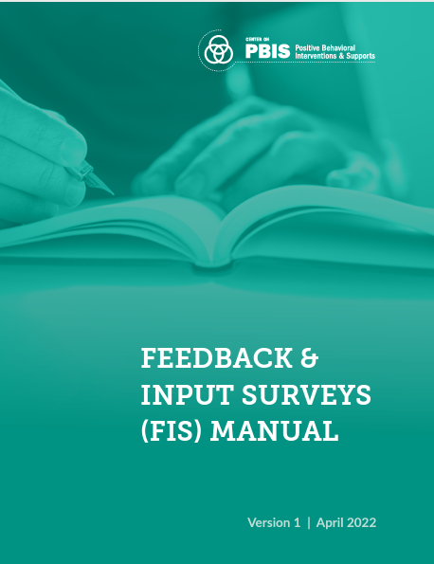
PBIS Assessment: Feedback & Input Surveys
The FIS is a set of four surveys to learn about how students, school personnel, and family members experience the school’s behavior support systems.
Surveys in the FIS include: (English & Spanish)
  Feedback and Input Survey: Elementary
  Feedback and Input Survey: Secondary
  Feedback and Input Survey: School Personnel
  Feedback and Input Survey: Family
Notes:
Feedback & Input Survey Manual https://www.pbisapps.org/resource/feedback-input-surveys-fis-manual

Slide 15
Climate Survey vs. Feedback & Input Survey
The School Climate Surveys are formal measures with strong evidence of reliability and validity for measuring quantitative perceptions of school climate.
The results are used to identify current status of school climate and to monitor progress over time. The School Climate Surveys are outcome measures.
The Feedback and Input Surveys give you more meaningful qualitative information about the experiences and suggestions of students, families, and school personnel. These surveys offer the entire school community a place to share their direct feedback with decision-makers.
The results are used to inform action plans to improve the effectiveness, efficiency, equity, and sustainability of Tier 1 behavior support systems. The Feedback and Input Surveys are feedback measures.

Slide 16
Quantitative vs Qualitative
Quantitative Research/Data
Use of statistics and “numbers” to measure variables, support hypothesis, make predictions, etc.
Uses directional verbs: effect, influence, cause, relate, etc..
Looks for “why”, ”to what extent”, etc.
Sample QT question:
What is the effect of PBIS in reducing ODRs in our school?
Qualitative Research/Data
Asks “what” or “how” questions in an open-ended design
Uses exploratory verbs: report, describe, discover, generate, explore
Looks for emergent themes from personal reports, focus groups, etc.
Sample of QL question (from Feedback Survey):
One thing teachers and staff could do better to improve behavior in my school is: ___________________

Slide 17
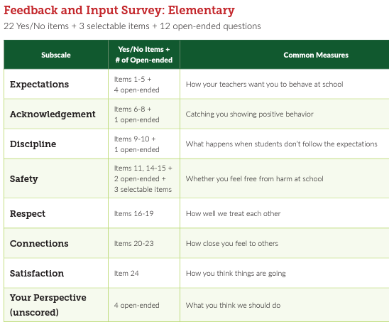
Student Surveys Elementary and Secondary
The student surveys are the same, but questions are phrased differently for the different age groups.
The secondary survey also has a few additional demographic categories
Elementary Grades: 3-6
Secondary Grades: 6-12

Slide 18
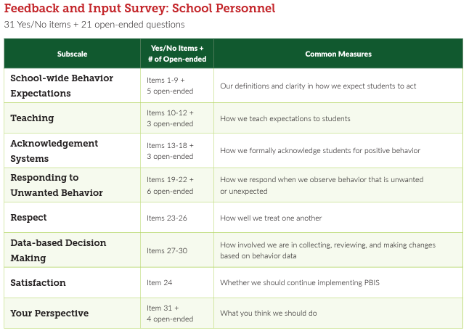
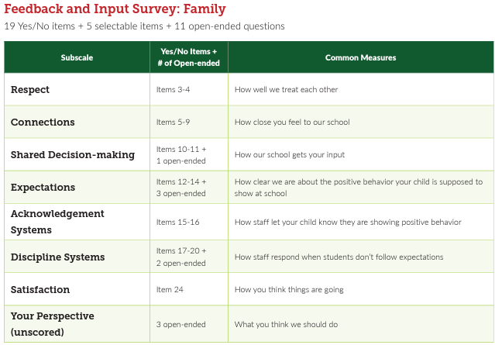
Staff and Family Input Surveys

Slide 19
DISCUSSION: Feedback & Input
Download & Review Feedback & Input Survey Manual.
Review Surveys (Appendix D – pgs. 20-48)
Would this information be valuable to your team?
Do you already collect this type of data? From all groups?
Which group would you most like to survey this year?
Independent Jot
Whole Group
10 minutes
10 minutes
Notes:
https://sebacademy.edc.org/annual-action-plan-template-advanced

Slide 20
Big Idea Check In:
Using PBIS Assessment for Evaluation Planning

Slide 21
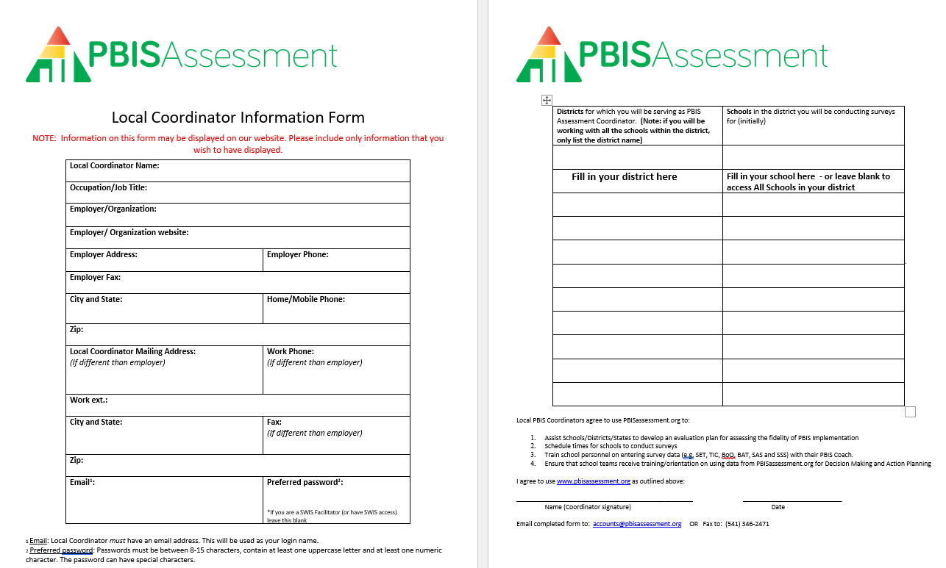
PBIS Assessments Coordinator
Did you complete form and send it in? If not, please download now and complete form and send to: accounts@pbisassessment.org
“Hello,
Please add me as a PBIS Assessment Coordinator. See attached form.
Thank you,”
Notes:
If they have not yet done so-----
Have coaches download this form from the EDC PBIS Resource page. https://sebacademy.edc.org/pbis-assessment-coordinator-form
Complete Form
Send it to accounts@pbisassessment.org with the script “Hello,
Please add me as a PBIS Assessment Coordinator. See attached form.
Thank you,”

Slide 22
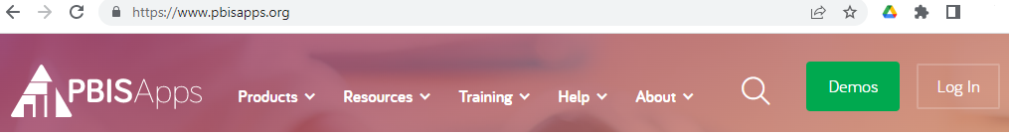
Let’s Log in to PBISApps
www.PBISApps.org
Notes:
TRAINER NOTE: Have coaches log onto PBIS Assessments and complete the tasks on the next page.
Walk them through logging on and demonstrate how to:
Review the open and closed surveys their dashboard.
How to VIEW REPORTS for one of their surveys.
How to OPEN a SURVEY drop down and choose a survey and set Open and Close Dates.
Delete Survey if it was a test or keep it to administer it.

Slide 23
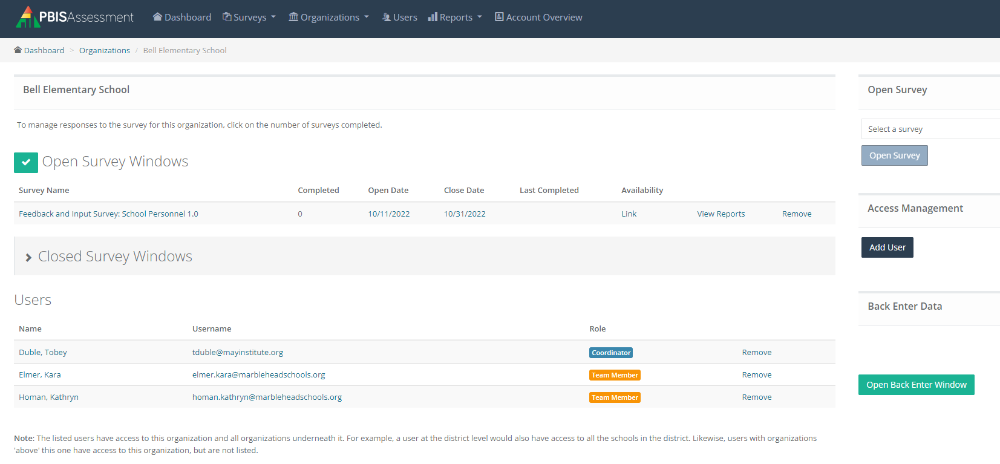
PBIS Assessment Dashboard
Open New Survey
Open and Closed Survey Windows
Add New
Users
Users
Notes:
Walk them through logging on and demonstrate how to:
Review the open and closed surveys their dashboard.
How to VIEW REPORTS for one of their surveys.
How to OPEN a SURVEY drop down and choose a survey and set Open and Close Dates.
Delete Survey if it was a test or keep it to administer it.

Slide 24
Practice: PBIS Assessment
Go to www.pbisapps.org and Log in.
Review the open and closed surveys for your school in your dashboard.
Click on VIEW REPORTS for one of your surveys.
Click on OPEN SURVEY drop down and choose a survey. Set Open and Close Dates.
Delete Survey if it was a test or keep it to administer it.
Together as a Group
15 minutes
Notes:
https://sebacademy.edc.org/annual-action-plan-template-advanced

Slide 25
Looking Ahead

Slide 26

NOVEMBER Team Training
7A – November 15th 8:30-2:30 - Marlborough
7C – November 16th 8:30-2:30 - Springfield
BIG IDEAS
Roundtable Sharing/Discussions
Classroom: Goals, Data, Assessments, & PD
PBIS Handbook Review

Slide 27
ROUNDTABLE DISCUSSIONS
Purpose: present one example of how you have used Systems, Data, and Practices to achieve a specific outcome.
Present to team members from other schools
Outline your school’s example using the logic model template (outcomes, systems, data, practices).
Be prepared to share and take notes.
Take new ideas back to your team for action planning!
Notes:
TRAINER NOTE: This is preparation of a sharing activity for the November Team Training
Instructions for roundtable prep below:
Outline your school’s example using the template (outcomes, systems, data, practices).
Be prepared to share and take notes.
Take new ideas back to your team for action planning!

Slide 28
School: ___________________________
Identify an outcome to focus on for this activity. For example:
Decrease ODRs on the playground
Increase consistency of response to behavior to ensure equity
Increase family engagement
How do we sustain this?
OUTCOME
Enter systems changes you made to help achieve your goal
Enter what dataa source you used to identify your goal and evaluate the results
How do we know we are doing what we say we are doing? How do we know it is working?
SYSTEMS
DATA
How do we support staff to
implement this with fidelity?
What is one highlight
associated with this outcome?
__________________________________
__________________________________
What is one lesson learned?
__________________________________
__________________________________
Enter Practices taught to achieve your goal
What are we doing?
What do we want to be doing?
PRACTICES

Slide 29
Lincoln School Logic Model
OUTCOME
How do we sustain this?
Explicit expectations taught & retaught, monitors trained and overlap with staff for first month, zones created & assigned to staff
Reduce injuries and referrals during recess
Recess monitors taught expectations with students at the start of the year. Four playground zones were created and staff were assigned to each zone and active monitoring was modeled by school staff for the first 3 weeks of school.
DATA
Office referrals, visits to the nurse, recess monitor weekly survey
How do we support staff to
implement this with fidelity?
SYSTEMS
What is one highlight
associated with this outcome?
Office referrals and injuries at recess have decreased. Monitors are more engaged with students and spend less time talking to one another.
What is one lesson learned?
Arranging schedules to overlap with monitors to train and model was challenging but critical.
Active monitoring at recess, expectations for behavior and use of equipment explicitly taught, each monitor acknowledges 5 students per recess for appropriate behavior
How do we know we are doing what we say we are doing? How do we know it is working?
What are we doing?
What do we want to be doing?
PRACTICES

Slide 30
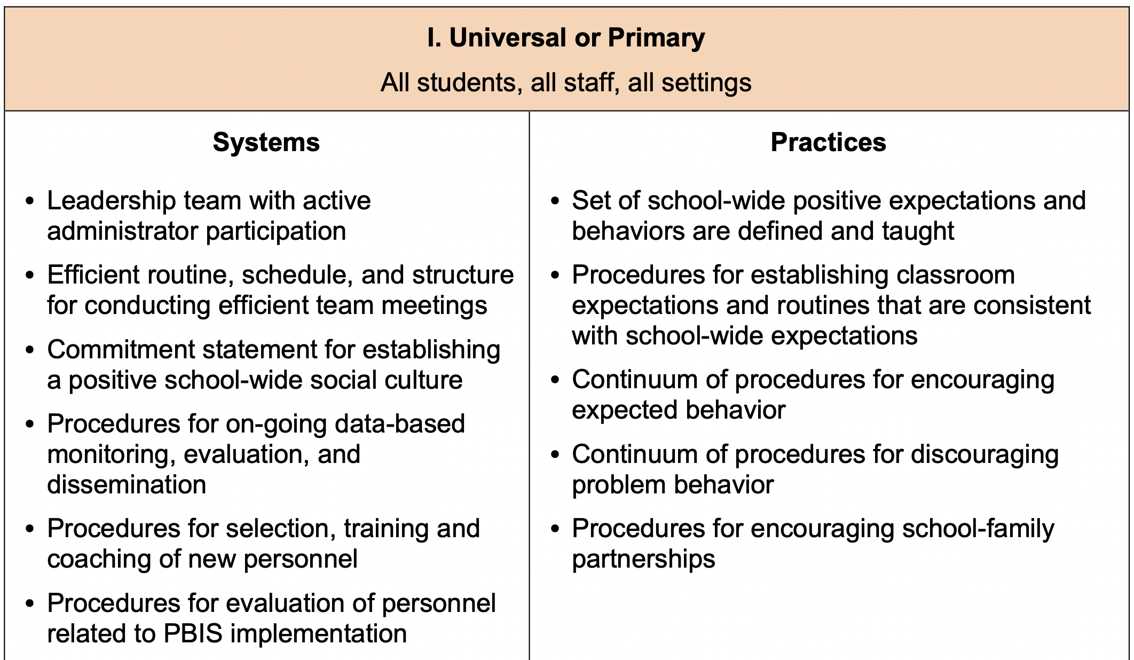

Slide 31



Washington School Logic Model
Outcome:
Increase consistancy in our ODR system to ensure equicty across our students
Systems
Clear definitions for problem behaviors both Major and Minor with examples.
Discipline Flow Chart updated to ensure all staff understand the strategies and process of behavioral management techniques before writing a referral.
Staff PD on how to write up a referral. Staff reviewed sample discipline scenarios to determine if it is a Minor, Major or a simple correction with no write up.
Discipline definitions and flowchart added to school handbook.
Data
Team examines equity reports monthly in SWIS as well as the drill down tool to ensure discpline is not disproportionate amongst different groups of students.
Data is shared with staff during faculty meeting to determine next steps
Highlight: Our ODR’s decreased signifantly once staff truly understood what should be a Major or Minor and after feeling comfortable with using the responding techniques that were practiced during PD
Lessons Learned:
Adults need lots of practice at writing referrals and keeping it unemotional.
Staff need lots of training and coaching on how to use behavior management
Practices
Teachers utilize the following:
Cool down space
Redirection/proximity/planned ignoring
Movement breaks
Mindfulness activities.
Only write up behaviors that fit a definition a Major

Slide 32
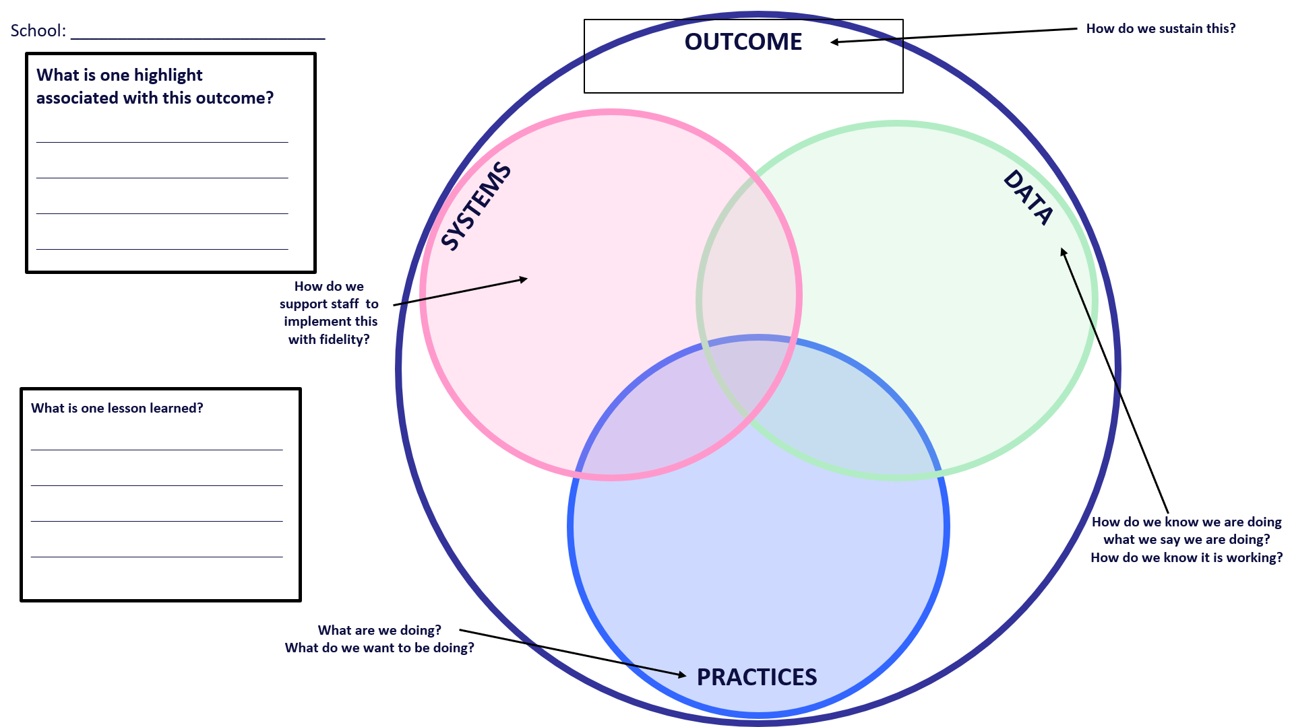
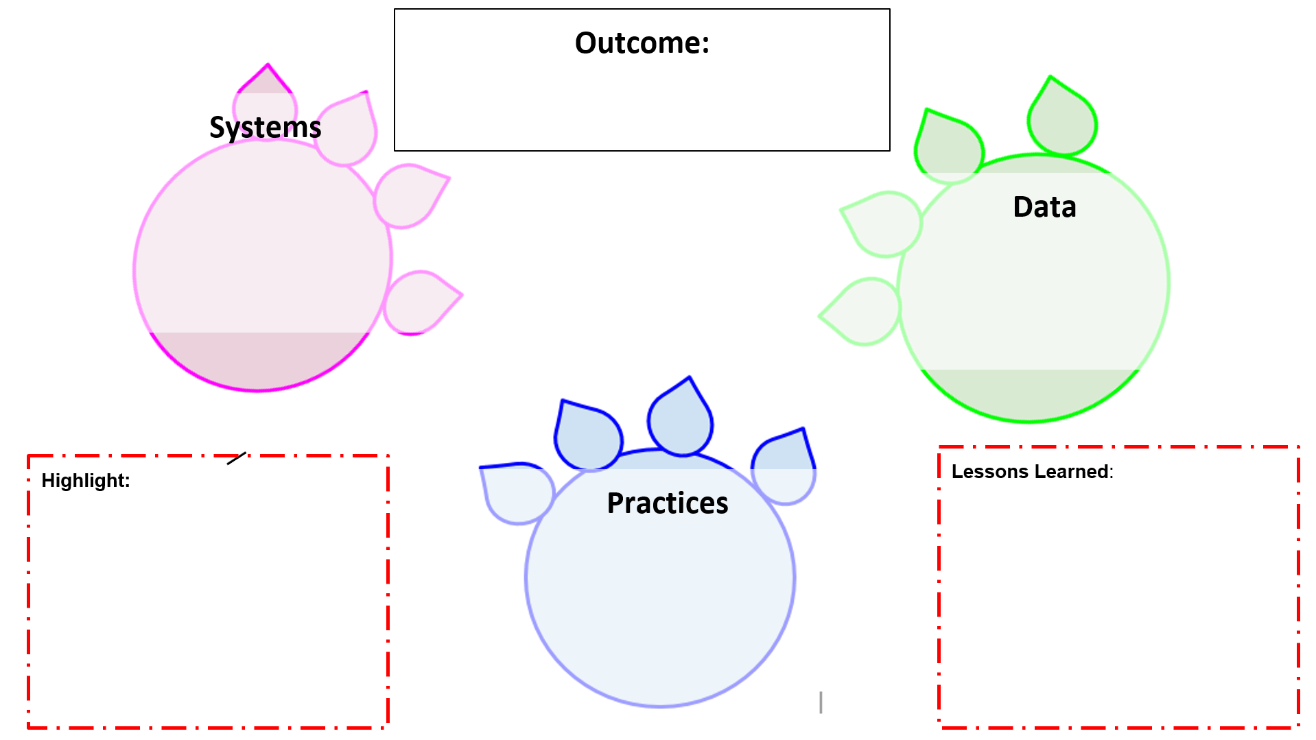
Optional Templates
Use one of these templates to organize your example. You may also create a word or other document.
Please ensure each member of your team has a copy and understands your example so they can share with others.

Slide 33
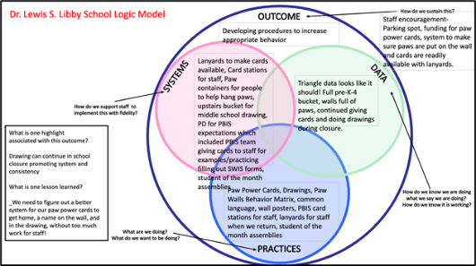
ACTIVITY: PLANNING ROUNDTABLES
Review roundtable template and examples.
Brainstorm potential outcomes you may want to target to highlight your school/team’s PBIS efforts.
What questions do you have?
Schedule a time to meet (or communicate) with your team to plan what your school wants to share.
All team members should have a copy
Find Logic Model Directions, Samples and Template on Website Resources
Co-coaches 5 minutes
Questions/full group 5 minutes
Notes:
Logic Model Directions, Samples and Template https://sebacademy.edc.org/pbis-logic-model-activity-directions-samples-and-template
TRAINER: Activity prompt below; allow 5 minutes
Review roundtable template and examples.
Brainstorm potential outcomes you may want to target to highlight your school/team’s PBIS efforts.
What questions do you have?
Schedule a time to meet (or communicate) with your team to plan what your school wants to share

Slide 34
Agenda & Coaches' Tasks- Debrief
Coaches’ Tasks:
Presentation Content:
Glows & Grows: Goals for 22-23
Decide how and when to solicit staff, student & family input: Focus Group, Feedback & Input Survey, School Created Survey – Add to Action Plan
Feedback and Input Surveys
PBIS Assessments: Becoming a PBIS Assessment Coordinator
Prepping for November Roundtables
Develop a logic model document with team for November Team training
What questions do you have on today’s content?
What questions do you have on the follow-up tasks?

Slide 35
HELPFUL RESOURCES
RESOURCES:
PBIS Assessment User Manual
Feedback & Input Survey Manual
PBIS Assessment FREE PD Options
Logic Model Sample & Template
READINGS / Videos:
Overview of the Feedback and Input Survey
Consistent Process + Reliable Data = Better Results
Notes:
RESOURCES:
PBIS Assessment User Manual https://www.pbisapps.org/resource/pbis-assessment-users-manual
Feedback & Input Survey Manual https://www.pbisapps.org/resource/feedback-input-surveys-fis-manual
READINGS / Videos:
Overview of the Feedback and Input Survey https://www.pbisapps.org/articles/announcing-the-feedback-and-input-survey
PBIS Assessment FREE PD Options https://training.pbisapps.org/w/courses/cat-8-pbis-assessment/
Consistent Process + Reliable Data = Better Results https://www.pbisapps.org/articles/consistent-process-reliable-data-better-results

Slide 36
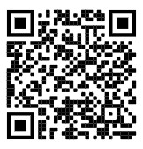
https://edc.co1.qualtrics.com/jfe/form/SV_cBF9GI7gVEBsfSC
EVALUATION
Please remember to complete the evaluation!
Scan the QR code to access.
Notes:
TRAINERS -
Put link to evaluation (below) in the chat for those who do not use the QR code:
https://edc.co1.qualtrics.com/jfe/form/SV_cBF9GI7gVEBsfSC

