Slide 1


PBIS School-Wide Team Training
Year 2: October 2022
PBIS Track
Christine Downs & Marcie Handler
with support from NEPBIS Network, May Institute & Broad Reach Consulting
Notes:
Add trainer names for your event

Slide 2
Agenda & Team Tasks
Team time
Team Tasks
Presentation Content
Tier 1 Foundation Check
Classroom PBIS Practices
Identify a targeted data driven outcome measure to focus on this year.
Sharing: Teaching Expectations
Share w/Trainer: Updated Action Plan with Goal Statement.
Function of Behavior
Plan current use of Classroom PBIS practices in your building.
Goal Setting / Precision Problem Statement
Plan how to integrate function of behavior content in your PD this year.
We’ve planned 90 mins of team time during this training event

Slide 3

HELPFUL READINGS & RESOURCES
RESOURCES:
Working Smarter Matrix
Start With Why: How to Put Purpose Back in Your Work
Supporting & Responding to Student Behavior
Motive, Motivate, Motivation: Why are my students doing that?
Supportive Environments Create Classroom Community
Classroom Support Systems Brief
Notes:
Working Smarter Matrix: https://nepbis.org/wp-content/uploads/2020/09/Working-Smarter-Activity.docx
Classroom Support Systems Brief: https://www.pbis.org/resource/pbis-technical-brief-on-systems-to-support-teachers-implementation-of-positive-classroom-behavior-support
Putting the Purpose back in your work: https://www.pbisapps.org/articles/start-with-why-how-to-put-purpose-back-in-your-work
Supporting & Responding to Student Behavior: https://www.pbis.org/resource/supporting-and-responding-to-behavior-evidence-based-classroom-strategies-for-teachers
Motive, Motivate, Motivation: Why are my students doing that? https://www.pbisapps.org/articles/motive-motivate-motivation-why-are-my-students-doing-that
Supportive Environments Create Classroom Community: https://www.pbisapps.org/articles/supportive-environments-create-classroom-community

Slide 4

EXPECTATIONS
Self
Others
Environment
Self-monitor
Listen while others are speaking​
Have your computer charged and ready to go​
If you have questions or comments:
Work as a team:
Keep necessary materials at hand
Are you participating?
Engaged as a learner?
Stretch, break, stand as needed​
Raise hand
Room for every voice
Reinforce participation
action plan
relevant docs
water/snacks
Minimize distractions if possible​

Slide 5
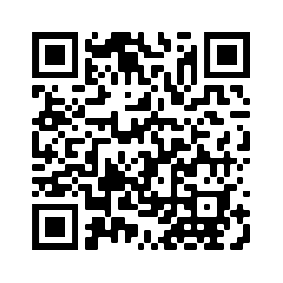
ACTIVITY: ATTENDANCE
Scan QR code on the left or follow the URL posted in the chat to access the online attendance survey
Follow prompts to enter attendance information
Notify trainers if you require assistance (e.g., identifying your cohort or cohort group)
Certificates of Attendance will be sent in January and June. Attendance records will be use as verification
You are in Cohort 8
1 minute
Notes:
Link to attendance form is here: https://edc.co1.qualtrics.com/jfe/form/SV_5BiXqi4bxzOCMS2
Add your cohort number
Post a link to the attendance survey (below) in the chat for those who do not use the QR code on the slide:
ATTENDANCE: https://edc.co1.qualtrics.com/jfe/form/SV_5BiXqi4bxzOCMS2

Slide 6
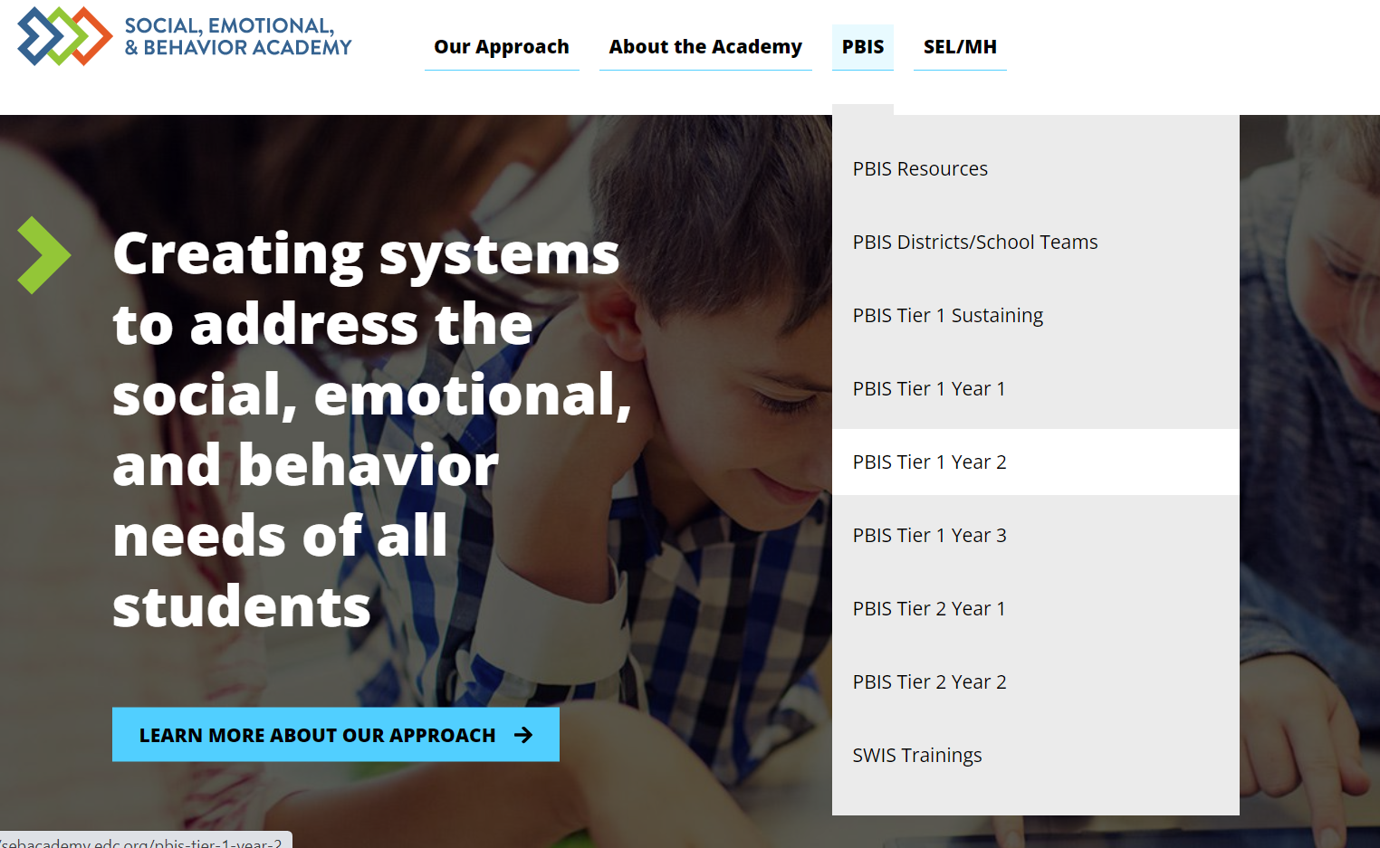
SEB Academy – PBIS Track Website
https://sebacademy.edc.org/

Slide 7

Four Points by Sheraton Norwood,
Boston-Providence Turnpike, Norwood, MA
https://www.mayinstitute.org/services-for-schools/pbis/forum.html

Slide 8
REVIEW:
Statement of Purpose / Goal Setting
Notes:
TRAINER NOTE: This is review content please be brief

Slide 9
Why are we doing this?

Slide 10




Purpose statement identifies WHY you are implementing PBIS at your school
Ensure all students develop the social-emotional-behavioral (SEB) skills needed to be effective learners through the implementation of evidence-based interventions and use of data to inform decisions.
Positively stated
2 to 3 sentences in length
Supportive of academic achievement and social-emotional-behavioral (SEB) health
Comprehensive in scope (relevant to all students, staff & settings)
We will have a positive climate.
To develop and implement universal systems and interventions supporting the academic and social success of each student.

Slide 11
Purpose Statement Considerations
Purpose Statement
Action Plan Outcome Goals
School/District Improvement Plans
Working Smarter Matrix (e.g. resource allocation)
Feel free to revisit your working smarter matrix!
Notes:
SIP = School Improvement Plan

Slide 12
PBIS PURPOSE STATEMENT
What would it look like if all students developed the SEB skills needed to be effective learners?
Example:
Ensure all students develop the social-emotional-behavioral (SEB) skills needed to be effective learners through the implementation of evidence-based interventions and use of data to inform decisions.
behavior referrals and exclusionary discipline would decrease
disproportionate discipline would decrease
students would be in class consistently
all students would meet academic standards

Slide 13
How will we get there?

Slide 14
Critical Features of PBIS
Systems
Practices
Data
Equity
Make student growth and benefit central to all decisions. Student outcomes that reflect equitable learning opportunities must be the ultimate criteria for all decisions.
Outcomes

Slide 15
Outcomes tell us if we achieve our purpose and guide framework implementation
As a result of implementing PBIS during the 20XX-20XY school year, student reports of school climate will improve by 20%
Based on data
Locally important and meaningful
Applicable to all (culturally equitable)
  Students’ social competence and academic achievement
  Staff implementation of critical skills
Observable and measurable
Written as a goal

Slide 16
Outcomes are our GOALS for implementation
Based on data
Locally important and meaningful
Applicable to all (culturally equitable)
  Students’ social competence and academic achievement
  Staff implementation of critical skills
Observable and measurable
Written as a goal
As a result of
implementing PBIS,
student behavior will improve, and the school will feel better.
As a result of implementing PBIS during the 20XX-20XY school year, student reports of school climate will improve by 20%
As a result of implementing PBIS during the
20XX-20XY school year, behavior incident data will decrease by __% relative to that same period the prior year.

Slide 17
What would it look like if all students developed the SEB skills needed to be effective learners?
As a result of implementing PBIS during the 20XX-20XY school year:
behavior incidents will decrease by __% relative to the same period as the prior year.
incidents of exclusionary discipline (suspension/expulsion) will decrease by __ % relative to the same period as the prior year
Behavior referrals and exclusionary discipline would decrease
disproportionate discipline would decrease
students would be in class consistently
all students would meet academic standards
use of disproportionate discipline will decrease by __%
% of students who are chronically absent will decrease by __%
% of students meeting grade level academic standards will increase by __%

Slide 18
Identifying Outcomes/Goals
What outcomes are you hoping to achieve this year?
(Consider BOTH implementation fidelity and student outcomes)
Step 1: Develop evaluation questions.
Step 2: Identify indicators or measures.
Step 3: Develop methods for collecting & analyzing indicators.
What do you want to know?
What information can be collected?
How/when should information be gathered?
Step 4: Make decisions and action plan from analysis of indicators.
How will the question be answered & what should be done next?

Slide 19
ACTIVITY: DEFINING PURPOSE AND OUTCOMES
As a team, review your team’s identified goal or purpose statement for PBIS implementation in your school.
Consider how you can support your team to use your team’s hope/goal to develop a purpose statement and determine 2-3 observable, measurable outcome statements as goals for next year..
Identify how your purpose statement and outcomes can be shared with stakeholders and used to support rollout.
Be ready to share your purpose statement and 1 goal.
15 minutes
Notes:
TRAINER NOTE: Remember last year folks prepared a hope / goal statement. Shifting this goal / purpose statement to be more data driven this year.

Slide 20
SELF CHECK:
Foundational elements of PBIS
Notes:
TRAINER NOTE: This is review content please be brief

Slide 21

QUICK REFRESHER: Teaming and Purpose
Establish an effective and representative leadership team
Develop brief statement of behavioral purpose
Membership representative of school community including administration?
Meeting at least monthly with agenda, minutes, action plan?
PBIS identified as a top priority with allocated time for team to share with staff?
Does the statement match the primary outcome(s) of PBIS implementation in your school?
Is it positively stated, short, and comprehensive?
Do staff know it exists and why it was created?
Learn More:
Tier 1 Coordination and Problem-Solving Team Meeting Foundations and
Action Planning
Establish Leadership Team
Notes:
TRAINERS: At the end of each refresher slide, prompt participants to jot down their responses to the questions.
Video on Team Meeting Foundations https://youtu.be/zs2z6dVtX1I
Team Profile https://sebacademy.edc.org/tier-1-team-profile-and-pbis-meeting-schedule-activity

Slide 22
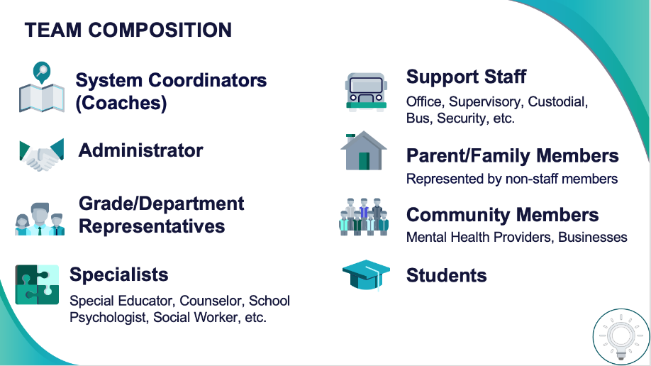

Establish an effective leadership team
Develop a brief statement of purpose & define outcomes
1
2
"Our mission is to provide a positive, safe, healthy, nurturing and respectful environment in which all students have the opportunity to become productive members of society."
Purpose
“As a result of implementing PBIS during the 20XX-20XY school year, student reports of school climate will improve by 20%.”
Outcome
Notes:
Your first step is to create a representative team to lead your school’s PBIS efforts.

Slide 23
QUICK REFRESHER: Developing and Teaching School-wide Expectations
Identify positive SW behavioral expectations
Do you have 3-5 positively stated expectations?
Do they match your school context?
Have your stakeholders helped to create them or provided feedback and know what they are?
Develop procedures for teaching SW expectations
Have you developed a teaching matrix with participation from all stakeholders?
Is there a teaching calendar with lesson plans created?
Have booster sessions been planned for reteaching?
Additional Videos:
Creating school wide expectations
Teaching expectations
Notes:
https://www.youtube.com/watch?v=QQCaKy6U50s&feature=youtu.be
https://youtu.be/K1DCgiJiIGk

Slide 24
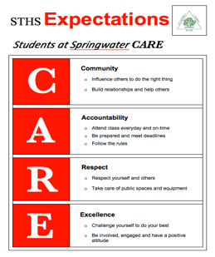
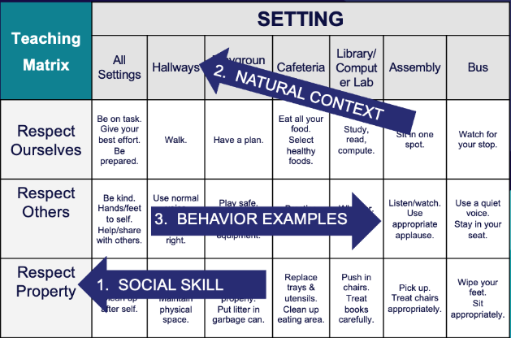

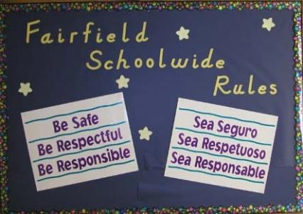
Identify positive school-wide behavior expectations
Develop procedures to teach school-wide expectations
3
4
Define
Teach
Prompt
Monitor
Evaluate
Notes:
Your team will work with your school community to uncover what you value and use those values to identify your schoolwide expectations

Slide 25
QUICK REFRESHER: Responding to Behavior
Develop continuum for strengthening appropriate behavior
Develop continuum for discouraging violations of expectations
Have you developed an efficient acknowledgement system that provides predictable, relevant feedback to students?
Have you gathered input from staff, students and families?
Are you acknowledging staff for their efforts?
Have you defined and determined which behaviors are staff vs. office managed?
Have you created a flowchart of ways to respond to undesired behavior and taught staff how to use it?
How are you documenting behavior violations for decision-making and interventions?
Additional Videos:
Developing acknowledgement systems
Responding to challenging behavior: Major v minor
Responding to challenging behavior: Discipline flow chart
Responding to challenging behavior: Referral form and data collection
Notes:
https://youtu.be/7M1OfJYMPcg
https://youtu.be/6-w19VJu1RU
https://youtu.be/ZJCU28XSLqQ
https://youtu.be/hq8kfsJLADQ

Slide 26
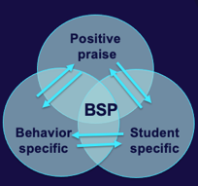
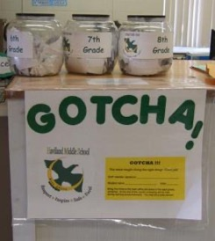
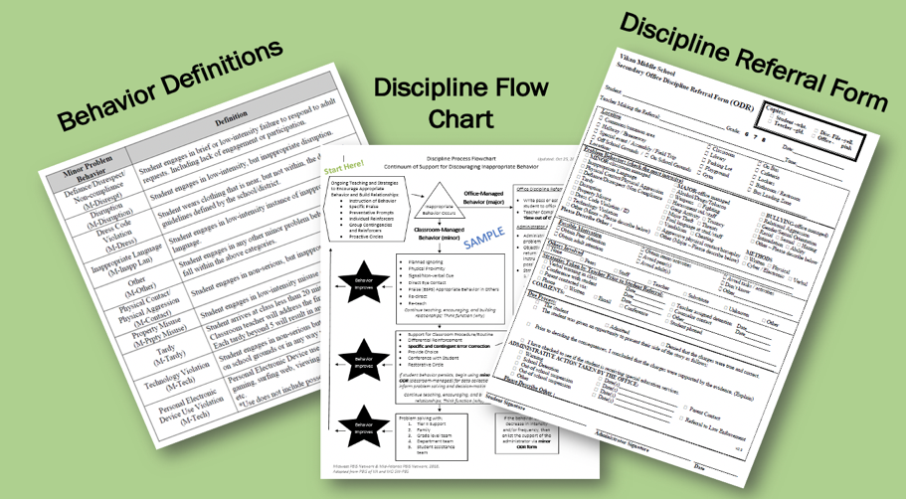
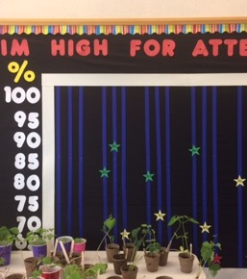
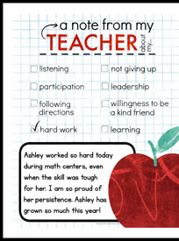
5
Develop a continuum to strengthen expectations
6
Develop a continuum to discourage violations
Notes:
To encourage contextually appropriate behaviors to occur, you'll support educators to provide frequent specific feedback and praise. To promote this critical practice, you’ll develop recognition/acknowledgement systems for both students and staff.

Slide 27
QUICK REFRESHER: Systems Check [Steps 7-10]
What is your efficient process for collecting student outcome data?
Develop data-based procedures for monitoring
Build routines to ensure on-going implementation
Develop systems to support staff
What structures and routines are in place to ensure regular review and sharing of data?
How are you monitoring the fidelity and effectiveness of PBIS implementation?
How are you gathering your staff voice as your implementation continues?
When do staff get to view outcome and fidelity data?
How are staff being trained in and supported with PBIS?
How will you continue to increase staff capacity?
How can PBIS be integrated into your school routines and systems?
What plans need to be made for next year?
Are systems formally documented (in writing)?
Additional Videos:
Data decisions & monitoring
Developing systems to support staff
Notes:
https://youtu.be/IvpbUWvl44g
https://www.youtube.com/watch?v=VE94EWTJo4Y&feature=youtu.be

Slide 28
TEAM TIME
Meet with your team and discuss action steps related to the systems check content:
1. Review and update your action plan document so your team can identify what is still needed to complete and what has been completed?
2. Has your team completed the Tiered Fidelity Inventory (TFI) in the Spring? If so, please use your action plan created to help guide this process.
Based on your discussions... Update your team's action plan!
Prepare to share 1 new action item or goal from your discussion.
Teams
30 minutes

Slide 29
SHARE OUT
What was one action item related to the 10 getting started steps you will work to complete?
10 minutes
Whole Group

Slide 30
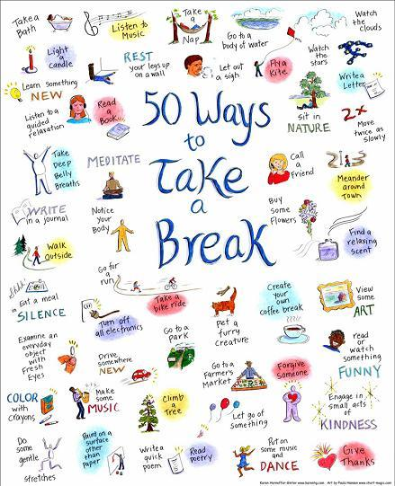
10-minute break

Slide 31
SHARING:
TEACHING EXPECTATIONS

Slide 32
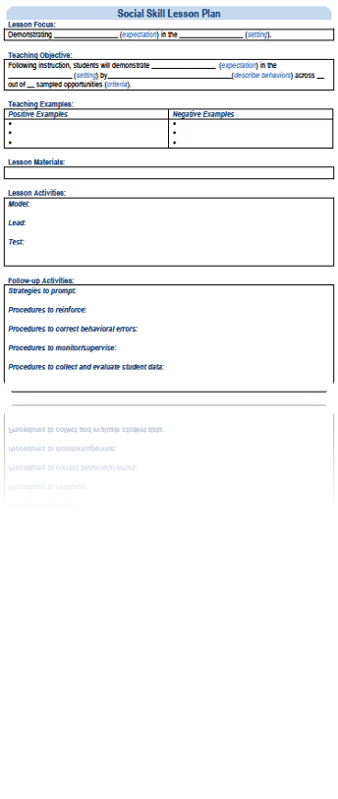
SHARING: How have you taught school-wide expectations to your students?
Suggested items for sharing with others today.
What is your lesson plan format?
How were lesson plans reviewed with faculty in advance of lesson plan delivery?
How were students involved in the lesson planning?
What went well this year? And what would you like to change for next year?

Slide 33
ACTIVITY: CROSS-SCHOOL SHARING
1. Randomize participants into 4 or 5 groups.
2. In each group take turns sharing how your school taught your expectations to your students, describe your lesson plan and teaching format, activities (4 or 5 mins).
3. Ask questions and take good notes.
4. Bring new examples back to your team for action planning!
20 minutes
Randomized Groups
Notes:
TRAINER NOTE: Please make sure that your zoom settings are set to allow screen sharing for all participants.

Slide 34
FUNCTION OF BEHAVIOR

Slide 35
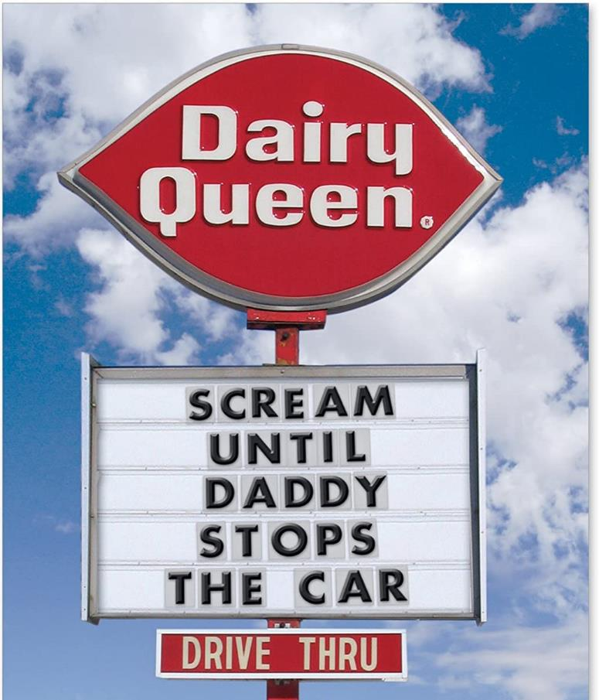
Before we can effectively encourage or discourage behavior, we need to understand why behavior happens AND how to identify why the behavior is continuing!

Slide 36
A basic understanding of the science of behavior change:
Gives us tools to observe, measure, teach, and correct behaviors effectively and efficiently.
Moves us away from perceptions, opinions, and assumptions about motivations or intentions
Shares the following assumptions (see right)
Behavior is communication.
Behavior occurs in the context of an antecedent and consequence.
Behavior is learned (function).
Behavior is lawful (function).
Behavior is escalated through successive interactions (practice).
Behavior can be changed through an instructional approach.
(Colvin & Sugai, 1989)

Slide 37
BUILDING BLOCKS OF BEHAVIOR: Three Term Contingency
What typically precedes?
What do the behaviors look like?
What typically follows?
Antecedent
Behavior
Consequence
Based on observing patterns across time,
we can infer the probable function of behavior.

Slide 38
All behavior serves a function...
Get/Obtain
desired activities
tangible items
Avoid/Escape
aversive activities
tangible items
attention
sensory stimulation
attention
sensory stimulation
“Function” = outcome, result, purpose, consequence

Slide 39
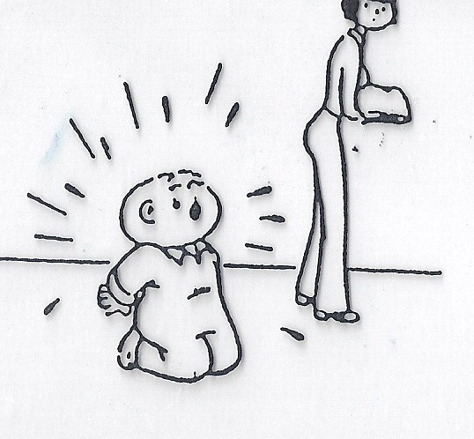
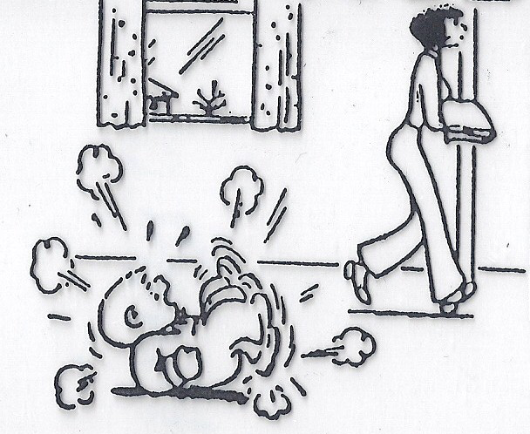
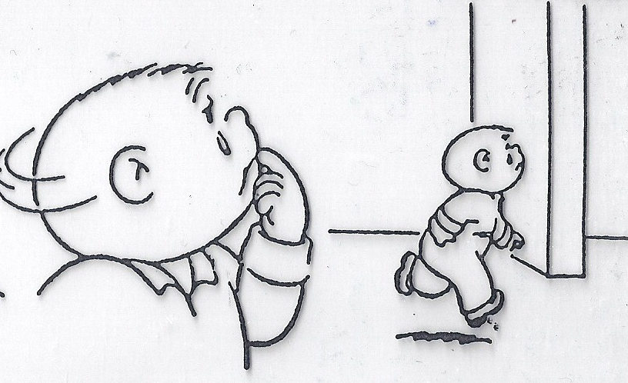
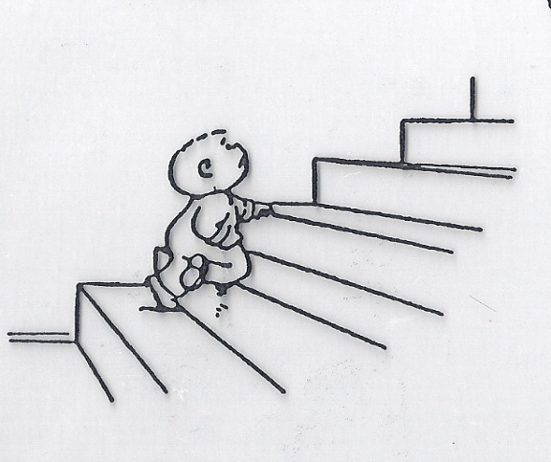
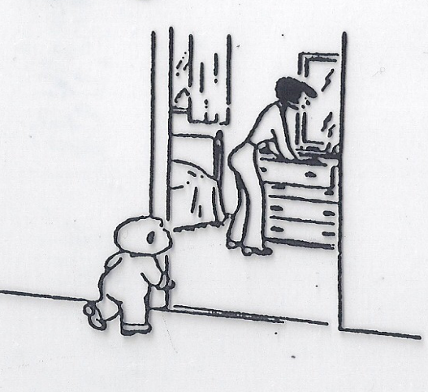
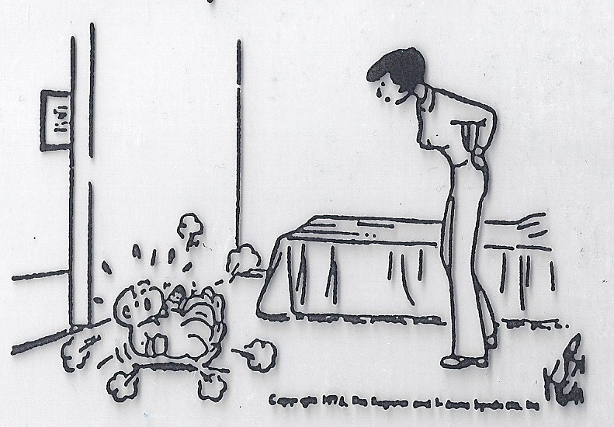

What's the function?
Notes:
Child function = Get Parental Attention
Adult Function = Escape tantruming child

Slide 40
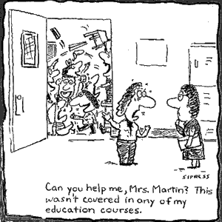
What's the function?
I’m sending my whole class to the office!

Slide 41
Non-examples of Function-Based Approach
“Lantana, you skipped 2 school days, so we’re going to suspend you for 2 more.”
“Phebe, I’m taking your book away because you obviously aren’t ready to learn.”
Why are these
NON-examples of a
function-based approach?
  “You want my attention?! I’ll show you attention…
  let’s take a walk down to the office & have a little chat with the principal.”

Slide 42
Let's practice...
During teacher lecture, Martha repeatedly and loudly calls out (without raising her hand). Each time, the teacher gives her a look, a redirection, or occasionally calls on her.
Teacher lecture (limited attention)
Calling out repeatedly
Teacher attention
Antecedent?
Behavior?
Consequence?
What Function?
Get/obtain Attention
Notes:
TRAINER NOTE: It is recommended that you practice a couple of the practice items. The additional practice items are available if additional practice is necessary or requested.

Slide 43
When given a difficult writing assignment Susannah regularly throws her pencil down, rips up her paper, and puts her head down. Her teacher ignores this behavior (and Susannah never completes her assignment).
Difficult writing assignment
Throw pencil, rip paper, head down
Nothing (doesn’t do assignment)
Antecedent?
Behavior?
Consequence?
What Function?
Escape task

Slide 44
A 6th grade teacher found that over 30% of the behavioral incident reports coming from her classroom occurred as students were being dismissed from class.
Physical contact & arguing
Getting to the hallway
Too many students leaving the room at once & confusion over where to turn in work
Antecedent?
Behavior?
Consequence?
What Function?
Getting access to peers in hallway

Slide 45

By understanding function, we can intervene more effectively.
How can we prevent?
What should we teach the student to do instead?
How do we respond to make sure the new skill “works”?
Prevent
Teach
Respond
We can make simple tweaks to the antecedents, behaviors, and consequences, to prevent, teach, and respond, respectively.

Slide 46
Let’s practice
During teacher lecture, Martha repeatedly and loudly calls out (without raising her hand). Each time, the teacher gives her a look, a redirection, or occasionally calls on her.
Provide attention ahead of lecture and frequent eye contact during
Teach and prompt hand raising
Call on her ONLY when she raises her hand (otherwise ignore)
Prevent?
Teach?
Respond/
Reinforce?
Simple strategies like this are part of effective
“Tier 1” responses to minor contextually inappropriate behavior.

Slide 47
When given a difficult writing assignment Susannah regularly throws her pencil down, rips up her paper, and puts her head down. Her teacher ignores this behavior (and Susannah never completes her assignment)
Modify writing assignment
Teach and prompt her to ask for help/break
Give immediate help/break when asked. Otherwise, redirect to task.
Prevent?
Teach?
Respond/
Reinforce?
With these simple tweaks, we’ve made it less likely for her to
engage in contextually inappropriate behavior to escape difficult tasks.

Slide 48
A 6th grade teacher found that over 30% of the behavioral incident reports coming from her classroom occurred as students were being dismissed from class.
Dismiss one table or row at a time.
Collect student work before dismissal.
Teach and prompt waiting behavior (how to keep busy while waiting) and traffic flow routines.
Provide acknowledgement to students waiting, walking, and using accurate traffic flow patterns.
Prevent?
Teach?
Respond/
Reinforce?
With these strategies, we’ve reduced opportunities for crowding, taught
the expectations and reinforced students for meeting the expectations.

Slide 49

ACTIVITY: Function of Behavior
Practice applying a function-based approach to a Tier 1 problem:
  Identify a common problem behavior in a non-classroom or classroom setting (e.g. students pushing one another while waiting in cafeteria line; many students not completing assignments)
  Describe the “ABCs”
  Identify strategies to prevent, teach, and respond/reinforce
Consider how you will teach function-based thinking to your staff and add items to your Action Plan as necessary.
Be ready to present 2-3 “big ideas” from your discussion.
15 minutes

Slide 50
WHOLE GROUP DEBRIEF: Function of Behavior
Share 1-2 highlights from your team discussion.
What support will you need to promote function-based thinking within your school?
5 minutes

Slide 51

LUNCH

Slide 52
CLASSROOM BEHAVIOR SUPPORT PRACTICES

Slide 53

Supporting and Responding to Students’ SEB Needs
Practices
Center on PBIS. (2022). Supporting and responding to student’s social, emotional, and behavioral needs: Evidence-based practices for educators (Version 2.0). Center on PBIS, University of Oregon. www.pbis.org.
Notes:
https://www.pbis.org/resource/supporting-and-responding-to-behavior-evidence-based-classroom-strategies-for-teachers

Slide 54

Supporting and Responding to Students’ SEB Needs
1. Create Positive Teaching and Learning Environments
Design a Safe Environment
2. Actively Promote SEB Growth
Engage Students in Relevant Learning
3. Monitor Fidelity and Use Data to Guide Implementation
Monitor Educator Implementation
4. Monitor Student Outcomes and Use Data to Guide Response
Establish Positive Connections
Develop Predictable Routines
Define and Teach Positive Expectations
Plan Relevant Instruction
Foster Positive Relationships
Prompt and Supervise SEB and Academic Skills
Provide Specific Feedback (> 5 : 1 Ratio)
Consider Other Response Strategies
Provide Training, Coaching, and Feedback
If data indicate implementation challenges...
Monitor Student Outcomes
Enhance Tier 1
If many students make ongoing SEB errors...
Enhance Tier 1 and Consider Tiers 2 and 3
If few students make ongoing SEB errors...

Slide 55
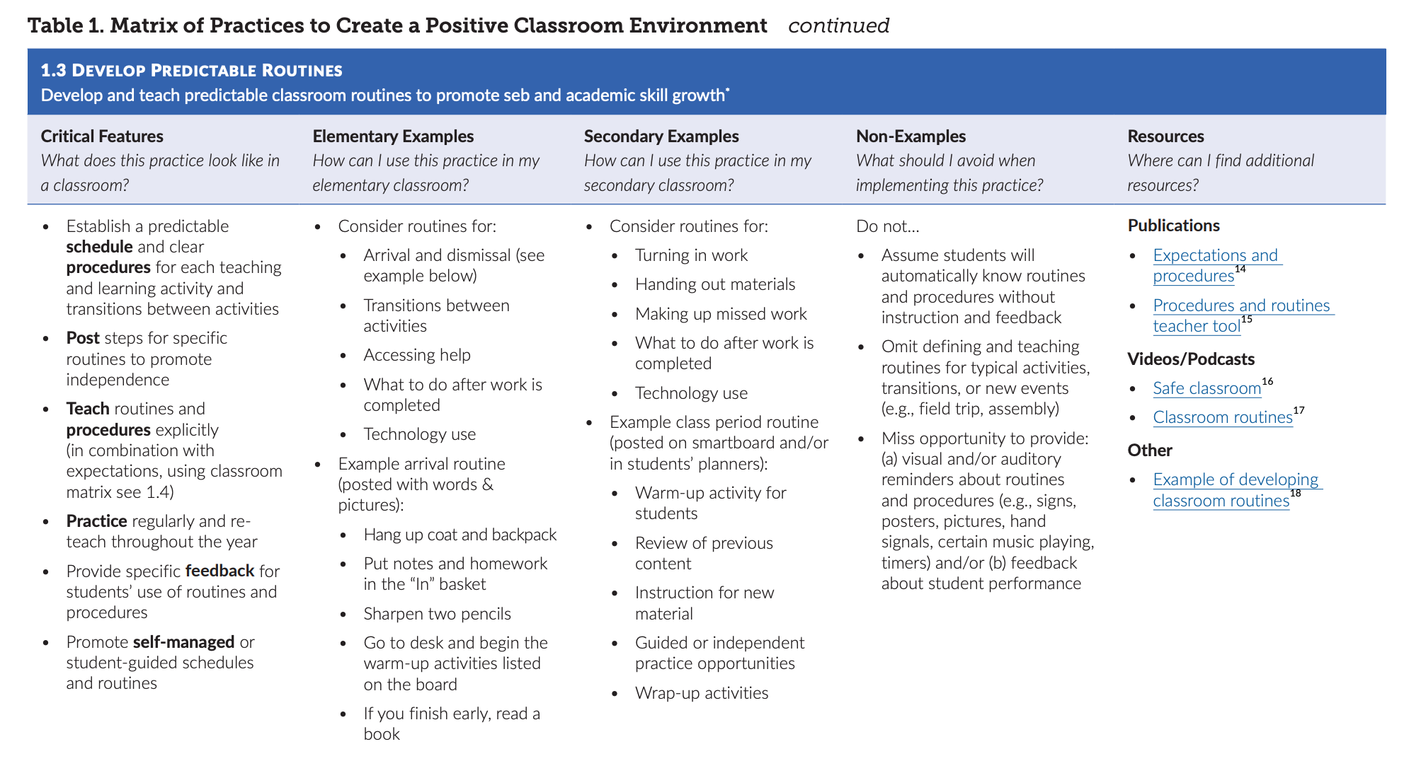

Slide 56
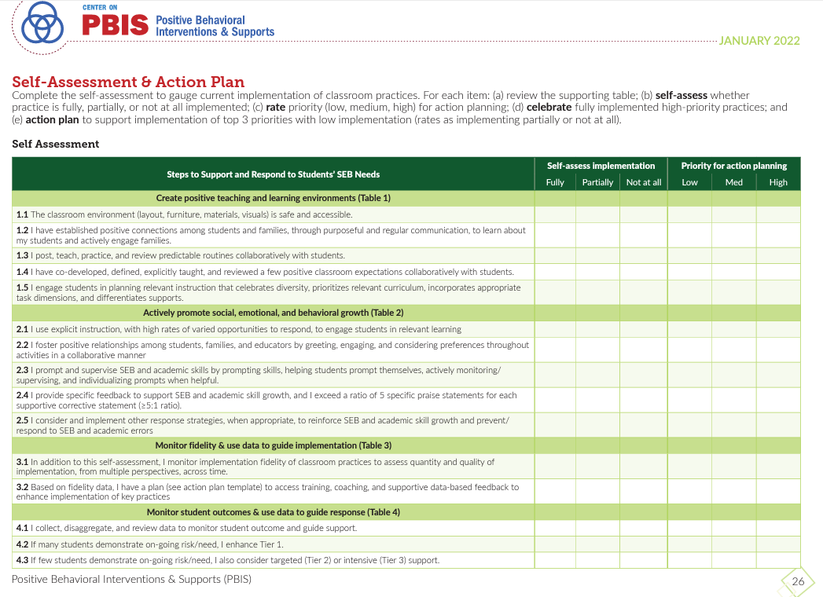
Self Assessment & Action Plan for Classrooms – pg. 26
Notes:
Page 26 in the document

Slide 57
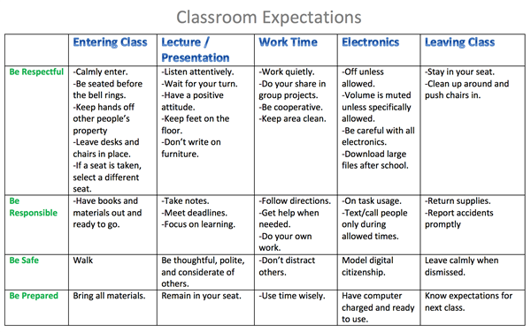
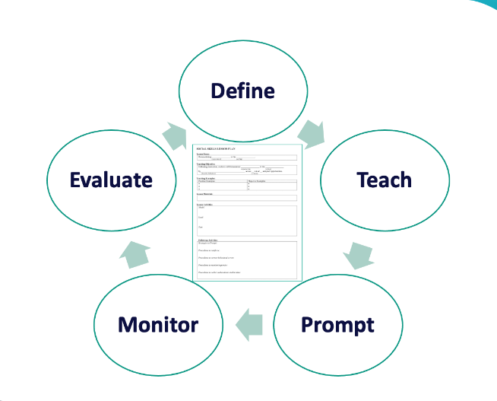
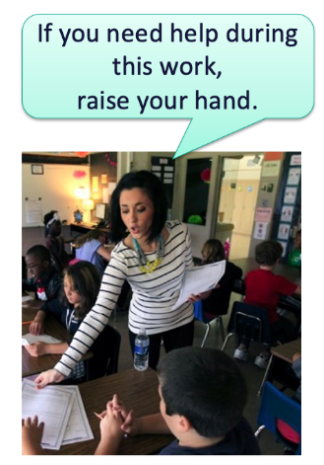
1. Create Positive Teaching and Learning Environments
Design a Safe Environment
2. Actively Promote SEB Growth
Engage Students in Relevant Learning
Establish Positive Connections
Develop Predictable Routines
Define and Teach Positive Expectations
Plan Relevant Instruction
Foster Positive Relationships
Prompt and Supervise SEB and Academic Skills
Provide Specific Feedback (> 5 : 1 Ratio)
Consider Other Response Strategies

Slide 58
SCHOOL-WIDE Teaching Matrix |  | SETTING/ROUTINE
 |  | All Settings | Hallways | Playgrounds | Cafeteria | Library/ Computer Lab | Assembly | Bus
 | Respect Ourselves | Be on task. Give your best effort. Be prepared. | Walk. | Have a plan. | Eat all your food. Select healthy foods. | Study, read, compute. | Sit in one spot. | Watch for your stop.
 | Respect Others | Be kind. Hands/feet to self. Help/share with others. | Use normal voice volume. Walk to right. | Play safe. Include others. Share equipment. | Practice good table manners | Whisper. Return books. | Listen/watch. Use appropriate applause. | Use a quiet voice. Stay in your seat.
 | Respect Property | Recycle. Clean up after self. | Pick up litter. Maintain physical space. | Use equipment properly. Put litter in garbage can. | Replace trays & utensils. Clean up eating area. | Push in chairs. Treat books carefully. | Pick up. Treat chairs appropriately. | Wipe your feet. Sit appropriately.
CLASS-WIDE
Teaching Matrix
All Routines | Entering/ Leaving the Classroom | Small Group Instruction | Whole Group Instruction | Independent Work Time
Be on task. Give your best effort. Be prepared. | Walk. | Participate. | Engage with the lesson. | Have a plan. Study, read, compute.
Be kind. Hands/feet to self. Help/share with others. | Use indoor voice volume. Walk to right. | Include others. Share equipment. | Raise your hand if you have something to share. | Whisper. Return books.
Recycle. Clean up after self. | Pick up litter. Maintain physical space. | Bring necessary materials to the table. | Have necessary materials handy. | Return materials where you found them.
1. SOCIAL SKILL
2. NATURAL CONTEXT
SCHOOL-WIDE EXPECTATIONS
3. BEHAVIOR EXAMPLES

Slide 59
3 Key Positive and Proactive Practices
1. Create Positive Teaching and Learning Environments
Design a Safe Environment
2. Actively Promote SEB Growth
Engage Students in Relevant Learning
Establish Positive Connections
Develop Predictable Routines
Define and Teach Positive Expectations
Plan Relevant Instruction
Foster Positive Relationships
Prompt and Supervise SEB and Academic Skills
Provide Specific Feedback (> 5 : 1 Ratio)
Consider Other Response Strategies
Prompts
Opportunities to Respond
Specific Praise

Slide 60
Prompts

Slide 61

What is it?
A verbal prompt is a reminder of previously taught behaviors, delivered before the behavior, that explicitly states the expected behavior.
Delivered before behavior
State expected behavior
Reminder of previously taught behaviors

Slide 62

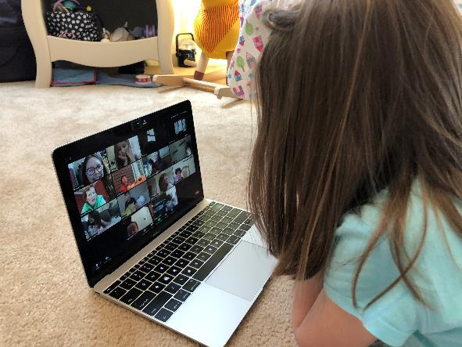


Classroom Prompt Examples
“As you head out, remember to use talk quietly in the hallway."
Verbal reminders
“Remember to mute unless its your turn”
“Remember to read to yourself”

Slide 63




Classroom Prompt Examples
WELCOME
As you come in,
did you remember:
something to write with?
your homework?
your planner?
our textbook?
Visual reminders
Gestural reminders

Slide 64
Opportunities to Respond

Slide 65

What is it?
(OTRs)
“An Opportunity to Respond (OTR) is a teacher behavior that…solicits a student response (e.g., asking a question, presenting a demand).”
Provide high rates of opportunities to respond (OTRs)
Consider various observable ways to engage students
Link engagement with outcome objectives
(Simonsen, Fairbanks, Briesch, Myers, & Sugai, 2008)

Slide 66

Examples of OTRs
Explicit, Direct
Instruction
Choral
Responding
Class-wide Peer Tutoring
Electronic
Clickers
Response
Cards
Computer Assisted Instruction
Guided
Notes
Non-Verbal
Responses

Slide 67

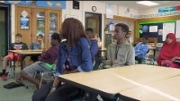
Choral Responding
Thumbs Up
https://youtu.be/g9kyl_WPFhU
https://youtu.be/37CTCDTesWA

Slide 68
Specific Praise

Slide 69
What is it?
Behavior Specific Praise
  “a positive statement, typically provided by the teacher, when a desired behavior occurs (contingent) to inform students specifically what they did well.”
(Simonsen et al. 2008, pp. 362, 364, emphasis added)

Slide 70
Examples
"That was a hard problem and you stuck with it.
Great job!
"Nice hand raise!"
"You walked to get into line. Way to go!"
"Clear pronunciation. Well done."
"You asked for help when you needed it! Terrific!"
"It was kind to help your friend like that!"

Slide 71
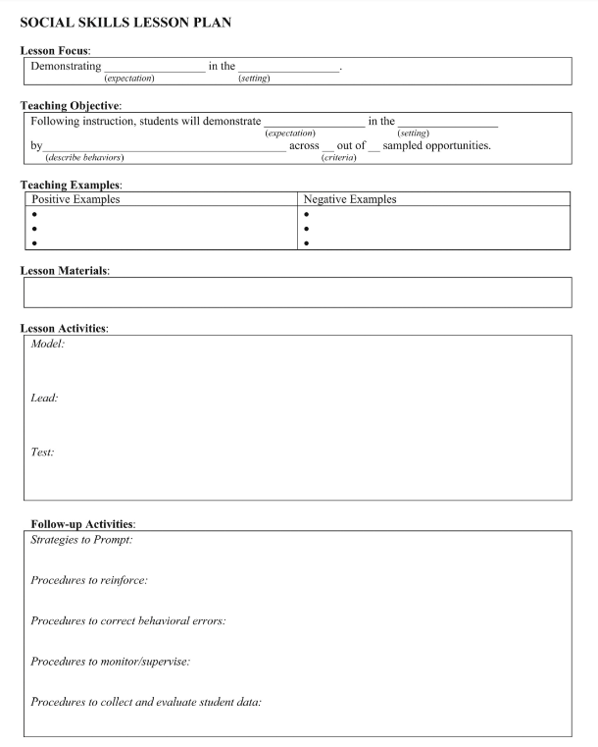
ACTIVITY: 3 Key Classroom Practices
As a team, return or draft a classroom lesson plan.
Draft examples of prompts, OTRs, and praise that you can embed into your plan.
Add items to your Action Plan as necessary
OR – Plan how you will provide this content to your staff
Be ready to present 2-3 “big ideas” from your discussion.
20 minutes
Notes:
TRAINER NOTE: If your school(s) are not ready for this step, support them to work on Creating Positive Teaching Learning Environments.

Slide 72
Team
Action Planning Time

Slide 73
TEAM TIME
Meet with your team and discuss action steps related to the following items reviewed today:
1. Review notes from our sharing activity today. What great ideas did you take away?
2. What are your next steps with PBIS getting started steps?
3. How can your team support school PD on understanding function of behavior?
4. Discuss your school's current use of classroom PBIS. How could assess staff’s use of these strategies?
Please update your action plans and share with your trainers.
Teams
90 minutes
Prepare to share 1 new action item or goal from your discussion.

Slide 74
SHARE OUT
What was one action item or goal your team identified?
5 minutes
Whole Group

Slide 75
AGENDA & FOLLOW-UP
Presentation Content
Goal Setting / Precision Problem Statement
Tier 1 Foundation Check
Function of Behavior
Sharing: Teaching Expectations
Classroom PBIS Practices
Team time
Team Tasks
Identify a targeted data driven outcome measure to focus on this year.
Plan how to integrate function of behavior content in your PD this year.
Plan current use of Classroom PBIS practices in your building.
Share w/Trainer: Updated Action Plan with Goal Statement.
What questions do you have on today’s content?
What questions do you have on the follow-up tasks?

Slide 76
HELPFUL READINGS & RESOURCES
RESOURCES:
Working Smarter Matrix
Start With Why: How to Put Purpose Back in Your Work
Supporting & Responding to Student Behavior
Motive, Motivate, Motivation: Why are my students doing that?
Supportive Environments Create Classroom Community
Classroom Support Systems Brief
Notes:
Working Smarter Matrix: https://nepbis.org/wp-content/uploads/2020/09/Working-Smarter-Activity.docx
Classroom Support Systems Brief: https://www.pbis.org/resource/pbis-technical-brief-on-systems-to-support-teachers-implementation-of-positive-classroom-behavior-support
Putting the Purpose back in your work: https://www.pbisapps.org/articles/start-with-why-how-to-put-purpose-back-in-your-work
Supporting & Responding to Student Behavior: https://www.pbis.org/resource/supporting-and-responding-to-behavior-evidence-based-classroom-strategies-for-teachers
Motive, Motivate, Motivation: Why are my students doing that? https://www.pbisapps.org/articles/motive-motivate-motivation-why-are-my-students-doing-that
Supportive Environments Create Classroom Community: https://www.pbisapps.org/articles/supportive-environments-create-classroom-community

Slide 77
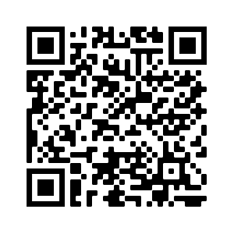
EVALUATION
Notes:
https://edc.co1.qualtrics.com/jfe/form/SV_cBF9GI7gVEBsfSC

