Slide 1


PBIS School-Wide Coach Meeting
Year 2: September 2022
PBIS Track
Insert Trainers Names
with support from NEPBIS Network, May Institute & Broad Reach Consulting
Notes:
Add trainer names for your event

Slide 2

EXPECTATIONS
Self
Others
Environment
Self-monitor
Mute when listening, unmute to talk​
Have your computer charged and ready to go​
If you have questions or comments:
Work as a team:
Keep necessary materials at hand
Are you participating?
Engaged as a learner?
Stretch, break, stand as needed​
unmute
use the chat box
Room for every voice
Reinforce participation
action plan
relevant docs
water/snacks
Minimize distractions if possible​

Slide 3
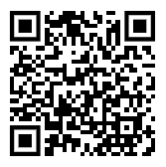
ACTIVITY: ATTENDANCE
Scan QR code on the left or follow the URL posted in the chat to access the online attendance survey
Follow prompts to enter attendance information
Notify trainers if you require assistance (e.g., identifying your cohort or cohort group)
Certificates of Attendance will be sent in January and June. Attendance records and Zoom log in will be use as verification
You are in Cohort 8
1 minute
Notes:
TRAINERS – QR Code is updated
Add your cohort number
Post a link to the attendance survey (below) in the chat for those who do not use the QR code on the slide:
ATTENDANCE: https://edc.co1.qualtrics.com/jfe/form/SV_5BiXqi4bxzOCMS2

Slide 4
Agenda & Coaches' Tasks
Coaches’ Tasks:
Presentation Content:
PBIS Academy Year 2 Training and Support Structure
Sustainability Factors – Team Functioning
Glows & Grows: PBIS Rollout
Complete Communication Survey for list of team members with emails for event reminders
Submit Advanced Action Plan with Team/Meeting portion upload to Canvas
Action Planning and Working Smarter
Review/Complete Working Smarter Matrix upload to Canvas

Slide 5
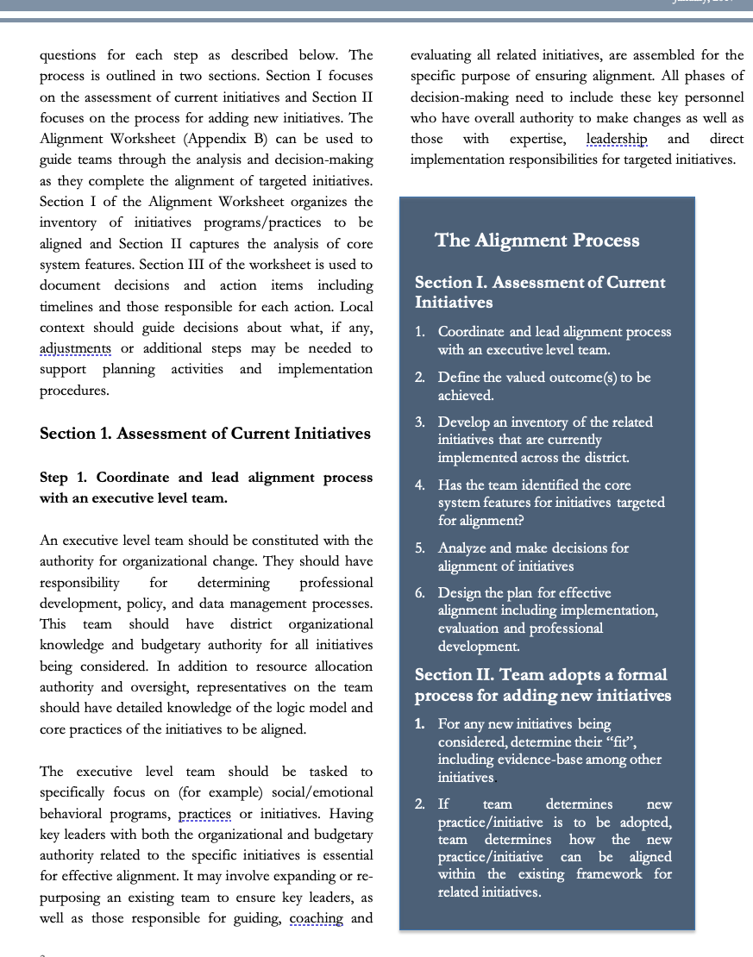
HELPFUL RESOURCES
RESOURCES:
Advanced Action Plan
Team meeting foundations checklist
Working Smarter Matrix
READINGS
9 Things You Might Have Forgotten How to Do in PBISApps
7 Ways to MacGyver Your Action Plans
Notes:
RESOURCES – Strongly encourage coaches to down load these resources.
Advance Action Plan: https://sebacademy.edc.org/annual-action-plan-template-advanced We will discuss this later in the slide deck
Team meeting foundations checklist: https://sebacademy.edc.org/team-meeting-foundations-checklist
Working Smarter Matrix https://sebacademy.edc.org/working-smarter-matrix
READINGS:
9 Things You Might Have Forgotten How to Do in PBISApps - https://www.pbisapps.org/articles/9-things-you-might-have-forgotten-how-to-do-in-pbisapps Helpful for logging in and SWIS issues
7 Ways to MacGyver Your Action Plans https://sebacademy.edc.org/7-ways-macgyver-your-action-plans

Slide 6

PBIS
Resource Spotlight:
PBIS Academy Support Structure

Slide 7
2022-2023 PBIS Academy Training Format
Years
Year
01
02
03
Attendees
Team Training (Minimum):
        Administrator
        Grade-Level Representatives
        Support Staff
        Coaches
Coaches Training:
2-3 Coaches
  Technical Assistance:
  Administrator
  Coach
  Data Entry Staff
  Faculty/Staff
04 Sustaining Academy
Support
Years 1 & 2
  7 – 1.5 hr. Monthly Coach Meetings (Virtual)
  3 Full Day - Team Trainings Meetings (Years 1 & 2) (In Person)
Year 3
  8 – 1.5 hr. Monthly Coach Meetings (Virtual)
  2 Full Day - Team Trainings Meetings (Year 3) (In Person)
1.5 day (12 hr.) Technical Assistance per school
SWIS Data System & Training
Support
4-2hr Coaches Meetings
Optional 2 Full Day Team Trainings with year 3 schools (In Person)
1 day School-based Technical Assistance
SWIS Data System & Training
Notes:
Trainer note: Review support options for this year. Please let folks that future trainings will include a mixture of in person and online (hybrid) approaches (e.g., in person team trainings, but virtual coaches meetings). Regardless of support delivery, the categories of the support will be listed and developed based on DESE recommendations.

Slide 8
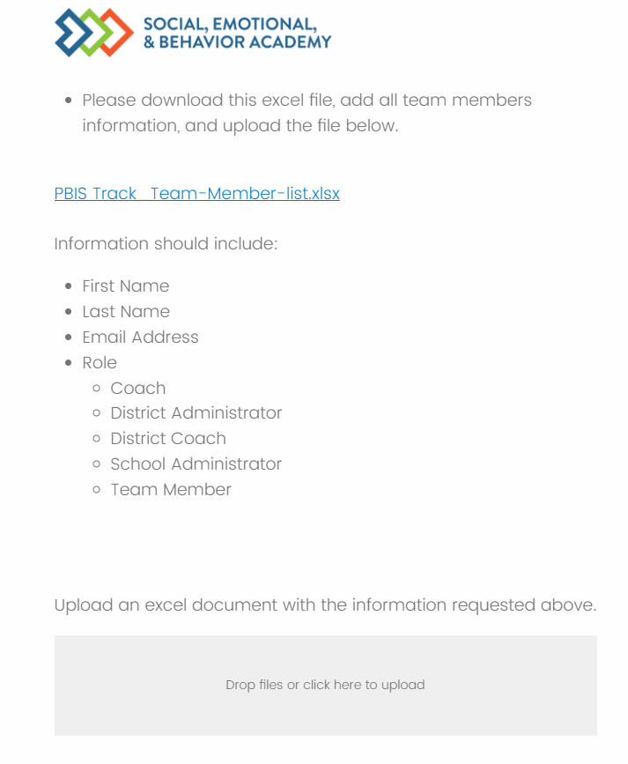
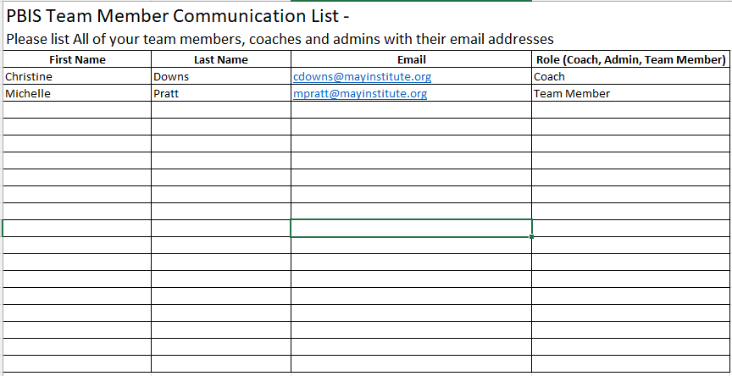
Communication Survey & Mail Chimp
Please add all your team’s contact information into the Communication Excel Sheet. Then upload to the
Download the excel sheet
Add names, email, and role, then save file
Drag file into box to upload
Communications Survey
https://edc.co1.qualtrics.com/jfe/form/SV_db8zhNj6NJ3eXga
Notes:
https://edc.co1.qualtrics.com/jfe/form/SV_db8zhNj6NJ3eXga
Go to website demonstrate how to download Team Member List and how to upload it.

Slide 9
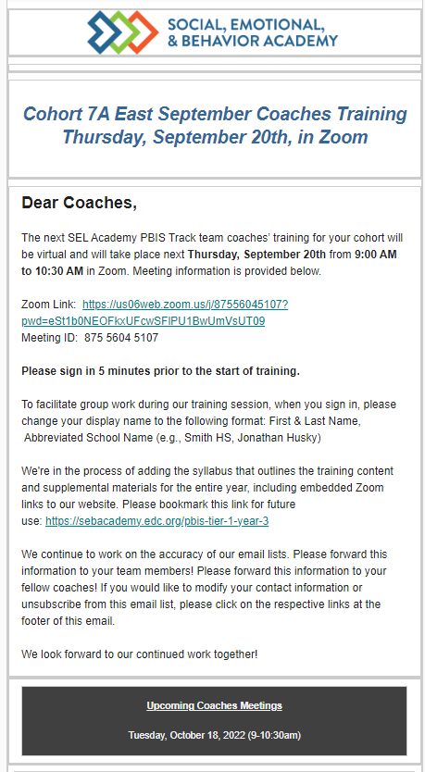
Communication Survey & Reminders
Email Reminders will be sent to all coaches, administrators and team members for our PBIS Events. The email will come from SEB Academy sebacademy@edc.org
Please review invitation for Date, Time, Location/Zoom Link, and any other important information included.
The next training or coach meeting will be displayed in the black box a the bottom
Share with other Coaches or Team Members as necessary.
You may update or add coaches or team members to the mailing list using the communication survey. You only need to add new members you do not need to list member you already uploaded.
Next upcoming Training or Coach Meeting

Slide 10
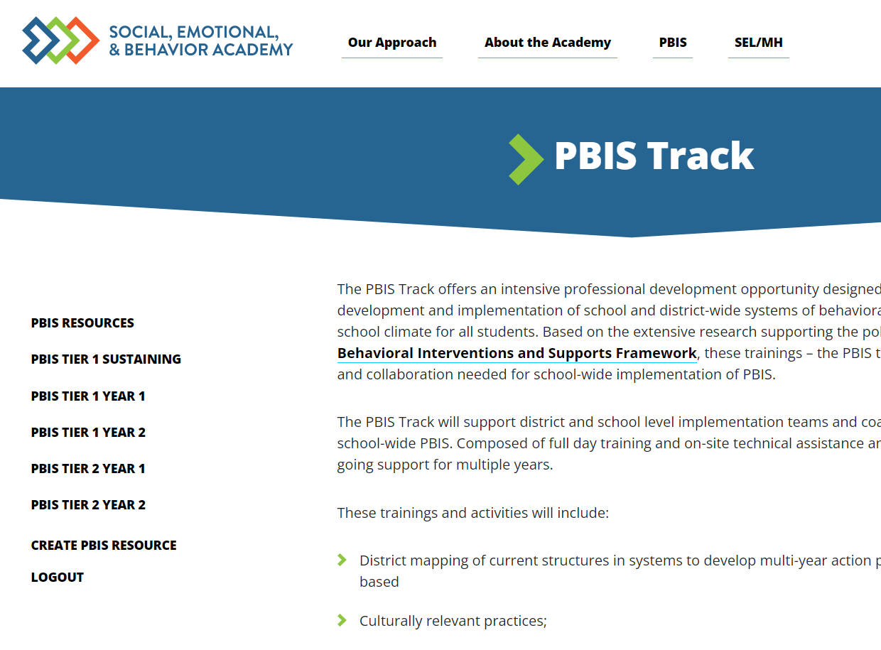
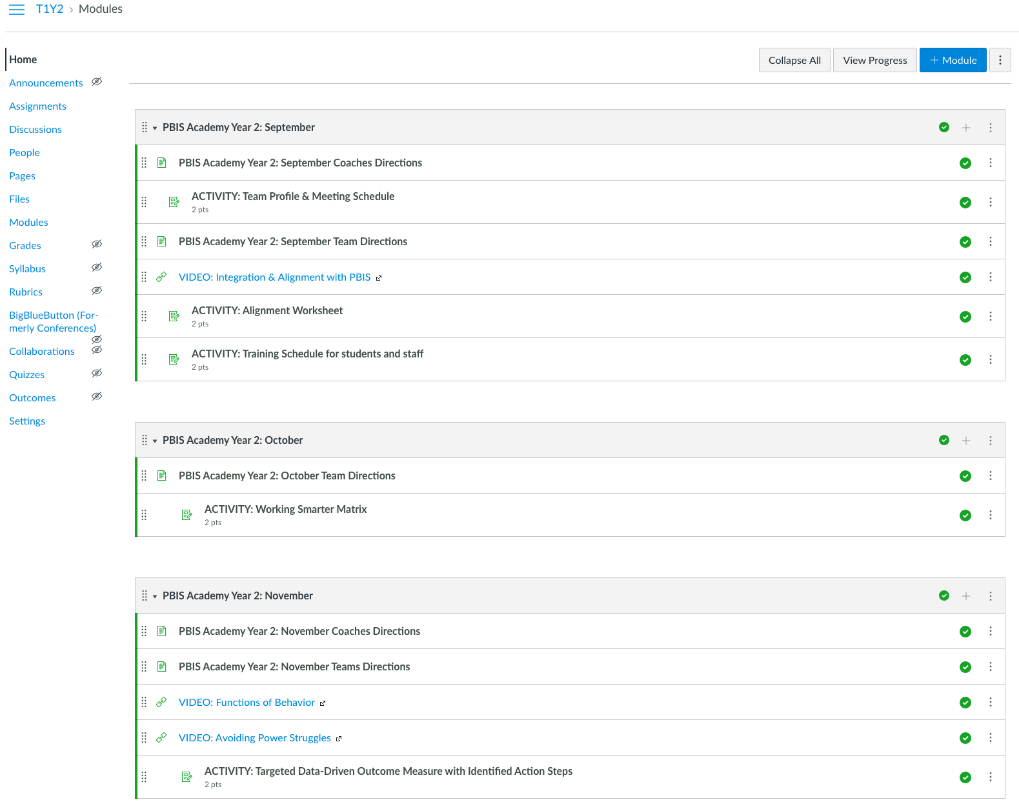
PBIS Academy Support Structure
Website
Canvas
https://sebacademy.edc.org/
Notes:
Review website https://sebacademy.edc.org/
Canvas – For coaches to upload assignments/activities. (Team member will not get an account this year) We will add coaches as soon as possible.

Slide 11
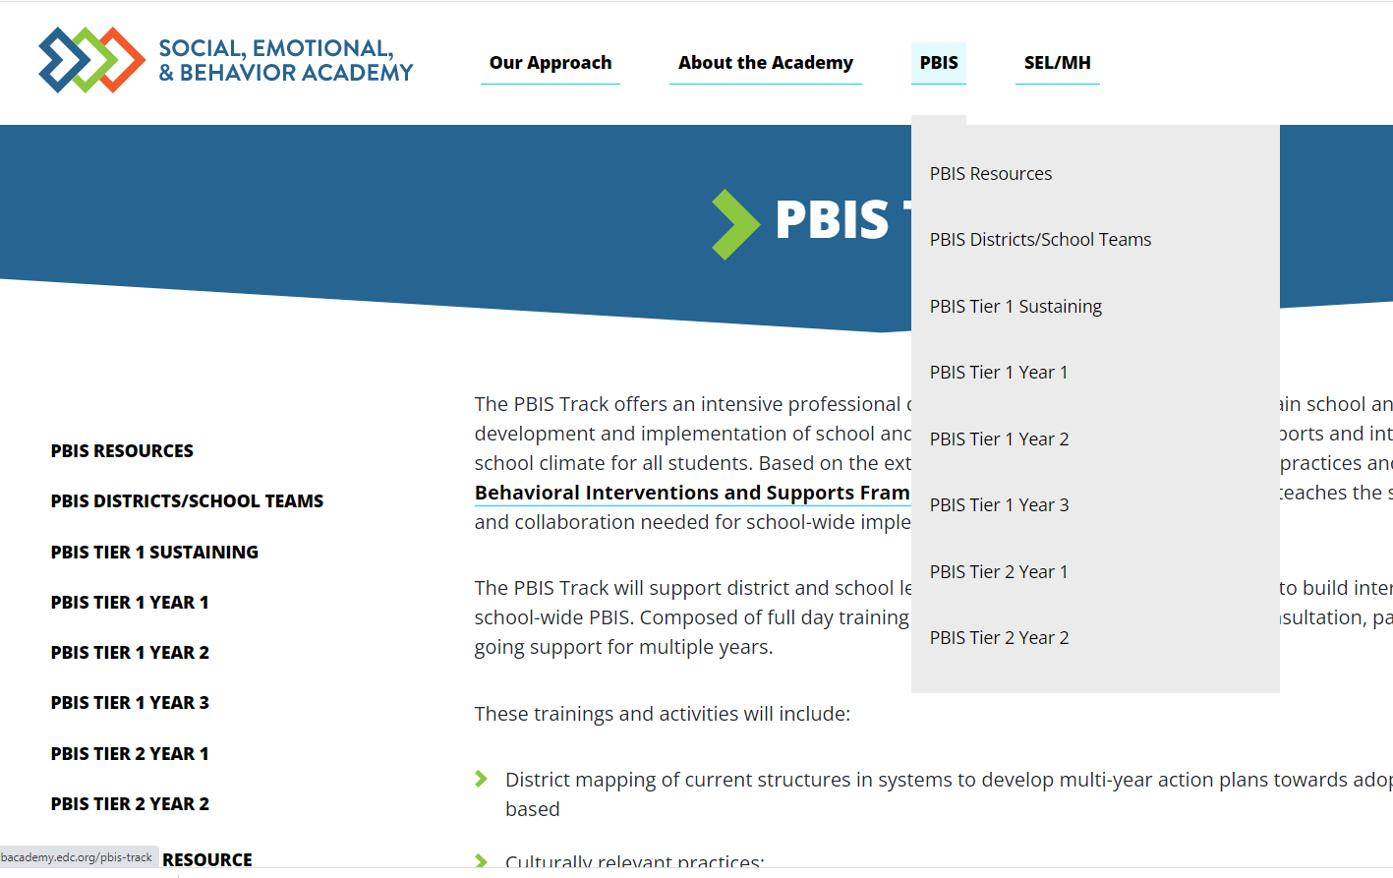
PBIS Academy Support Structure Questions?
What questions do you have?
What is it?
Your team's guide for training content, readings, and resources for both each monthly event.
Purpose:
Monthly organized resource repository for your team to access all PBIS Academy content
Important features?
All event tools, activities, ppts, and other resources
Coach meeting and Team training dates/times with zoom links or hotel locations.
Website
https://sebacademy.edc.org
Notes:
TRAINER NOTE: Please share the website address https://sebacademy.edc.org/pbis-track
Review The resource page and the Tier 1 Year 3 page. - There should be an event card there to review
NOTE: SWIS page with training dates will be up shortly

Slide 12
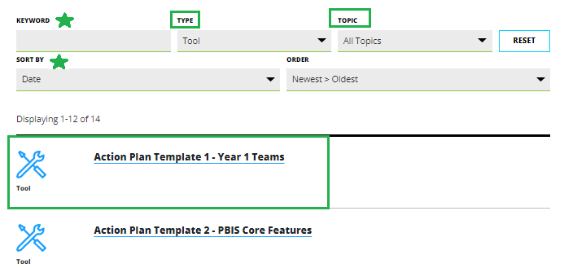
Resources
Notes:
Go to RESOURCES. If you know the topic or the Type of resource you are looking for you can select that in the search area. If not, just leave all types and all topics.
Find the resources and click on it.
The resources will open
Click the blue Button to download resource or be taken to the webpage with the resource

Slide 13
Year 2 page
Under Construction– All Monthly information will displayed here soon!
Notes:
This page is in the process of being created/updated. Please be patient it will be functioning soon. Please check back. All information for each monthly training or meeting will be displayed here

Slide 14
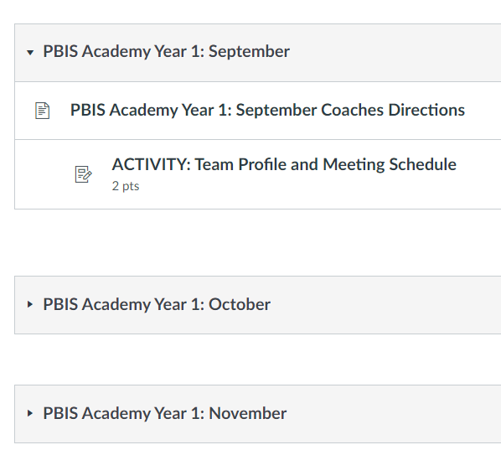
PBIS Academy Support Structure Continued
What questions do you have?
Canvas
What is it?
Coach area for monthly activity submissions.
Purpose:
Sharing area for coaches to receive feedback from trainers.
Important features?
Activities and submission for feedback
Coach meeting and Team training dates with zoom links
Notes:
Canvas: Only Coaches this year. (Admins OK if they want to be on) Ask them to be patient as we populate this and the website
Please tell coaches to check in on access to Canvas https://canvas.instructure.com/
Add emails to Canvas using the people and email add process.
Remind Coaches to check spam folders. If they can not find the invite, send their name and email to Adam to add.
Email will come from Canvas Free for Teachers <notifications@instructure.com with subject “course invitation”

Slide 15
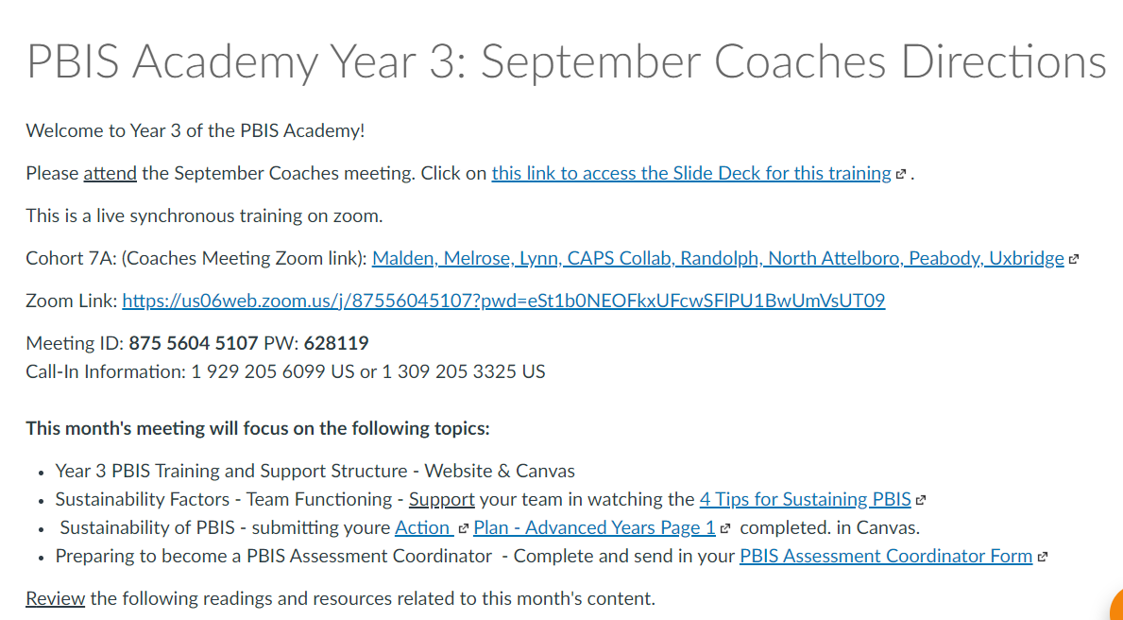
Canvas – Coach Directions
Notes:
Review how to read directions and how to upload into canvas

Slide 16
Website and Canvas
Have you logged into Canvas?
Have you submitted names & emails for your team via the survey?
All PowerPoints, tools, supplemental videos, directions, and resources will be organized on the Website.
All team products will be submitted through Canvas so you can get feedback from your TA provider.
Any trouble finding videos or materials?
Questions about how Canvas will be used?

Slide 17
HELPFUL RESOURCES
RESOURCES:
Advanced Action Plan
Team meeting foundations checklist
Working Smarter Matrix
READINGS
9 Things You Might Have Forgotten How to Do in PBISApps
7 Ways to MacGyver Your Action Plans
Notes:
RESOURCES – Strongly encourage coaches to down load these resources.
Advance Action Plan: https://sebacademy.edc.org/annual-action-plan-template-advanced We will discuss this later in the slide deck
Team meeting foundations checklist: https://sebacademy.edc.org/team-meeting-foundations-checklist
Working Smarter Matrix https://sebacademy.edc.org/working-smarter-matrix
READINGS:
9 Things You Might Have Forgotten How to Do in PBISApps - https://www.pbisapps.org/articles/9-things-you-might-have-forgotten-how-to-do-in-pbisapps Helpful for logging in and SWIS issues
7 Ways to MacGyver Your Action Plans https://sebacademy.edc.org/7-ways-macgyver-your-action-plans

Slide 18

Glows & Grows
Rollout
Notes:
TRAINER NOTE:
Use this time to check in with coaches and gauge their existing knowledge base of PBIS and determine whether or not they already watched the PBIS Overview.
The following 2 slides provide an opportunity for a BRIEF review and chance to develop a basic common understanding. It is not intended to be a full explanation.

Slide 19
DISCUSSION: INTRODOCTIONS, & GLOWS & GROWS
Introduce yourself and your school
What is something to celebrate about & something you’re working on related to: PBIS Rollout to staff, students, and families
5 minutes
20 minutes
Independent Jot
Whole Group

Slide 20

Big Idea Check In:
Team Meeting Foundations
Notes:
This is basically review…you can move through this quickly

Slide 21
GUIDELINES FOR TEAMS
Membership
Systems
Scheduling
Systems
Representative of school/community demographics
1-2 members with behavior/classroom management competence
1-2 family members
Active participation from administrator
Integrated with other behavior-related initiatives/programs
Given appropriate priority relative to school/district goals
Monthly meetings
Monthly communications to staff
Annual self-assessments
Notes:
TRAINER NOTE: Keep this brief, this is review content

Slide 22
Ensuring a Representative Team
Supports Relevance & Equity
Improves student outcomes
Promotes Engagement
Family/Student Voice
Ensure the family/student role is clearly outlined, defined, and understood
Give families ownership of system components (e.g., celebrations, acknowledgements)
Ask families to assist in reporting team discussions & data
Seek family/student feedback regarding school processes
Notes:
TRAINER NOTE: Use this slide if needed.

Slide 23

Team Roles
Facilitator
Note Taker
Time Keeper
Norm Keeper
“Friendly Reminder”
(Parent/Student Voice)
Notes:
TRAINER NOTE: Keep this brief, this is review content

Slide 24
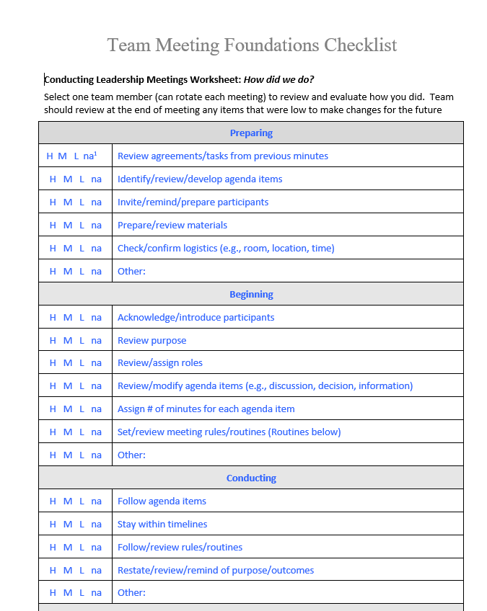
Meeting Foundation Checklist
This is a great way to prepare for and evaluate your team meetings
Use it as a coach to prepare for your meetings
Ask one team member each meeting to complete the checklist as best as possible throughout your meeting to evaluate your meeting.
Review checklist at the end of the meeting
Adjust practices / systems for items that receive an L (low) rating.
Notes:
Meeting Foundation Checklist https://sebacademy.edc.org/team-meeting-foundations-checklist

Slide 25
ACTION PLANNING
Action Plan
Foundation for all you do as a team
Vital for achieving goals
Specifies three features:
1
2
3
Who
What
When
Who is responsible…
…for doing what…
…by when?
Action Planning: The process of organizing resources to enable individuals to engage in activities designed to achieve specific and important outcomes.
Notes:
TRAINER NOTE: Keep this brief, this is review content

Slide 26

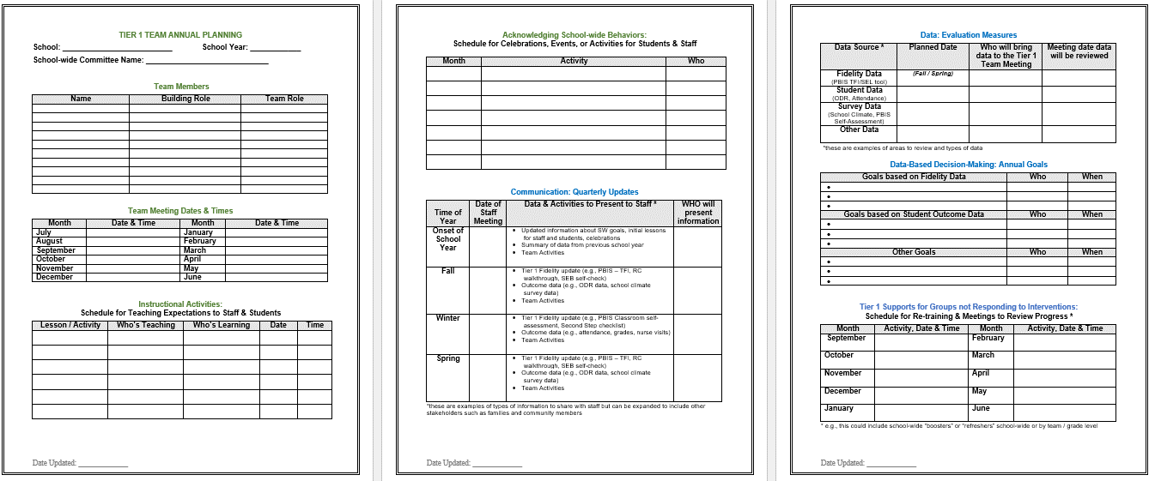
Annual Action Planning - Advanced
Evaluation Measures
Acknowledgment Plans
Team
Info
Annual Goals
Teaching Expectations Plan
Communication
Tier 1 Student Follow Up
Notes:
This Action plan is more advanced and is intended for schools in years 2 and beyond. Review with the team.
Advanced Action Plan https://sebacademy.edc.org/annual-action-plan-template-advanced

Slide 27
DATA-INFORMED OUTCOME GOALS
Review the following with your team when considering your PBIS outcome goals for the year:
Fidelity Assessments (TFI, TIC)
Student Outcome Data (attendance, screening, discipline, grades)
Stakeholder Input (surveys, focus groups)
School/District Priorities (DIP, SIP)
Notes:
We will review Stakeholder Input Surveys (new on PBIS apps) in October.
Teams should consider these factors when setting goals for this year.

Slide 28
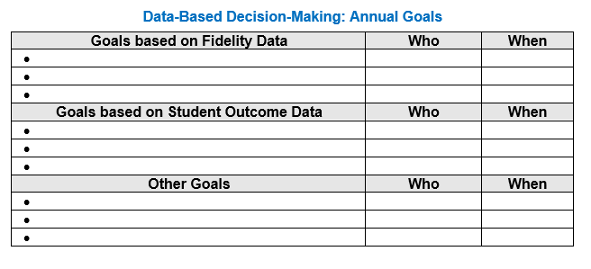
Goals and Outcomes
Notes:
Have them begin to think about their Goals for This year. They should come to the Oct team training prepared to identify goals and the data sources they will use to measure the goal.
This will be an October team activity. Coaches should start to think about these based upon last years goals, the TFI, and other Data

Slide 29
WORK SMARTER
Systems
How does PBIS fit with what is already in place in our school?

Slide 30
ALIGNING TEAM STRUCTURES – EXAMPLE
Initiative/
Committee/ Team
Purpose & Strategic Goal Supported
Measurable, Data-Based Outcome(s)
Target Group
Staff Involved
Overlap? Modify? Eliminate?
PBIS
Ensure positive, safe, predictable, & consistent environment
ODRs, suspensions, attendance, universal screening, school climate survey
All students, staff, & families
Principal, social worker, 3 general + 1 special ed. teachers
- Overlap with crisis& TI teams
- Combine and rename
- Add EOY meeting to revise safety protocols
Safety/Crisis Team
Update protocols to ensure safe environment & plan for crisis
None
All students, staff, & families
Principal, social worker, 2 general ed. teachers
- Expand use of data to monitor police contacts from school & safety assessments
Trauma-Informed Team
Ensure students feel safe, supported, & ready to learn
ODRs, suspensions, attendance, universal screening, school climate
  All students, staff, & families
Principal, social worker, 2 general + 1 special ed. teachers
- Overlap with PBIS team
Combine team
- Make current members coaches
Notes:
Working Smarter Matrix to help with 22-23 Goals around function of teams or merging teams

Slide 31
GUIDING QUESTIONS
Systems
How would our teams work more effectively if we had a single model of service delivery to address the social-emotional-behavioral needs of our students?
What communication loops and /or progress monitoring exists among all these support personnel?
Are there other school teams with similar goals we should consider coordinating with?
Notes:
Once they complete WS Matrix these guiding questions should help with how to use that information.

Slide 32
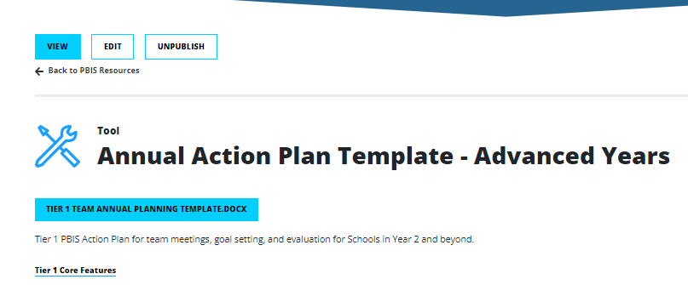
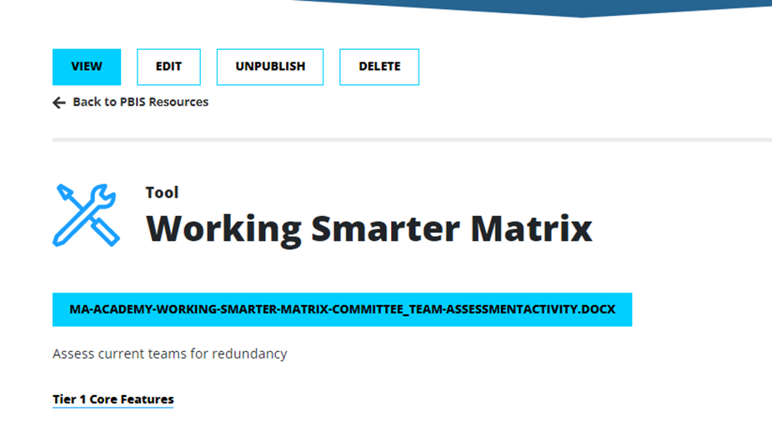
Action Plan – Annual Planning Advanced Years
Find and review your Working Smarter Matrix from last year
If starting new, download Working Smarter Matrix from SEB website
Download “Annual Action Plan Template” from SEB website
Notes:
Ask Coaches to download this Action Plan for use this year. Will be reviewed in the next slide.
https://sebacademy.edc.org/annual-action-plan-template-advanced
Working Smarter Matrix
https://sebacademy.edc.org/working-smarter-matrix

Slide 33
DISCUSSION: TEAMING
Download & Review Advanced Action Plan.
Complete Page 1 and upload to canvas.
Consider what other parts you can fill in and what you need to work on. (This can be completed later with your team)
Review data on the Getting Smarter Matrix and use guiding questions to develop an action plan for eliminating or modifying teams as needed.
What is the current status of your Team foundations? What further support do you need so you can support your team with this work?
5 minutes
15 minutes
Independent Jot
Whole Group
Notes:
https://sebacademy.edc.org/annual-action-plan-template-advanced

Slide 34
PBIS
Looking Ahead:
Previewing October Team Training
Notes:
Quick Preview of next few slides….not indepth

Slide 35
OCTOBER TEAM TRAINING
8A – October 24th 8:30-2:30 PM Marlborough Hotel
8B – October 20th 8:30-2:30 PM Worcester Hotel
In Person – Whole team attends
BIG IDEAS
Evaluate Tier 1 Core Features
Identify Data Driven Goals for PBIS in your school
Review Function of Behavior and Power Struggles
Building Classroom Systems
Notes:
TRAINER NOTE:
Hotel location to be updated when we have conformation. Will be in the invite.

Slide 36
AGENDA & FOLLOW-UP
Presentation Content:
Coaches’ Tasks:
PBIS Academy Year 2 Training and Support Structure
Complete Communication Survey for list of team members with emails for event reminders
Sustainability Factors – Team Functioning
Glows & Grows: PBIS Rollout
Action Planning and Working Smarter
Submit Advanced Action Plan with Team/Meeting portion upload to Canvas
Review/Complete Working Smarter Matrix upload to Canvas
What questions do you have on today’s content?
What questions do you have on the follow-up tasks?

Slide 37
HELPFUL RESOURCES
RESOURCES:
Advanced Action Plan
Team meeting foundations checklist
Working Smarter Matrix
READINGS
9 Things You Might Have Forgotten How to Do in PBISApps
7 Ways to MacGyver Your Action Plans
Notes:
RESOURCES – Strongly encourage coaches to down load these resources.
Advance Action Plan: https://sebacademy.edc.org/annual-action-plan-template-advanced We will discuss this later in the slide deck
Team meeting foundations checklist: https://sebacademy.edc.org/team-meeting-foundations-checklist
Working Smarter Matrix https://sebacademy.edc.org/working-smarter-matrix
READINGS:
9 Things You Might Have Forgotten How to Do in PBISApps - https://www.pbisapps.org/articles/9-things-you-might-have-forgotten-how-to-do-in-pbisapps Helpful for logging in and SWIS issues
7 Ways to MacGyver Your Action Plans https://sebacademy.edc.org/7-ways-macgyver-your-action-plans

Slide 38
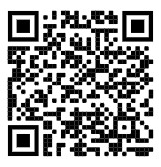
https://edc.co1.qualtrics.com/jfe/form/SV_cBF9GI7gVEBsfSC
EVALUATION
Cohort 8A
Erik Maki - emaki@mayinstitute.org
Karen Robbie - karen.robbie@uconn.edu
Cohort 8B
Christine Downs - cdowns@mayinstitute.org
Marcie Handler -
mwhandler@gmail.com
Please remember to complete the evaluation!
Scan the QR code to access.
Notes:
TRAINERS -
Put link to evaluation (below) in the chat for those who do not use the QR code:
https://edc.co1.qualtrics.com/jfe/form/SV_cBF9GI7gVEBsfSC

