Slide 1


PBIS School-Wide Coach Meeting
Year 1: September 2022
PBIS Track
Christine Downs & Michelle Pratt
with support from NEPBIS Network, May Institute & Broad Reach Consulting
Notes:
Add trainer names for your event

Slide 2

EXPECTATIONS
Self
Others
Environment
Self-monitor
Mute when listening, unmute to talk​
Have your computer charged and ready to go​
If you have questions or comments:
Work as a team:
Keep necessary materials at hand
Are you participating?
Engaged as a learner?
Stretch, break, stand as needed​
unmute
use the chat box
Room for every voice
Reinforce participation
action plan
relevant docs
water/snacks
Minimize distractions if possible​

Slide 3
ACTIVITY: ATTENDANCE
Scan QR code on the left or follow the URL posted in the chat to access the online attendance survey
Follow prompts to enter attendance information
Notify trainers if you require assistance (e.g., identifying your cohort or cohort group)
Certificates of Attendance will be sent in January and June. Attendance records and Zoom log in will be use as verification
You are in Cohort 9
1 minute
Notes:
TRAINERS – QR Code is updated
Add your cohort letter – PLEASE review Certificates of Attendance process – They will automatically be sent in Jan and June based upon attendance and Zoom Log in info.
Post a link to the attendance survey (below) in the chat for those who do not use the QR code on the slide:
ATTENDANCE: https://edc.co1.qualtrics.com/jfe/form/SV_5BiXqi4bxzOCMS2

Slide 4
Agenda & Coaches' Tasks
Coaches’ Tasks:
Submit Team Profile and Meeting Schedule
Presentation Content:
Introductions
Glows and Grows: Getting Started
Intro to PBIS and Coaching
Complete PBIS Communication Survey
Preview of October Team Training
Team Foundation Check In
Choose an Action Planning Template

Slide 5

HELPFUL RESOURCES
MATERIALS:
Action Plan Template Options
Team Profile and Meeting Schedule
Communication Survey
RESOURCES:
Center on PBIS’ Coaching page
Become a Better Team by Solving 3 Common Mistakes
7 Ways to MacGyver Your Action Plans
Notes:
Center on PBIS’ Coaching Page: https://www.pbis.org/topics/coaching
Become a Better Team by Solving 3 Common Mistakes: https://www.pbisapps.org/articles/become-a-better-team-by-solving-3-common-mistakes
7 Ways to MacGyver Your Action Plans: https://www.pbisapps.org/articles/7-ways-to-macgyver-your-action-plans
These can be accessed using the webpage using resource list.

Slide 6
DISCUSSION: Introductions/Grows & Glows
Introduce your self, your school, your role at your school and share something you’re excited about with PBIS or something your interested in learning about.
Whole Group
10 minutes

Slide 7

PBIS
Resource Spotlight:
PBIS Academy Support Structure

Slide 8
2022-2023 PBIS Academy Support Sturcture
Years
Year
01
02
03
Attendees
Team Training (Minimum):
        Administrator
        Grade-Level Representatives
        Support Staff
        Coaches
Coaches Training:
2-3 Coaches
  Technical Assistance:
  Administrator
  Coach
  Data Entry Staff
  Faculty/Staff
04 Sustaining Academy
Support
7 – 1.5 hr. Monthly Coach Meetings (Virtual)
3 Full Day - Team Trainings Meetings (Years 1 & 2) (In Person)
2 Full Day - Team Trainings Meetings (Year 3) (In Person)
1.5 day (12 hr.) Technical Assistance per school
SWIS Data System & Training
Support
4-2hr Coaches Meetings
Optional 2 Full Day Team Trainings with year 3 schools (In Person)
1 day School-based Technical Assistance
SWIS Data System & Training
District Coordinator Support
Notes:
Trainer note: Review support options for this year.

Slide 9
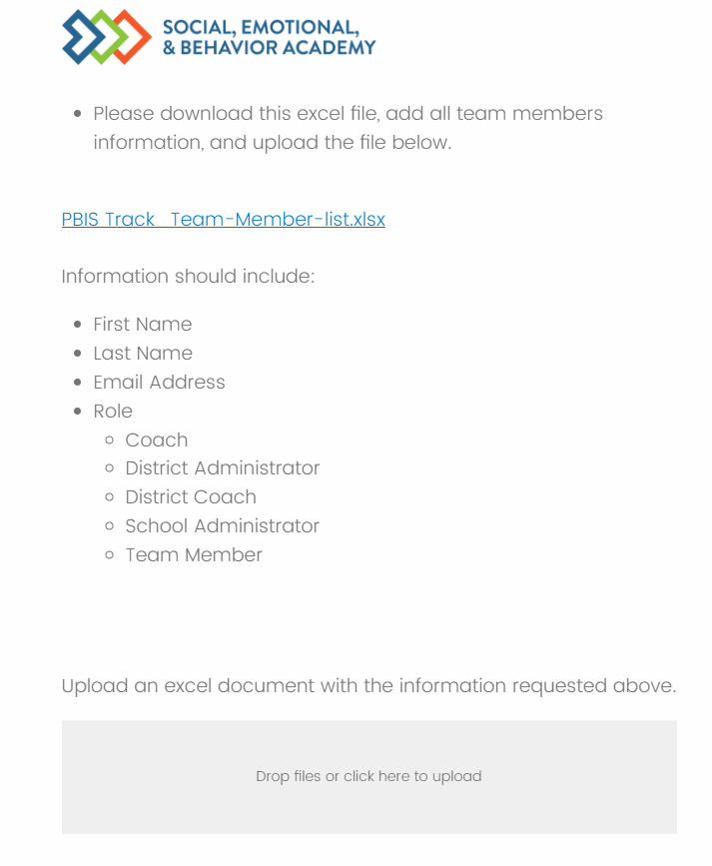
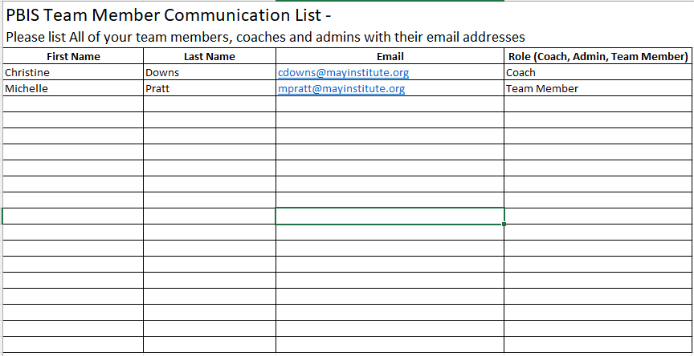
Communication Survey & Mail Chimp
Please add all your team’s contact information into the Communication Excel Sheet. Then upload to the
Download the excel sheet
Add names, email, and role, then save file
Drag file into box to upload
Communications Survey
https://edc.co1.qualtrics.com/jfe/form/SV_db8zhNj6NJ3eXga
Notes:
https://edc.co1.qualtrics.com/jfe/form/SV_db8zhNj6NJ3eXga
Have this open so you can quickly demonstrate how to download Team Member List and how to upload it.

Slide 10
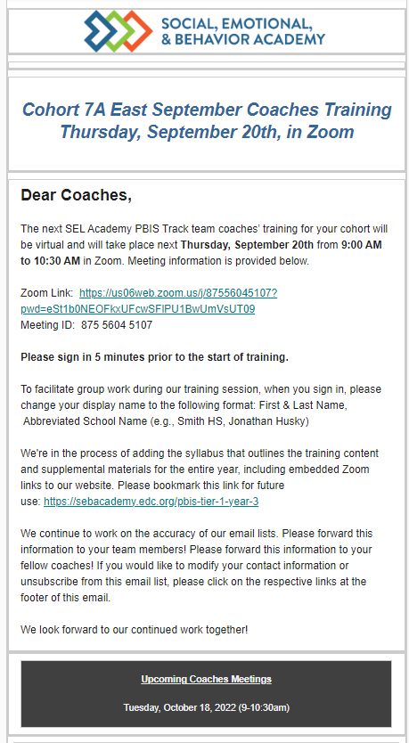
Communication Survey & Mail Chimp
Email Reminders will be sent to all coaches, administrators and team members for our PBIS Events. The email will come from SEB Academy sebacademy@edc.org
Please review invitation for Date, Time, Location/Zoom Link, and any other important information included.
The next training or coach meeting will be displayed in the black box at the bottom
Share with other Coaches or Team Members, as necessary.
You may update or add coaches or team members to the mailing list using the communication survey. You only need to add new members you do not need to list member you already uploaded.
Next upcoming Training or Coach Meeting
Notes:
Review Email Reminder. The email will come from SEB Academy sebacademy@edc.org

Slide 11
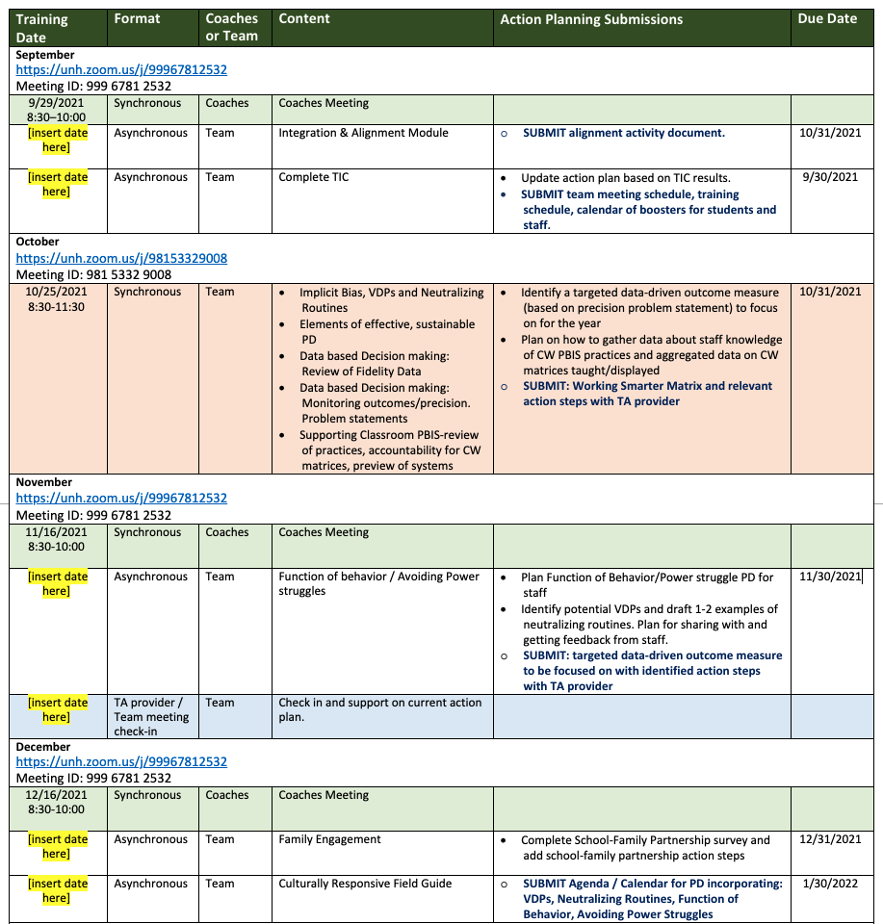
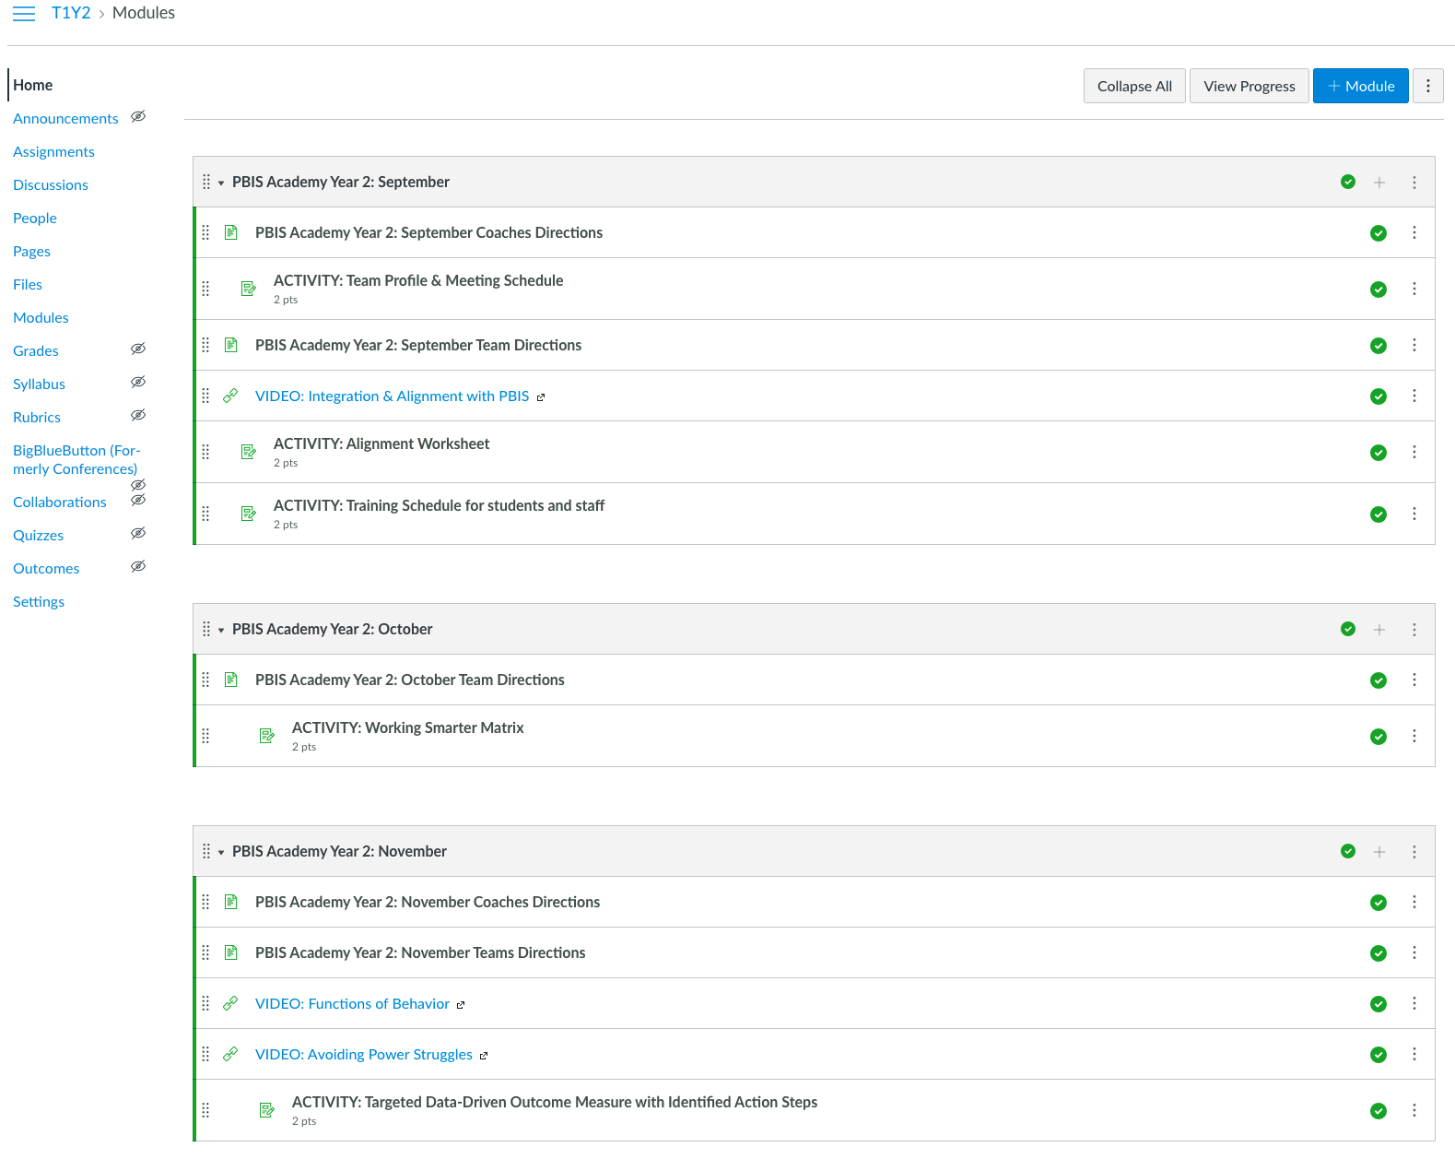
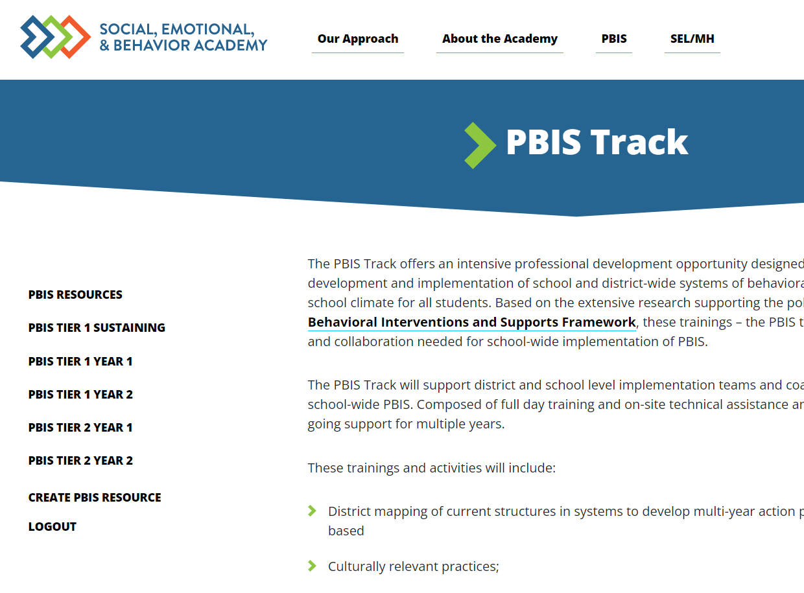
PBIS Academy Support Structure
Learning Plan
Website
Canvas
https://sebacademy.edc.org/
Notes:
Overview slide…each resource has it’s own slide.

Slide 12
PBIS Academy Support Structure
Learning Plan
What is it?
Year at a glance guide for coach meetings and team trainings including content and activities.
Purpose:
Help keep us organized, stay on track, and plan ahead.
Important features?
Synchronous coaches meeting and team training dates
Supplemental content topics/videos
Monthly team discussion activities and product submissions
Team meeting check-ins
Your team meeting dates!
Notes:
TRAINER NOTE: Please share the learning plan with everyone in the chat.
You can find a learning plan for each cohort here from Website Resource list: https://sebacademy.edc.org/list-of-pbis-resources
This contains dates and content for all coach meetings and team trainings. Includes the Zoom Link

Slide 13
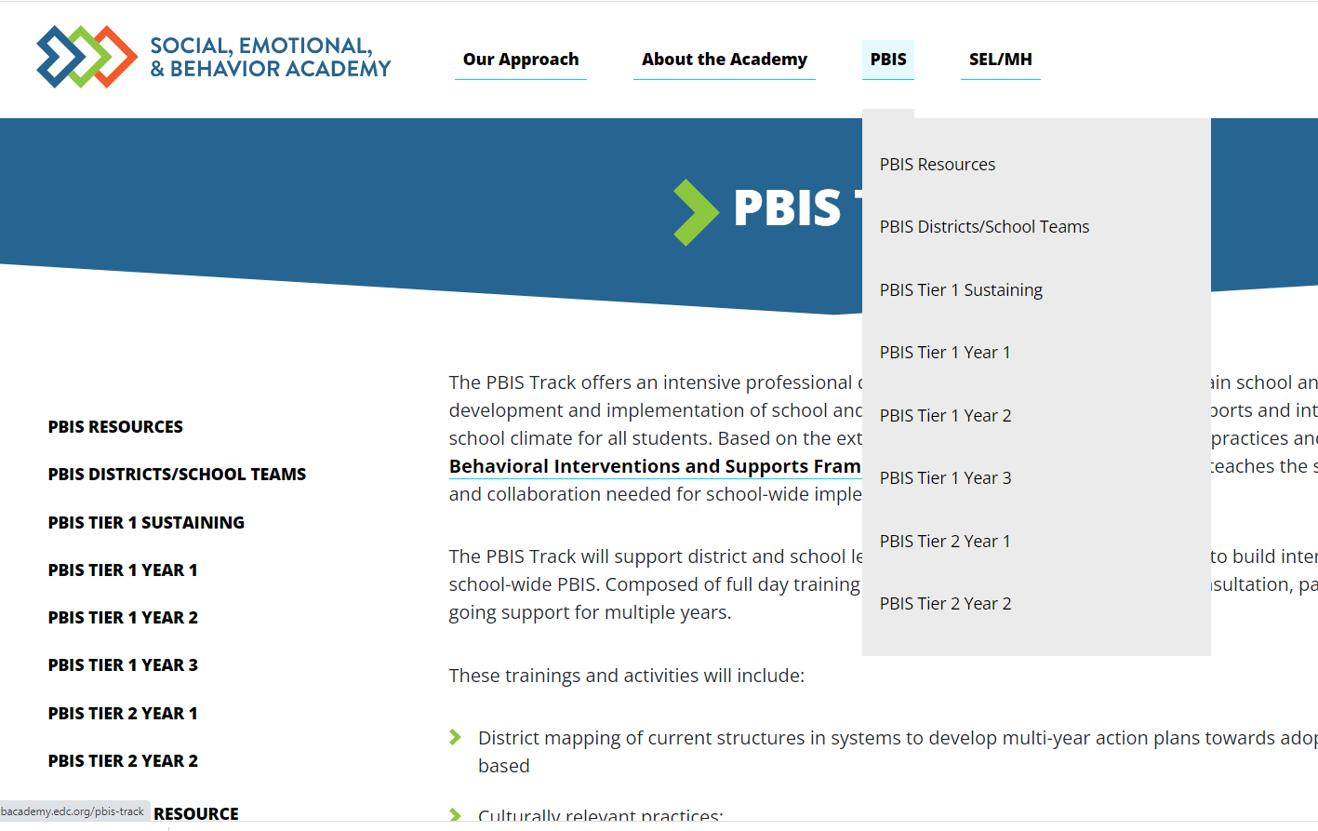
PBIS Academy Support Structure
What is it?
Your team's guide for training content, readings, and resources for each monthly event.
Purpose:
Monthly organized resource repository for your team to access all PBIS Academy content
Website
https://sebacademy.edc.org
Important features?
All event tools, activities, ppts, and other resources
Coach meeting and Team training dates/times with zoom links or hotel locations.
Notes:
TRAINER NOTE: Please share the website address https://sebacademy.edc.org/pbis-track
Review The resource page and the Tier 1 Year 1 page.
Remind them that we are in the process of building the website.

Slide 14
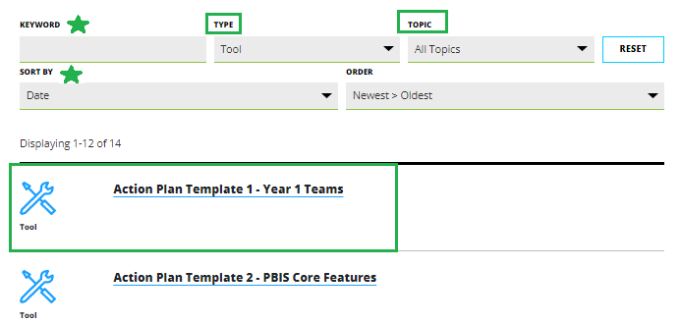
Resources
Notes:
Go to RESOURCES. If you know the topic or the Type of resource you are looking for you can select that in the search area. If not, just leave all types and all topics.
Find the resources and click on it.
The resources will open
Click the blue Button to download resource or be taken to the webpage with the resource

Slide 15
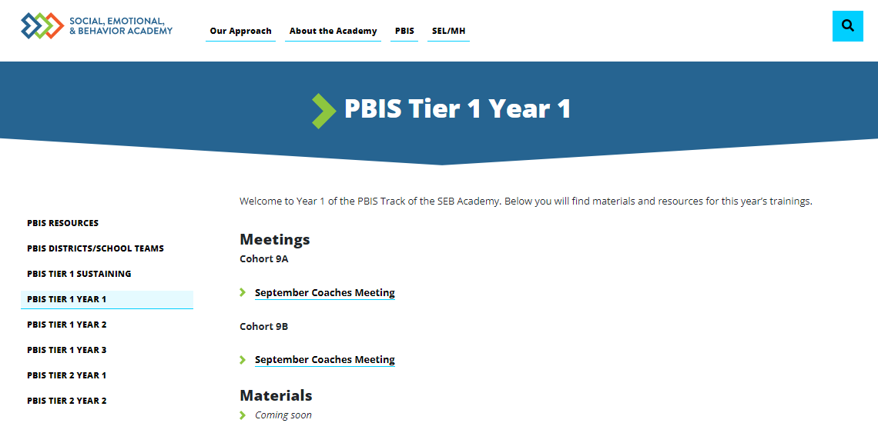
PBIS Tier 1 Year 1 Page
Notes:
This page is in the process of being created/updated. Please be patient it will be functioning soon. Please check back. All information for each monthly training or meeting will be displayed here

Slide 16
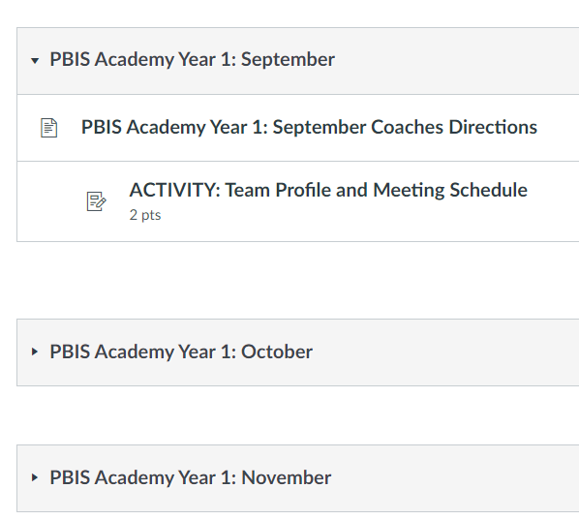
PBIS Academy Support Structure
Canvas
What is it?
Coach area for monthly activity submissions.
Purpose:
Sharing area for coaches to receive feedback from trainers.
Important features?
Activities and submission for feedback
Coach meeting and Team training dates with zoom links and all materials
Notes:
Canvas: Only Coaches this year. (Admins OK if they want to be on)
We will be adding coaches soon. Please have coaches check if they have access to Canvas https://canvas.instructure.com/
Trainers: If they can’t long on get their names and emails so you can add coaches to Canvas using the PEOPLE process.
Remind Coaches to check spam/junk/trash folders. If they can not find the invite,
Email will come from Canvas Free for Teachers <notifications@instructure.com with subject “course invitation”

Slide 17

Introduction to PBIS:
Notes:
TRAINER NOTE:
Use this time to check in with coaches and gauge their existing knowledge base of PBIS.
The following 2 slides provide an opportunity for a BRIEF review and chance to develop a basic common understanding. It is not intended to be a full explanation. We will go in depth in October

Slide 18
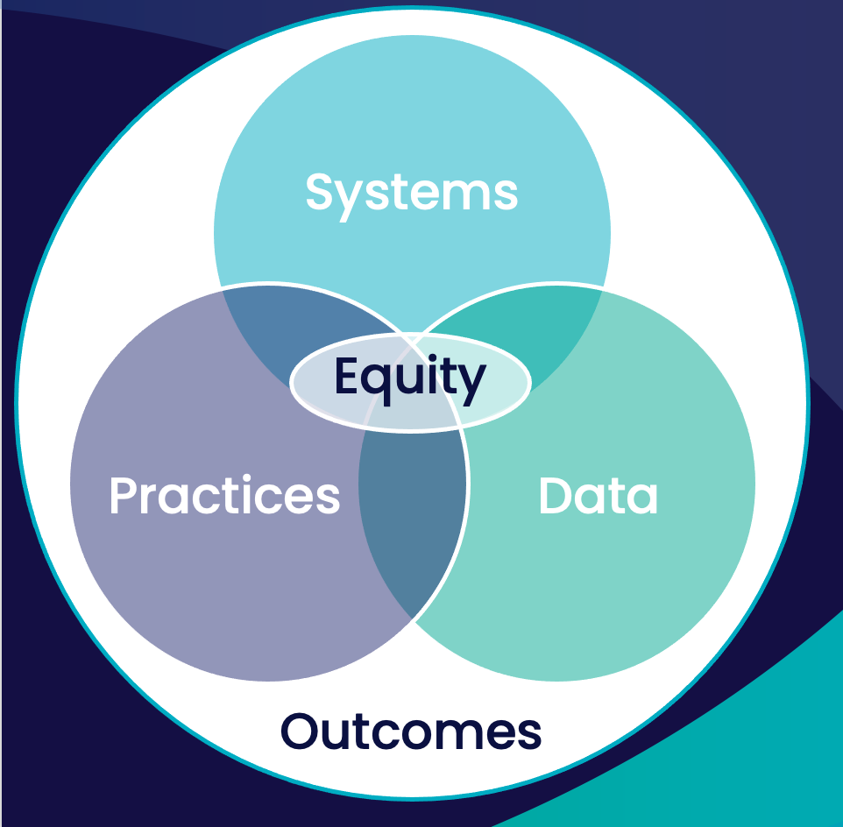
School-wide PBIS is a...
~5%
~15%
~80% of Students
Framework for enhancing adoption & implementation of
Continuum of evidence-based interventions to achieve
Academically & behaviorally important outcomes for
All students
Notes:
Quick review of PBIS main Core Components – We will dig deeper into the overview in October at the team training

Slide 19










GETTING STARTED WITH SWPBIS
Establish an effective leadership team
Develop a continuum to strengthen appropriate behaviors
Develop a brief statement of purpose
Develop a continuum to discourage violations of expectations
Identify positive school-wide behavior expectations
Develop data-based procedures for monitoring
Develop procedures to teach school-wide expectations
Develop systems to support staff
Develop procedures to teach class-wide expectations
Build routines to ensure ongoing implementation
Notes:
Quick review of the 10 Getting Started Steps. Oct. Team training will review steps 1-4

Slide 20

BRIEF INTRODUCTION TO COACHING
This is where you come in!

Slide 21
FUNCTIONS OF COACHING
Communication
Start-Up
Fidelity
Network
Sustainability & Accountability
Facilitation
Coaches provide team start-up support
Coaches improve and increase public relations and communication
Think of past experiences when you have been coached. What makes an effective coach?
Coaches promote fidelity of implementation
Coaches are linked:
Across schools
To leadership
To trainers
To teams
Coaches facilitate by providing:
Technical assistance
Problem solving
Positive reinforcement
Prompts (“positive nags”)
Coaches allow for local facilitation
Behavioral Capacity
Increases as coaches build their own skills
Notes:
These are basic functions of coaching. Coach should facilitate/oversee these tasks within the team. There may be similar roles for team members such as communications with staff.

Slide 22
Necessary
Preferred
We will work with you to develop these skills
COACHING COMPETENCIES
-Participate in team training, coaches training, and networking
-Facilitate team meetings at least monthly
-Work effectively with adults
-Knowledgeable about school operating systems
-Professional commitment
-Knowledge of SWPBIS
-Knowledge about behavior support practices at school-wide, class-wide, targeted, and individual levels
-Skilled in data collection & use of data for decision-making
Notes:
Have them consider 2 or 3 coaches to share the work.

Slide 23
COACHING ROLES
Poll:
Which role are you most/least comfortable with?
Poll:
Which role are you least
comfortable with?
Content Knowledge
Facilitate
Communicate
Content
Facilitate
Local PBS expert
Positive “nag”
Link to resources (e.g., pbis.org)
Communicate
Team meetings
Activities at training events
Implementation
Share advanced content with team
Share information at faculty meetings
Notes:
Which role are you most comfortable with:
a. Content knowledge
b. Facilitation
c. Communication
Which role are you least comfortable with:
a. Content knowledge
b. Facilitation
c. Communication

Slide 24
ACTION PLANNING
Specifies three features:
Foundation for all you do as a team
Vital for achieving goals
Action Plan
Who
What
When
1
2
3
Who is responsible…
…for doing what…
…by when?
Action Planning: The process of organizing resources to enable individuals to engage in activities designed to achieve specific and important outcomes.

Slide 25
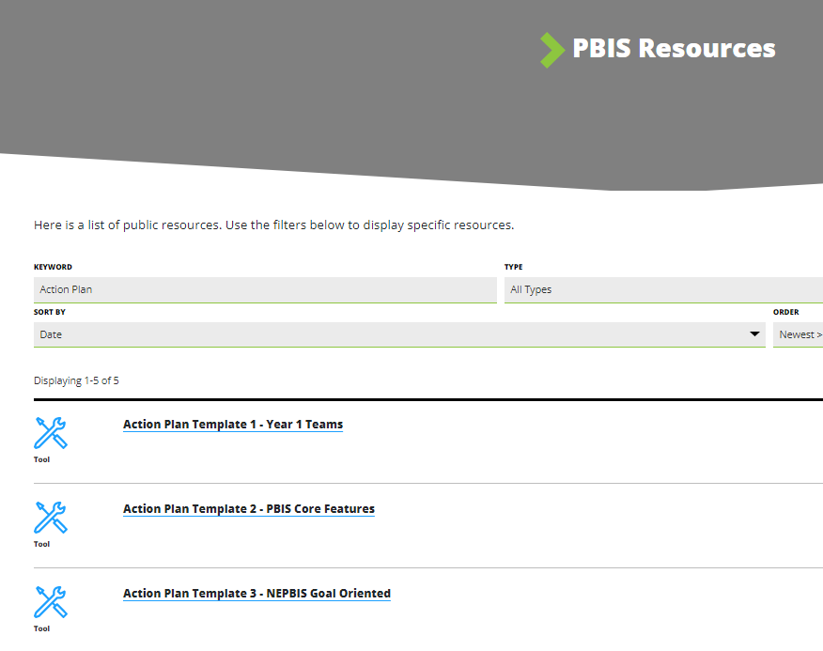
ACTION PLAN TEMPLATE
Preview the action plan templates, selecting one for your team to use as a foundation.
We recommend Action Plan #1
Consider how will you share access to documents with your team members? (Google Docs, School Common Drive, SharePoint)
Notes:
Review and remind they can use their School base action plan if they already use one.
Recommend - Action Plan #1 is simple and straight forward. Link to action plan #1—https://sebacademy.edc.org/action-plan-template-1-year-1-teams

Slide 26
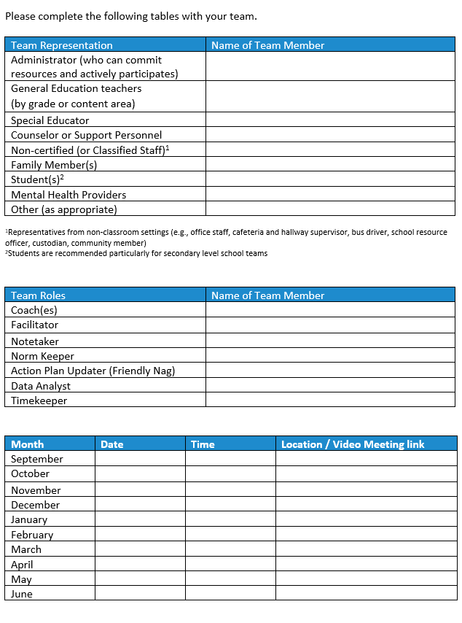
TIER 1 TEAM PROFILE AND MEETING SCHEDULE
Download the Team Profile and Meeting Schedule
Complete with your team and upload to Canvas for trainer feedback. (You will have time to finish this at the Oct Training)
Notes:
https://sebacademy.edc.org/tier-2-team-profile-and-meeting-schedule

Slide 27
DISCUSSION: Comments - Questions?
Questions about:
Academy Structure
Resource sites: Website/Canvas
Resources: Articles, Templates
Activity: Complete and Upload Team Profile to Canvas
Other Questions or Comments
Whole Group
5 minutes

Slide 28
PBIS
Looking Ahead:
Previewing October Team Training
Notes:
Quick Preview of next few slides….not indepth

Slide 29

OCTOBER TEAM TRAINING
October 18th 8:30-2:30 PM
In Person – 9A-Marlborough
9B Worcester
Whole team attends
BIG IDEAS
Team Functioning
Identify hopes and goals for PBIS in your school
Determine your School-wide Expectations/Core Values
Begin working on your Teaching Matrix
Preview Lesson Plans
Notes:
TRAINER NOTE:
Provide hotel location and update slide to just your location.

Slide 30

TEAM COMPOSITION
Administrator
Support Staff
Grade/Department Representatives
Parent/Family
Members
Specialists
Community Members
If team size is a concern,
use subcommittees.
Office, Supervisory, Custodial, Bus, Security, etc.
Special Educator, Counselor, School Psychologist, Social Worker, etc.
Mental Health Providers, Businesses
Student

Slide 31
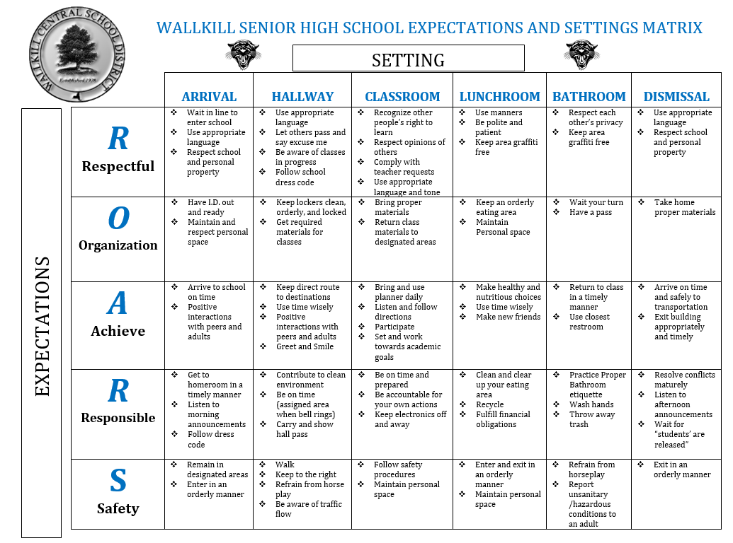
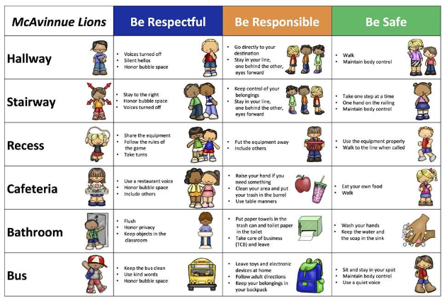
Creating a Teaching Matrix
Notes:
Primary and Secondary examples

Slide 32
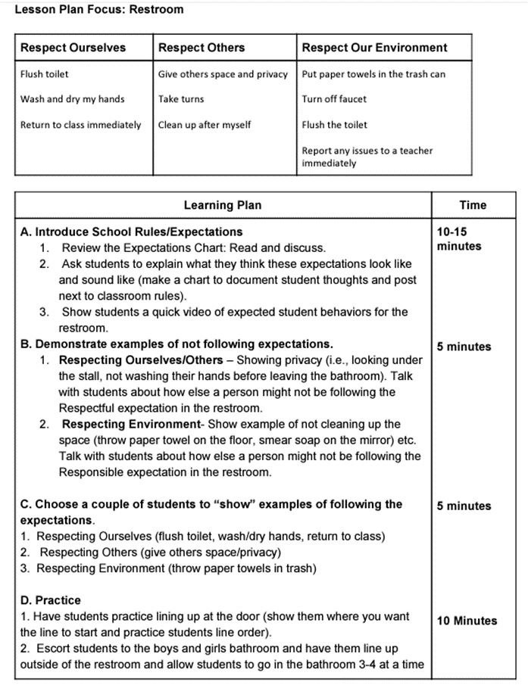
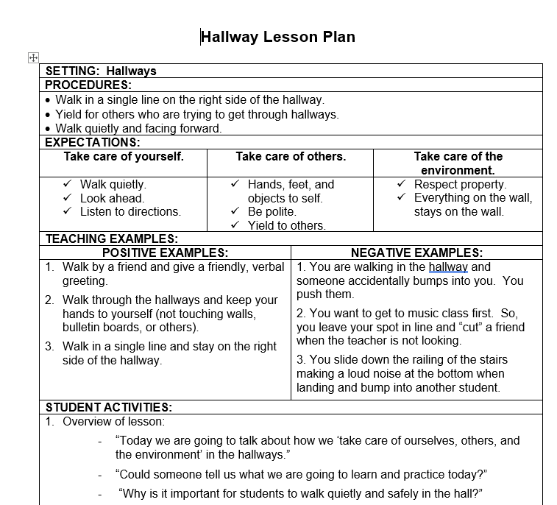
Creating Lesson Plans (Reviewed)
Notes:
We will review lesson plans at the Oct training so that teams can work on them between Oct and then next in person day in Jan

Slide 33
Agenda & Coaches' Tasks
Coaches’ Tasks:
Submit Team Profile and Meeting Schedule
Presentation Content:
Introductions
Glows and Grows: Getting Started
Intro to PBIS and Coaching
Complete PBIS Communication Survey
Preview of October Team Training
Team Foundation Check In
Choose an Action Planning Template
What questions do you have on today’s content?
What questions do you have on the follow-up tasks?

Slide 34
HELPFUL RESOURCES
MATERIALS:
Action Plan Template Options
Team Profile and Meeting Schedule
Communication Survey
RESOURCES:
Center on PBIS’ Coaching page
Become a Better Team by Solving 3 Common Mistakes
7 Ways to MacGyver Your Action Plans
Notes:
Center on PBIS’ Coaching Page: https://www.pbis.org/topics/coaching
Become a Better Team by Solving 3 Common Mistakes: https://www.pbisapps.org/articles/become-a-better-team-by-solving-3-common-mistakes
7 Ways to MacGyver Your Action Plans: https://www.pbisapps.org/articles/7-ways-to-macgyver-your-action-plans
These can be accessed using the webpage using resource list.

Slide 35
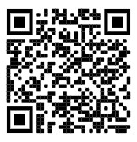
https://edc.co1.qualtrics.com/jfe/form/SV_cBF9GI7gVEBsfSC
EVALUATION
Please remember to complete the evaluation!
Scan the QR code to access.
Notes:
TRAINERS -
Put link to evaluation (below) in the chat for those who do not use the QR code:
https://edc.co1.qualtrics.com/jfe/form/SV_cBF9GI7gVEBsfSC

