Slide 1


PBIS School-Wide Coach Meeting
Sustaining Academy
September 2022
PBIS Track
Enter Trainers Names
with support from NEPBIS Network, May Institute & Broad Reach Consulting
Notes:
Add trainer names for your event

Slide 2

EXPECTATIONS
Self
Others
Environment
Self-monitor
Mute when listening, unmute to talk​
Have your computer charged and ready to go​
If you have questions or comments:
Work as a team:
Keep necessary materials at hand
Are you participating?
Engaged as a learner?
Stretch, break, stand as needed​
unmute
use the chat box
Room for every voice
Reinforce participation
action plan
relevant docs
water/snacks
Minimize distractions if possible​

Slide 3
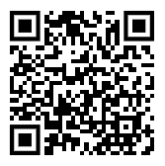
ACTIVITY: ATTENDANCE
Scan QR code on the left or follow the URL posted in the chat to access the online attendance survey
Follow prompts to enter attendance information
Notify trainers if you require assistance (e.g., identifying your cohort or cohort group)
Certificates of Attendance will be sent in January and June. Attendance records and Zoom log in will be use as verification
You are in Sustaining Cohort
1 minute
Notes:
TRAINERS – QR Code is updated
Add your cohort number
Post a link to the attendance survey (below) in the chat for those who do not use the QR code on the slide:
ATTENDANCE: https://edc.co1.qualtrics.com/jfe/form/SV_5BiXqi4bxzOCMS2

Slide 4
Agenda & Coaches' Tasks
Coaches’ Tasks:
Presentation Content:
PBIS Academy Year 3 Training and Support Structure
Sustainability Factors – Team Functioning / Action Planning
Glows & Grows: PBIS Rollout
Complete and send in your PBIS Assessment Coordinator Form
Complete Communication Survey for list of team members with emails for event reminders
Submit Advanced Action Plan with Team/Meeting portion completed in Canvas
Review the Logic Model Activity prepare for Nov. Team Training

Slide 5
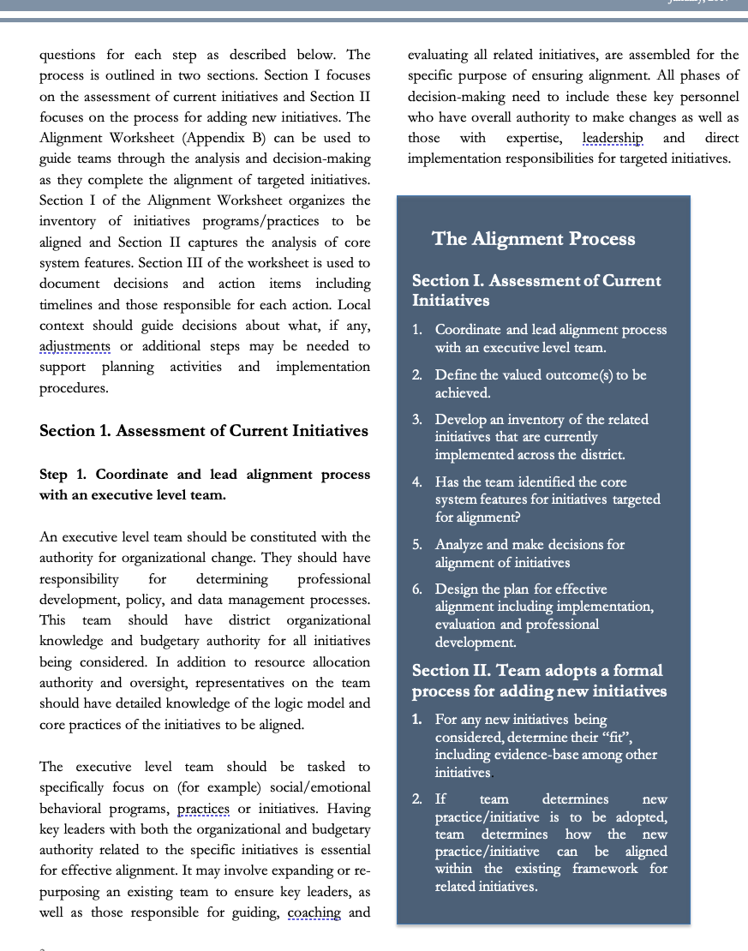
HELPFUL RESOURCES
RESOURCES:
Advanced Action Plan
Team meeting foundations checklist
PBIS Assessment Coordinator form
Logic Model Sample & Template
READINGS / Videos:
Four Tips for Sustaining PBIS
9 Things You Might Have Forgotten How to Do in PBISApps
7 Ways to MacGyver your Action Plan
Notes:
RESOURCES – Strongly encourage coaches to down load these resources.
Advance Action Plan: https://sebacademy.edc.org/annual-action-plan-template-advanced We will discuss this later in the slide deck
Team meeting foundations checklist: https://sebacademy.edc.org/team-meeting-foundations-checklist Not reviewed later but
PBIS Assessment Coordinator Form https://sebacademy.edc.org/pbis-assessment-coordinator-form We will discuss this later in the slide deck
READINGS:
9 Things You Might Have Forgotten How to Do in PBISApps - https://www.pbisapps.org/articles/9-things-you-might-have-forgotten-how-to-do-in-pbisapps Helpful for logging in and SWIS issues
Four Tips for Sustaining PBIS - https://www.pbis.org/video/four-tips-for-sustaining-pbis We will watch this later in the slide deck

Slide 6

PBIS
Resource Spotlight:
PBIS Academy Support Structure

Slide 7
2022-2023 PBIS Academy Training Format
Years
Year
01
02
03
Attendees
Team Training (Minimum):
        Administrator
        Grade-Level Representatives
        Support Staff
        Coaches
Coaches Training:
2-3 Coaches
  Technical Assistance:
  Administrator
  Coach
  Data Entry Staff
  Faculty/Staff
04 Sustaining Academy
Support
Years 1 & 2
  7 – 1.5 hr. Monthly Coach Meetings (Virtual)
  3 Full Day - Team Trainings Meetings (Years 1 & 2) (In Person)
Year 3
  8 – 1.5 hr. Monthly Coach Meetings (Virtual)
  2 Full Day - Team Trainings Meetings (Year 3) (In Person)
1.5 day (12 hr.) Technical Assistance per school
SWIS Data System & Training
Support
4-2hr Coaches Meetings
Optional 2 Full Day Team Trainings with year 3 schools (In Person)
1 day School-based Technical Assistance
SWIS Data System & Training
Notes:
Trainer note: Review support options for this year. Please let folks that future trainings will include a mixture of in person and online (hybrid) approaches (e.g., in person team trainings, but virtual coaches meetings). Regardless of support delivery, the categories of the support will be listed and developed based on DESE recommendations.

Slide 8
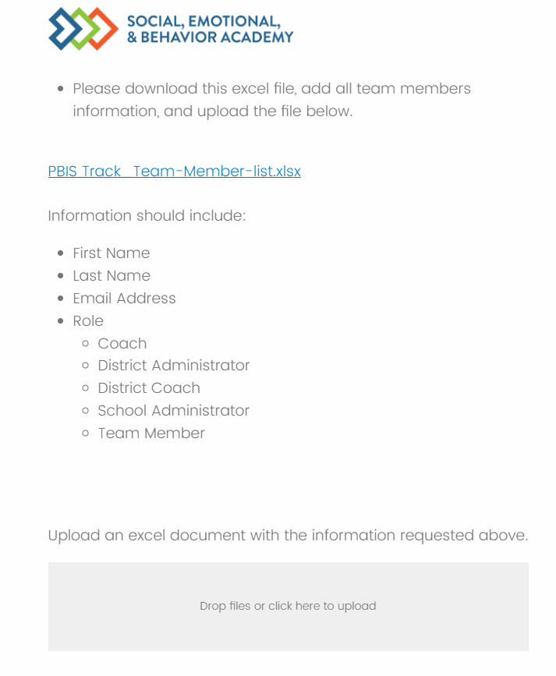
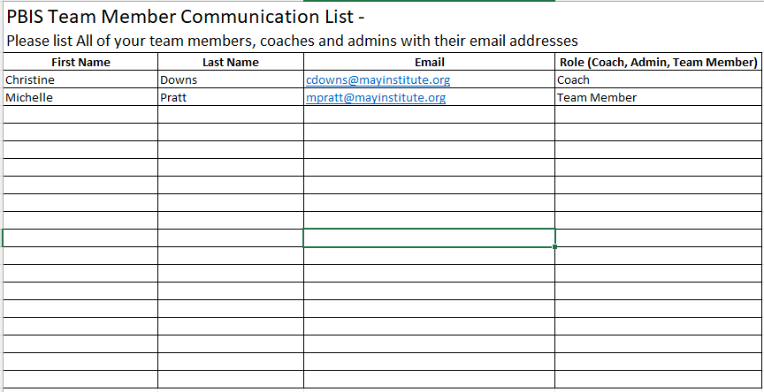
Communication Survey & Mail Chimp
Please add all your team’s contact information into the Communication Excel Sheet. Then upload to the
Download the excel sheet
Add names, email, and role, then save file
Drag file into box to upload
Communications Survey
https://edc.co1.qualtrics.com/jfe/form/SV_db8zhNj6NJ3eXga
Notes:
https://edc.co1.qualtrics.com/jfe/form/SV_db8zhNj6NJ3eXga
Go to website demonstrate how to download Team Member List and how to upload it.

Slide 9
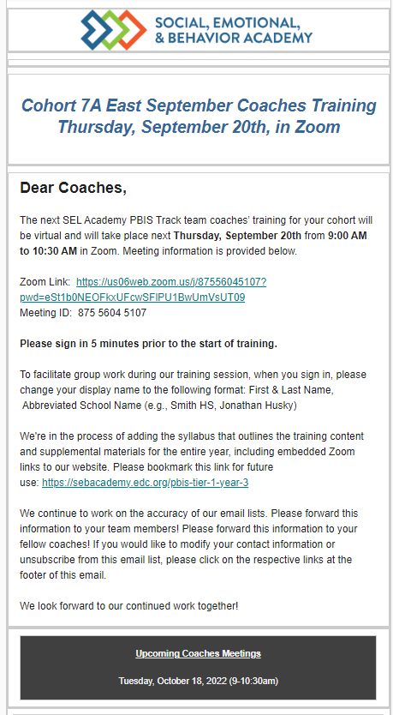
Communication Survey & Reminders
Email Reminders will be sent to all coaches, administrators and team members for our PBIS Events. The email will come from SEB Academy sebacademy@edc.org
Please review invitation for Date, Time, Location/Zoom Link, and any other important information included.
The next training or coach meeting will be displayed in the black box a the bottom
Share with other Coaches or Team Members as necessary.
You may update or add coaches or team members to the mailing list using the communication survey. You only need to add new members you do not need to list member you already uploaded.
Next upcoming Training or Coach Meeting

Slide 10
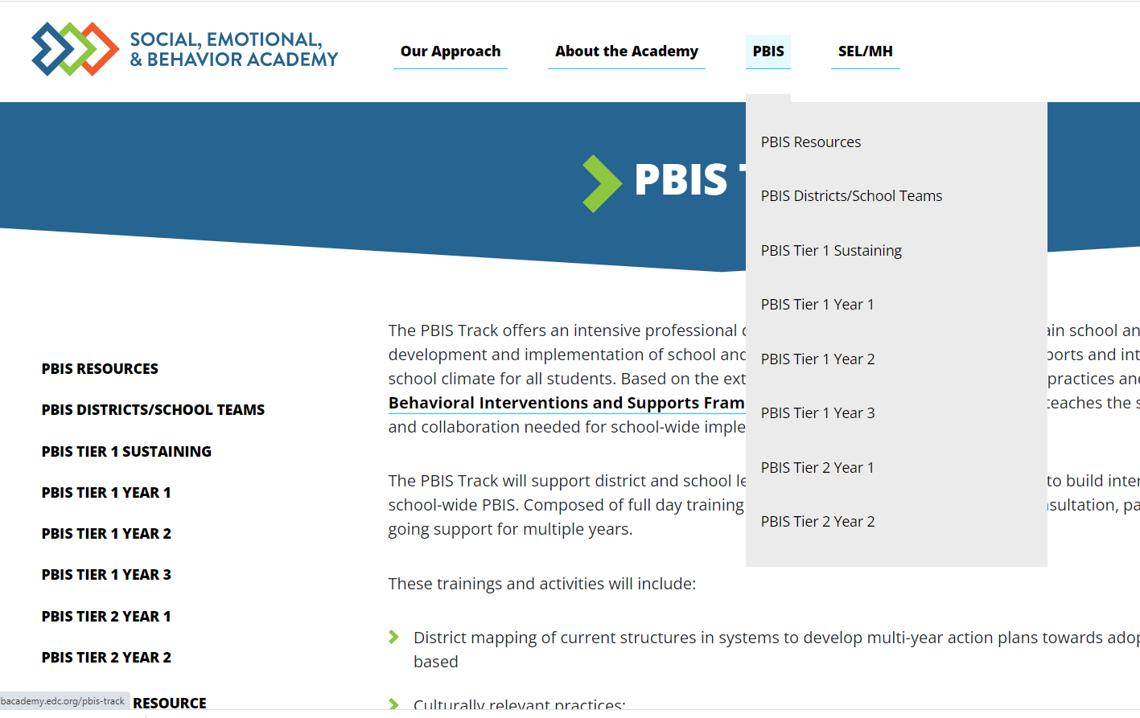
PBIS Academy Support Structure Questions?
What questions do you have?
What is it?
Your team's guide for training content, readings, and resources for both each monthly event.
Purpose:
Monthly organized resource repository for your team to access all PBIS Academy content
Important features?
All event tools, activities, ppts, and other resources
Coach meeting and Team training dates/times with zoom links or hotel locations.
Website
https://sebacademy.edc.org
Notes:
TRAINER NOTE: Please share the website address https://sebacademy.edc.org/pbis-track
Review The resource page and the Tier 1 Year 3 page. - There should be an event card there to review
NOTE: SWIS page with training dates will be up shortly

Slide 11
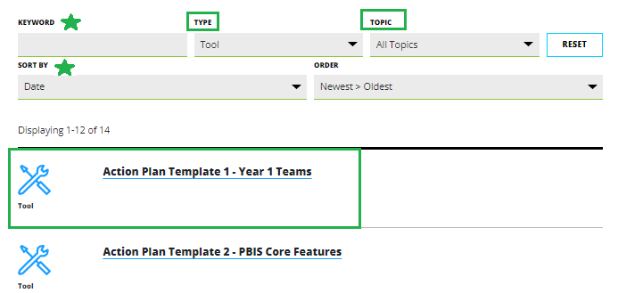
Resources
Notes:
Go to RESOURCES. If you know the topic or the Type of resource you are looking for you can select that in the search area. If not, just leave all types and all topics.
Find the resources and click on it.
The resources will open
Click the blue Button to download resource or be taken to the webpage with the resource

Slide 12
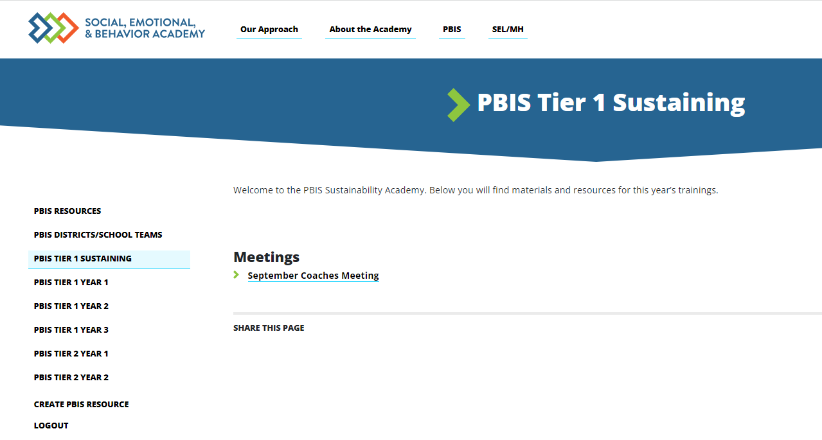
PBIS Tier 1 Sustaining page
Notes:
This page is in the process of being created/updated. Please be patient it will be functioning soon. Please check back. All information for each monthly training or meeting will be displayed here

Slide 13
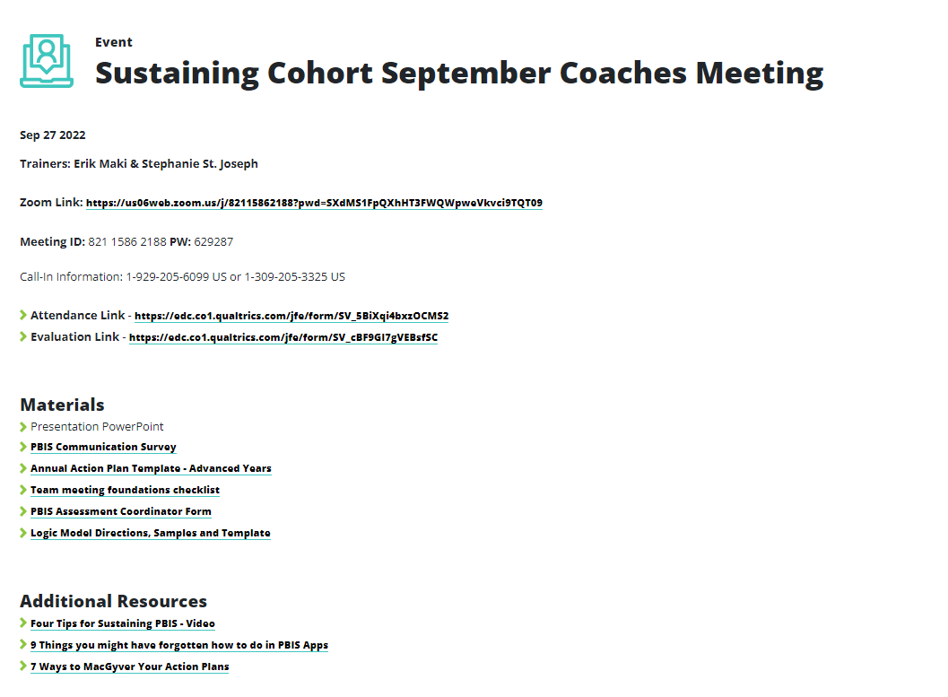
September Coaches Meeting
Notes:
This page is in the process of being created/updated. Please be patient it will be functioning soon. Please check back. All information for each monthly training or meeting will be displayed here

Slide 14

Glows & Grows:
Teaming and Goals
Notes:
12:30

Slide 15
DISCUSSION: GLOWS & GROWS
What is something to celebrate & something you’re working on related to:
Goals for this year (outcome goals or implementation goals)
TFI Results from Last year
Summer Planning / Fall Kick Off
5 minutes
15 minutes
Independent Jot
Whole Group

Slide 16
Big Idea Check In:
Yearly Planning & Outcome Goals
Notes:
TRAINER NOTE: This is review contnent please be brief

Slide 17

4 Tips for Sustaining PBIS
https://youtu.be/xPt9pGkOgIo?t=7
Notes:
Trainers: Play this entire 4.41-minute video as a set up for the slides to come. (Be sure you shared your Sound when you shared your screen)
https://www.pbis.org/video/four-tips-for-sustaining-pbis

Slide 18










GETTING STARTED WITH SWPBIS
Establish an effective leadership team
Develop a continuum to strengthen appropriate behaviors
Develop a brief statement of purpose
Develop a continuum to discourage violations of expectations
Identify positive school-wide behavior expectations
Develop data-based procedures for monitoring
Develop procedures to teach school-wide expectations
Develop systems to support staff
Develop procedures to teach class-wide expectations
Build routines to ensure ongoing implementation
Notes:
Emphasise the 4 ideas from the video
1 – Keep a strong team (next slide)
2 – Use TFI data to improve systems (we will do this at the November training)
3 – Use your school discipline data – slide to come with all data mentioned…good for goal planning
4 – Implement PBIS in the Classroom (Nov Training)

Slide 19
GUIDELINES FOR TEAMS
Membership
Systems
Scheduling
Systems
Representative of school/community demographics
1-2 members with behavior/classroom management competence
1-2 family members
Active participation from administrator
Integrated with other behavior-related initiatives/programs
Given appropriate priority relative to school/district goals
Established rules/agreements
Coaching support (at the school, district, or regional level)
Monthly meetings
Monthly presentations to staff
Annual self-assessments
Notes:
TRAINER NOTE: This is review contnent please be brief

Slide 20
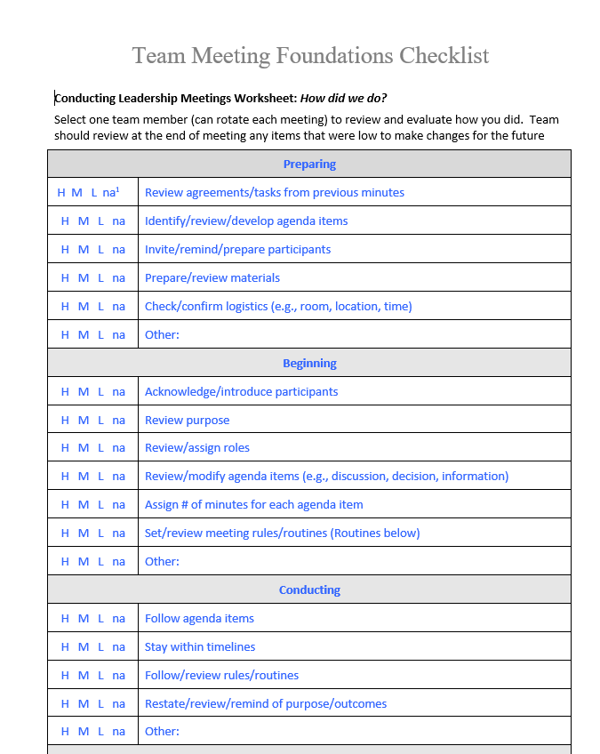
Meeting Foundation Checklist
This is a great way to prepare for and evaluate your team meetings
Use it as a coach to prepare for your meetings
Ask one team member each meeting to complete the checklist as best as possible throughout your meeting to evaluate your meeting.
Review checklist at the end of the meeting
Adjust practices / systems for items that receive an L (low) rating.
Notes:
https://sebacademy.edc.org/team-meeting-foundations-checklist

Slide 21
DISCUSSION: Meeting Foundations
Download Meeting Foundation Checklist
Review items and reflect on areas you do well and where you can improve.
What is the current status of your Team foundations? What further support do you need so you can support your team with this work?
What examples can you share?
5 minutes
15 minutes
Independent Jot
Whole Group
Notes:
https://sebacademy.edc.org/annual-action-plan-template-advanced

Slide 22
ACTION PLANNING
Action Plan
Foundation for all you do as a team
Vital for achieving goals
Specifies three features:
1
2
3
Who
What
When
Who is responsible…
…for doing what…
…by when?
Action Planning: The process of organizing resources to enable individuals to engage in activities designed to achieve specific and important outcomes.
Notes:
TRAINER NOTE: Keep this brief, this is review content

Slide 23

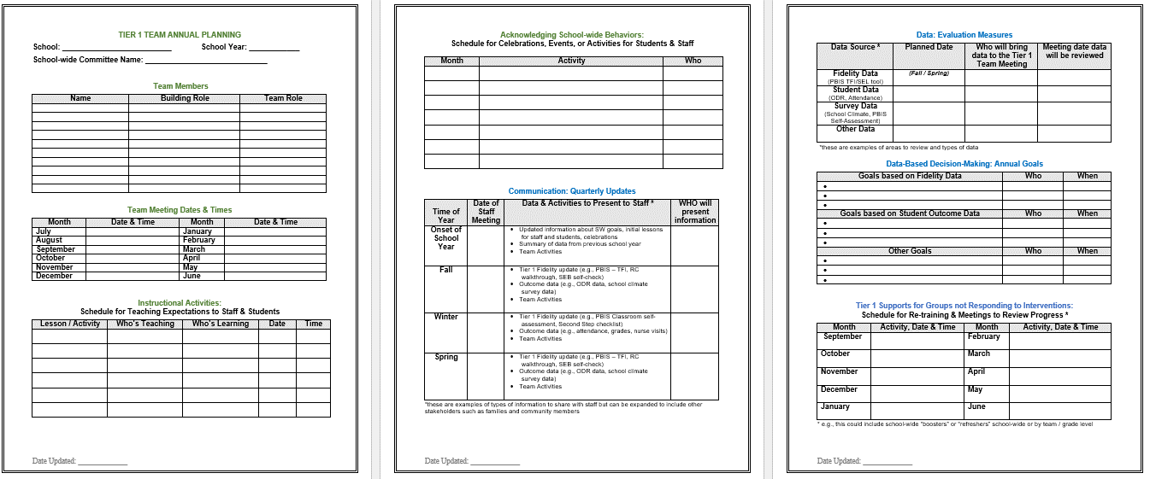
Annual Action Planning - Advanced
Evaluation Measures
Acknowledgment Plans
Team
Info
Annual Goals
Teaching Expectations Plan
Communication
Tier 1 Student Follow Up
Notes:
This Action plan is more advanced and is intended for schools in years 2 and beyond. Review with the team.
Advanced Action Plan https://sebacademy.edc.org/annual-action-plan-template-advanced

Slide 24
DATA-INFORMED OUTCOME GOALS
Review the following with your team when considering your PBIS outcome goals for the year:
Fidelity Assessments (TFI, TIC)
Student Outcome Data (attendance, screening, discipline, grades)
Stakeholder Input (surveys, focus groups)
School/District Priorities (DIP, SIP)
Notes:
We will review Stakeholder Input Surveys (new on PBIS apps) in October.
Teams should consider these factors when setting goals for this year.

Slide 25
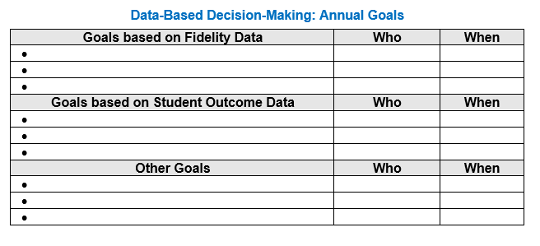
Goals and Outcomes
Notes:
Have them begin to think about their Goals for This year. They should come to the Oct team training prepared to identify goals and the data sources they will use to measure the goal.
This will be an October team activity. Coaches should start to think about these based upon last years goals, the TFI, and other Data

Slide 26
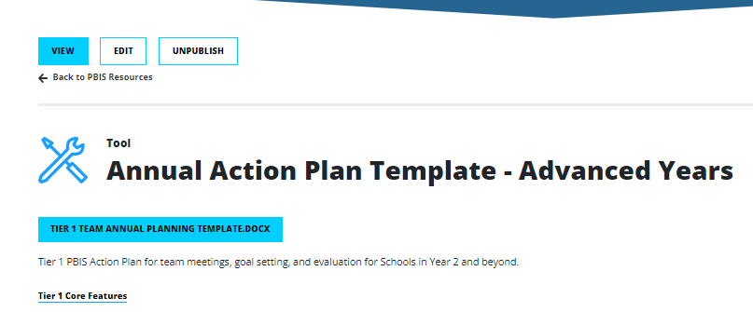
Action Plan – Annual Planning Advanced Years
https://sebacademy.edc.org/annual-action-plan-template-advanced
Notes:
Ask Coaches to download this Action Plan for use this year. Will be reviewed in the next slide.
https://sebacademy.edc.org/annual-action-plan-template-advanced

Slide 27
DISCUSSION: TEAMING
Download & Review Advanced Action Plan.
Complete Team and Goals Section and share with trainers.
Consider what other parts you can fill in and what you need to work on. (This can be completed later with your team)
Share out with group
10 minutes
15 minutes
Independent Jot
Whole Group
Notes:
https://sebacademy.edc.org/annual-action-plan-template-advanced

Slide 28
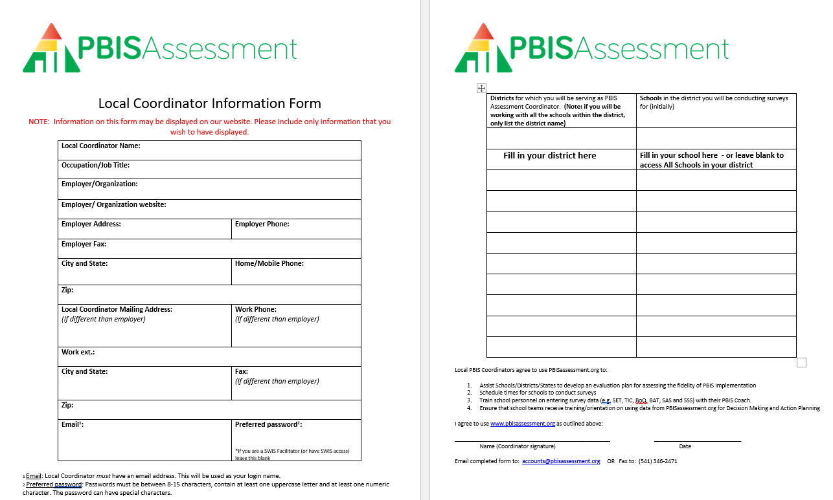
PBIS Assessments Coordinator
In October we will review how to open Assessments and surveys in PBIS Apps.
Please download and complete form and send to: accounts@pbisassessment.org
“Hello,
Please add me as a PBIS Assessment Coordinator. See attached form.
Thank you,”
Notes:
Have coaches download this form from the EDC PBIS Resource page. https://sebacademy.edc.org/pbis-assessment-coordinator-form
They should complete it and send it to accounts@pbisassessment.org with the script “Hello,
Please add me as a PBIS Assessment Coordinator. See attached form.
Thank you,”

Slide 29
DISCUSSION: TEAMING
Download & Review PBIS Assessment Coordinator Form
Complete form with your information. Add your school district and school to page 2. If you need access to the entire district just enter district name.
Send to accounts@pbisassessment.org with the message: “Hello,
Please add me as a PBIS Assessment Coordinator for ___________ School. Please see attached form.
Thank you,”
10 minutes
Notes:
Have coaches download this form from the EDC PBIS Resource page. https://sebacademy.edc.org/pbis-assessment-coordinator-form
We will review how to be a PBIS Assessment Coordinator at December Coach Meeting

Slide 30
Looking Ahead

Slide 31

November Team Training
Please let us know if you will be attending and which date/location you will be joining
Join 7A – 11/15 – Marlboro 8:30-2:30
Join 7C – 11/16 – Springfield 8:30-2:30
BIG IDEAS
Reviewing your PBIS Handbook
Classroom Assessment and Goals
SW-Data Collection and Use
Evaluation Plan
Logic Model Sharing

Slide 32
ROUNDTABLE DISCUSSIONS
Purpose: present one example of how you have used Systems, Data, and Practices to achieve a specific outcome.
Present to team members from other schools
Outline your school’s example using the logic model template (outcomes, systems, data, practices).
Be prepared to share and take notes.
Take new ideas back to your team for action planning!
Notes:
TRAINER NOTE: This is preparation of a sharing activity for the November Team Training
Instructions for roundtable prep below:
Outline your school’s example using the template (outcomes, systems, data, practices).
Be prepared to share and take notes.
Take new ideas back to your team for action planning!

Slide 33
School: ___________________________
Identify an outcome to focus on for this activity. For example:
Decrease ODRs on the playground
Increase consistency of response to behavior to ensure equity
Increase family engagement
How do we sustain this?
OUTCOME
Enter systems changes you made to help achieve your goal
Enter what dataa source you used to identify your goal and evaluate the results
How do we know we are doing what we say we are doing? How do we know it is working?
SYSTEMS
DATA
How do we support staff to
implement this with fidelity?
What is one highlight
associated with this outcome?
__________________________________
__________________________________
What is one lesson learned?
__________________________________
__________________________________
Enter Practices taught to achieve your goal
What are we doing?
What do we want to be doing?
PRACTICES

Slide 34
Lincoln School Logic Model
OUTCOME
How do we sustain this?
Explicit expectations taught & retaught, monitors trained and overlap with staff for first month, zones created & assigned to staff
Reduce injuries and referrals during recess
Recess monitors taught expectations with students at the start of the year. Four playground zones were created and staff were assigned to each zone and active monitoring was modeled by school staff for the first 3 weeks of school.
DATA
Office referrals, visits to the nurse, recess monitor weekly survey
How do we support staff to
implement this with fidelity?
SYSTEMS
What is one highlight
associated with this outcome?
Office referrals and injuries at recess have decreased. Monitors are more engaged with students and spend less time talking to one another.
What is one lesson learned?
Arranging schedules to overlap with monitors to train and model was challenging but critical.
Active monitoring at recess, expectations for behavior and use of equipment explicitly taught, each monitor acknowledges 5 students per recess for appropriate behavior
How do we know we are doing what we say we are doing? How do we know it is working?
What are we doing?
What do we want to be doing?
PRACTICES

Slide 35



Washington School Logic Model
Outcome:
Increase consistancy in our ODR system to ensure equicty across our students
Systems
Clear definitions for problem behaviors both Major and Minor with examples.
Discipline Flow Chart updated to ensure all staff understand the strategies and process of behavioral management techniques before writing a referral.
Staff PD on how to write up a referral. Staff reviewed sample discipline scenarios to determine if it is a Minor, Major or a simple correction with no write up.
Discipline definitions and flowchart added to school handbook.
Data
Team examines equity reports monthly in SWIS as well as the drill down tool to ensure discpline is not disproportionate amongst different groups of students.
Data is shared with staff during faculty meeting to determine next steps
Highlight: Our ODR’s decreased signifantly once staff truly understood what should be a Major or Minor and after feeling comfortable with using the responding techniques that were practiced during PD
Lessons Learned:
Adults need lots of practice at writing referrals and keeping it unemotional.
Staff need lots of training and coaching on how to use behavior management
Practices
Teachers utilize the following:
Cool down space
Redirection/proximity/planned ignoring
Movement breaks
Mindfulness activities.
Only write up behaviors that fit a definition a Major

Slide 36
School: ___________________________
OUTCOME
How do we sustain this?
What is one highlight
associated with this outcome?
__________________________________
__________________________________
__________________________________
__________________________________
SYSTEMS
DATA
How do we support staff to
implement this with fidelity?
What is one lesson learned?
__________________________________
__________________________________
__________________________________
__________________________________
How do we know we are doing what we say we are doing? How do we know it is working?
What are we doing?
What do we want to be doing?
PRACTICES
Notes:
Template 2

Slide 37
Outcome:
Systems
Data
Highlight:
Lessons Learned:
Practices
Notes:
Template 2

Slide 38
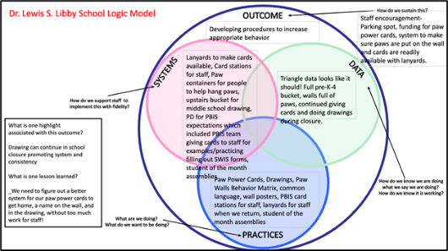
ACTIVITY: PLANNING ROUNDTABLES
Review roundtable template and examples.
Brainstorm potential outcomes you may want to target to highlight your school/team’s PBIS efforts.
What questions do you have?
Schedule a time to meet (or communicate) with your team to plan what your school wants to share.
Logic Model Directions, Samples and Template
https://sebacademy.edc.org/pbis-logic-model-activity-directions-samples-and-template
Co-coaches 5 minutes
Questions/full group 5 minutes
Notes:
https://sebacademy.edc.org/pbis-logic-model-activity-directions-samples-and-template
TRAINER: Activity prompt below; allow 5 minutes
Review roundtable template and examples.
Brainstorm potential outcomes you may want to target to highlight your school/team’s PBIS efforts.
What questions do you have?
Schedule a time to meet (or communicate) with your team to plan what your school wants to share

Slide 39
December Coach Meeting
12/6 – Zoom Meeting
BIG IDEAS
PBIS Assessment Use and Practice
Feedback and Input Surveys
PBIS Alignment with Trauma/Mental Health
Conducting Self-Assessment TFI

Slide 40
Agenda & Coaches' Tasks- Debrief
Coaches’ Tasks:
Presentation Content:
PBIS Academy Year 3 Training and Support Structure
Sustainability Factors – Team Functioning
Glows & Grows: PBIS Rollout
Complete and send in your PBIS Assessment Coordinator Form
Complete Communication Survey for list of team members with emails for event reminders
Submit Advanced Action Plan with Team/Meeting portion completed in Canvas
What questions do you have on today’s content?
What questions do you have on the follow-up tasks?

Slide 41
HELPFUL RESOURCES
RESOURCES:
Advanced Action Plan
Team meeting foundations checklist
PBIS Assessment Coordinator form
Logic Model Sample & Template
READINGS / Videos:
Four Tips for Sustaining PBIS
9 Things You Might Have Forgotten How to Do in PBISApps
7 Ways to MacGyver your Action Plan
Notes:
RESOURCES – Strongly encourage coaches to down load these resources.
Advance Action Plan: https://sebacademy.edc.org/annual-action-plan-template-advanced We will discuss this later in the slide deck
Team meeting foundations checklist: https://sebacademy.edc.org/team-meeting-foundations-checklist Not reviewed later but
PBIS Assessment Coordinator Form https://sebacademy.edc.org/pbis-assessment-coordinator-form We will discuss this later in the slide deck
READINGS:
9 Things You Might Have Forgotten How to Do in PBISApps - https://www.pbisapps.org/articles/9-things-you-might-have-forgotten-how-to-do-in-pbisapps Helpful for logging in and SWIS issues
Four Tips for Sustaining PBIS - https://www.pbis.org/video/four-tips-for-sustaining-pbis We will watch this later in the slide deck

Slide 42
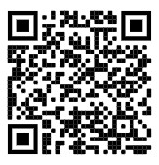
https://edc.co1.qualtrics.com/jfe/form/SV_cBF9GI7gVEBsfSC
EVALUATION
Please remember to complete the evaluation!
Scan the QR code to access.
Notes:
TRAINERS -
Put link to evaluation (below) in the chat for those who do not use the QR code:
https://edc.co1.qualtrics.com/jfe/form/SV_cBF9GI7gVEBsfSC

