Slide 1
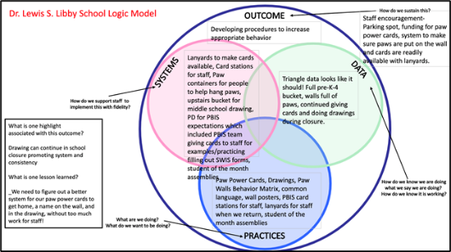
ACTIVITY: PLANNING ROUNDTABLES
Create a Logic Model for a problem you addressed or a PBIS feature you implemented
Identify an outcome you worked on.
What systems, practices and data did you use?
What are some highlights about how it turned out?
What are some lessons learned?
Review the 2 samples and create one of your own to share at the training.
Notes:
TRAINER: Activity prompt below; allow 5 minutes
Review roundtable template and examples.
Brainstorm potential outcomes you may want to target to highlight your school/team’s PBIS efforts.
What questions do you have?
Schedule a time to meet (or communicate) with your team to plan what your school wants to share

Slide 2
School: ___________________________
Identify an outcome to focus on for this activity. For example:
Decrease ODRs on the playground
Increase consistency of response to behavior to ensure equity
Increase family engagement
How do we sustain this?
OUTCOME
Enter systems changes you made to help achieve your goal
Enter what dataa source you used to identify your goal and evaluate the results
How do we know we are doing what we say we are doing? How do we know it is working?
SYSTEMS
DATA
How do we support staff to
implement this with fidelity?
What is one highlight
associated with this outcome?
__________________________________
__________________________________
What is one lesson learned?
__________________________________
__________________________________
Enter Practices taught to achieve your goal
What are we doing?
What do we want to be doing?
PRACTICES

Slide 3
Lincoln School Logic Model
SAMPLE
OUTCOME
How do we sustain this?
Explicit expectations taught & retaught, monitors trained and overlap with staff for first month, zones created & assigned to staff
Reduce injuries and referrals during recess
Recess monitors taught expectations with students at the start of the year. Four playground zones were created and staff were assigned to each zone and active monitoring was modeled by school staff for the first 3 weeks of school.
DATA
Office referrals, visits to the nurse, recess monitor weekly survey
How do we support staff to
implement this with fidelity?
SYSTEMS
What is one highlight
associated with this outcome?
Office referrals and injuries at recess have decreased. Monitors are more engaged with students and spend less time talking to one another.
What is one lesson learned?
Arranging schedules to overlap with monitors to train and model was challenging but critical.
Active monitoring at recess, expectations for behavior and use of equipment explicitly taught, each monitor acknowledges 5 students per recess for appropriate behavior
How do we know we are doing what we say we are doing? How do we know it is working?
What are we doing?
What do we want to be doing?
PRACTICES

Slide 4
Washington School Logic Model
Outcome:
Increase consistancy in our ODR system to ensure equicty across our students
Systems
Clear definitions for problem behaviors both Major and Minor with examples.
Discipline Flow Chart updated to ensure all staff understand the strategies and process of behavioral management techniques before writing a referral.
Staff PD on how to write up a referral. Staff reviewed sample discipline scenarios to determine if it is a Minor, Major or a simple correction with no write up.
Discipline definitions and flowchart added to school handbook.
SAMPLE
Data
Team examines equity reports monthly in SWIS as well as the drill down tool to ensure discpline is not disproportionate amongst different groups of students.
Data is shared with staff during faculty meeting to determine next steps
Highlight: Our ODR’s decreased signifantly once staff truly understood what should be a Major or Minor and after feeling comfortable with using the responding techniques that were practiced during PD
Lessons Learned:
Adults need lots of practice at writing referrals and keeping it unemotional.
Staff need lots of training and coaching on how to use behavior management
Practices
Teachers utilize the following:
Cool down space
Redirection/proximity/planned ignoring
Movement breaks
Mindfulness activities.
Only write up behaviors that fit a definition a Major

Slide 5
School: ___________________________
OUTCOME
How do we sustain this?
What is one highlight
associated with this outcome?
__________________________________
__________________________________
__________________________________
__________________________________
SYSTEMS
DATA
How do we support staff to
implement this with fidelity?
What is one lesson learned?
__________________________________
__________________________________
__________________________________
__________________________________
How do we know we are doing what we say we are doing? How do we know it is working?
What are we doing?
What do we want to be doing?
PRACTICES
Notes:
Template 2

Slide 6
Outcome:
Systems
Data
Highlight:
Lessons Learned:
Practices
Notes:
Template 2

